Slide 1
Chapter 1
What is Biology?

Slide 2
The Science of Biology
Biology is
the study of life
the concepts, principles, and theories that allow people to understand the natural environment

Slide 3
The Science of Biology
Biologists study the interactions of life
living things do not exist in isolation, they are all functioning parts in the delicate balance of nature
living things depend upon other living and nonliving things
the study of one species always involves the study of other species with which it interacts

Slide 4
Characteristics of Living Things
Organization
all living things have an orderly structure based on cellular organization
made up of cells

Slide 5
Characteristics of Living Things
Reproduction
production of offspring
essential for the continuation of an organism's species
species: a group of organisms that can interbreed and produce fertile offspring

Slide 6
Characteristics of Living Things
Growth
an increase in the amount of living material and the formation of new structures
living things change during their lifetime
all of the changes that take place during the life of an organism are known as its development

Slide 7
Characteristics of Living Things
Adjust to Surroundings
organisms live in constant interaction with their environment
environmental factors include air, water, temperature, and other organisms
the ability to respond to stimuli in the environment is a characteristic of living
any condition that requires an organism to adjust is called a stimulus
a reaction to a stimulus is a response
Example: regulation of an organism's internal environment to maintain conditions suitable for its survival→ homeostasis
can be a response to external or internal stimuli
response requires energy: the ability to do work.

Slide 8
Characteristics of Living Things
Adapt and Evolve
Adaption:
any structure, behavior, or internal process that enables an organism to respond to stimuli and better survive in an environment
inherited from previous generations
human adaptations: resistance to certain diseases, skin color
Evolution: the gradual accumulation of adaptations over time

Slide 9
The Methods of Biology: Scientific Method
The common steps that scientists use to gather information and answer questions are scientific methods.

Slide 10
The Methods of Biology: Scientific Method
Observing and Hypothesizing
identify a problem to solve (a question you want answered)
hypothesis = an explanation for a question or a problem that can be formally tested
a hypothesis can be tested using an experiment

Slide 11
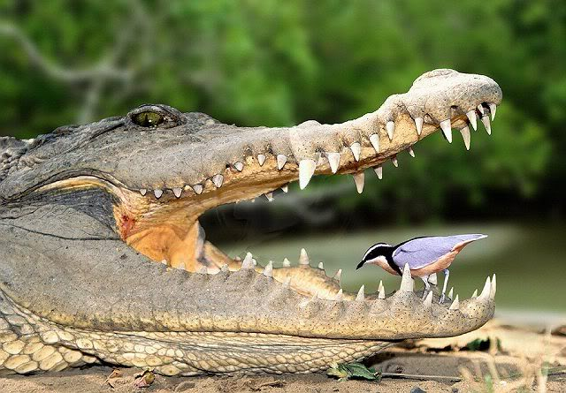
Write down some observations about this picture…

Slide 12
Now make a hypothesis about what’s happening…
How could you test your hypothesis?

Slide 13
The Methods of Biology: Scientific Method
Experimenting
experiment = a procedure that tests a hypothesis by the process of collecting information under controlled conditions
control group = the group in which all conditions are kept the same
the experimental group = the test group in which all conditions are kept the same except for the single condition being tested

Slide 14
The Methods of Biology: Scientific Method
designing an experiment
the condition in an experiment that is changed is the independent variable - the only variable that affects the outcome of the experiment
dependent variable = a condition that results from the change
Example experiment: A scientist is investigating how to increase corn production and sets up these three groups: no fertilizer, 1 treatment of fertilizer, and 5 treatments of fertilizer.
Which is the control group? why?
What are the independent and dependent variables?

Slide 15
The Methods of Biology: Scientific Method
Tools and Safety
a wide variety of tools are available for scientists to use in the process of experimentation
beakers, microscopes, thermometers, graduated cylinders, centrifuges…
always try to minimize hazards
safety symbols warn about a danger that may exist from chemicals, electricity, heat, or other procedures that you may use

Slide 16
The Methods of Biology: Scientific Method
Data Gathering and Results
Data = information obtained from experiments
numerical data may be measurements of time, temperature, length, mass, area, volume, or other factors.
analyzing experimental data provides scientists with results that help form conclusions
was the hypothesis supported by the data or not?
results and conclusion of experiments are reported in scientific journals where they are open to examination by other scientists
data and conclusions are shared so that the results can be verified
it is only after a hypothesis is supported by data from additional experiments that it is considered valid

Slide 17
The Methods of Biology: Scientific Method
Theories and Laws
theory = an explanation of a natural phenomenon that is supported by a large body of scientific evidence obtained from many different investigations and observations
a theory results from continual verification and refinement of a hypothesis
scientific laws are principles, or facts of nature, that are generally known to be true; (such as gravity)

Slide 18
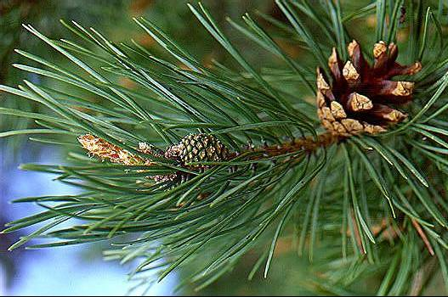

Slide 19
The Nature of Biology
Research
Quantitative research
experiments that result in counts or measurements (numerical data)
data are analyzed by comparing numerical values
data can be used to make graphs and/or tables
graphs and tables communicate large amounts of data in a form that is easy to understand

Slide 20
With a partner complete the problem solving lab on p.22 of your textbook

Slide 21
The Nature of Biology
International System
it is important that scientific research be understandable to scientists around the world therefore scientists report measurements in a form of metric system called the International System of Measurement commonly known as SI.
Basic SI units
length = meter (m)
mass = gram (g)
volume = liter (l)
time = second (sec)
temperature = Celsius (°C)

Slide 22
The Nature of Biology
Descriptive research
observational data: written descriptions of observations
when scientists use purely observational data, they are carrying out descriptive research

Slide 23
The Nature of Biology
Science and Society
Scientific research provides society with important information that can be put to practical use
ethics refers to the moral principles and values held by humans
society as a whole must take responsibility for the ethical use of scientific discoveries.

Slide 24
The Nature of Biology
Can science answer all questions?
some questions simply cannot be answered by science
how else could we answer these questions?

Slide 25
The Nature of Biology
Can technology solve all problems?
technology is the application of scientific research to society's needs and problems; it is concerned with making improvements in human life and the world around us
the advance of technology has benefited humans in many ways…
medicine
irrigation
communication

