Slide 1
Chapter 11: DNA and Genes

Slide 2
11.1 DNA: The Molecule of Heredity

Slide 3
What is DNA?
The structure of DNA
DNA is capable of holding all this information because it is a very long molecule
DNA is a polymer
Made of repeating subunits called nucleotides which have 3 parts:
A simple sugar =
deoxyribose
A phosphate group =
one atom of phosphorus
4 atoms of oxygen

Slide 4
A nitrogen base =
A carbon ring structure
Contains one or more atoms of nitrogen
4 possibilities
Adenine (A)
Guanine (G)
Cytosine (C)
Thymine (T)

Slide 5
The phosphate groups and deoxyribose molecules form the backbone of the polymer chain
James Watson and Francis Crick proposed that DNA is made of two chains of nucleotides joined together by the nitrogen bases
Two strands are complementary to each other
Adenine bonds with thymine
Guanine bonds with cytosine
Forms a double helix shape

Slide 6
The importance of nucleotide sequences
The sequence of nucleotides forms the unique genetic information of an organism
Used to determine evolutionary relationships: the more closely related the more similar the sequence

Slide 7
Replication of DNA
The DNA in the chromosome is copied in a process called DNA replication
All cells undergo DNA replication

Slide 8
How DNA replicates
During replication, each strand serves as a pattern to make a new DNA molecule
Begins as an enzyme breaks the hydrogen bonds between nitrogen bases – unzipping the molecule
Nucleotides that are floating free bond to the single strands by base pairing
Another enzyme bonds these new nucleotides into a chain
The result is the formation of two DNA molecules identical to the original

Slide 9
11.2 From DNA to Protein

Slide 10
Genes and Proteins
Genetic information in DNA is used in the production of proteins
Proteins form into complex 3D shapes to become key cell structures and regulators of cell functions
The sequence of nucleotides in each gene contains information for assembling the string of amino acids that make up a single protein

Slide 11
RNA
RNA is a nucleic acid
Single stranded
Sugar = ribose
Nitrogen bases
Adenine (A)
Guanine (G)
Cytosine (C)
Uracil (U)

Slide 12
Takes the DNA instructions on how the protein should be assembled and assemble the protein
Three types
Messenger RNA (mRNA)
Brings information from the DNA in the nucleus to the cytoplasm
Ribosomal RNA (rRNA)
Clamp onto the mRNA and use its information to assemble the amino acids in the correct order
Transfer RNA (tRNA)
Transports amino acids to the ribosome to be assembled

Slide 13
Transcription
In the nucleus, enzymes make an RNA copy of a portion of a DNA strand in a process called transcription
Results in the formation of one single-stranded RNA molecule

Slide 14
The Genetic Code
A code is needed to convert the language of mRNA into the language of proteins
A group of three nucleotides codes for one amino acid
Each set of three nitrogen bases in mRNA coding for an amino acid is known as a codon
Sixty four combinations are possible when a sequence of three bases is used

Slide 15
Some do not code for amino acids but provide instructions for assembling the protein
UAA = stop codon (protein production ends at this point)
AUG = start codon
More than one codon can code for the same amino acid

Slide 16
Translation: From mRNA to Protein
The process of converting the information in a sequence of nitrogen bases in mRNA into a sequence of amino acids that make up a protein is known as translation
Takes place at the ribosomes in the cytoplasm

Slide 17
The role of transfer RNA
For proteins to be built, the 20 different amino acids dissolved in the cytoplasm must be brought to the ribosomes
Correct translation depends on the joining of each mRNA codon with the correct tRNA molecule
On the opposite side of the tRNA molecules from the amino-acid attachment site, there is a sequence of three nucleotides that are the complement of the nucleotides in the codon: called an anticodon.

Slide 18
Translating the mRNA code
As translation begins, a tRNA molecule brings the first amino acid to the mRNA strand that is attached to the ribosome
The anticodon forms a temporary bond with the codon of the mRNA strand

Slide 19
The ribosome slides to the next codon and a new tRNA molecule brings another amino acid
The amino acids are joined by an enzyme and form a peptide bond, the first tRNA releases its amino acid and detaches from the mRNA
Free to pick up an deliver another molecule

Slide 20
Process continues until a stop codon is reached and the amino acid strand is released from the ribosome
Twist and curl into complex 3d shapes

Slide 22
Pop Quiz
Copy the table onto a separate piece of paper.
DNA base sequence | mRNA codon | tRNA anticodon

Slide 23
Pop Quiz
DNA base sequence | mRNA codon | tRNA anticodon
CTA | #1 | #2
TGC | #3 | #4
GGA | #5 | #6
ATC | #7 | #8

Slide 24
Pop Quiz
DNA base sequence | mRNA codon | tRNA anticodon
CTA | GAU | CUA
TGC | ACG | UGC
GGA | CCU | GGA
ATC | UAG | AUC

Slide 25
11.3 Genetic Changes

Slide 26
Mutation: A Change in DNA
Radiation can break apart a molecule of DNA, causing the nucleotide sequence to be changed
Any change in the DNA sequence that also changes the protein it codes for is called a mutation.

Slide 27
Mutations in reproductive cells
Passed onto offspring
May produce a new trait
May result in a protein that does not work correctly
Resulting in structural or functional problems in cells and in the organism
In rare cases, it may have positive effects

Slide 28
Mutations in body cells
Impair the function of the cell
New cells resulting from cell division will have the same mutation
Some mutations affect genes that control cell division
Result in cells growing and dividing rapidly: cancer

Slide 29
The effects of point mutations
A point mutation is a change in a single base pair in DNA
Incorrect amino acid inserted into a growing protein
Can change the entire structure of a protein

Slide 30
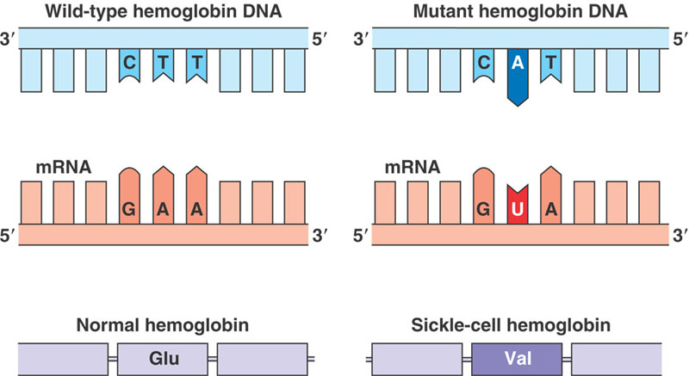

Slide 31
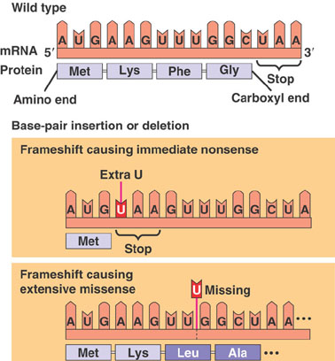
Frameshift mutations
A single base lost from a DNA strand
Every codon after the deleted base would be different

Slide 32
Chromosomal Mutations
Changes may occur at the level of chromosomes as well as in genes.
Chromosomes break and then rejoin incorrectly
Chromosomal mutations are mutations that occurs at the chromosome level resulting in changes in the gene distribution during meiosis

Slide 33
Effects of chromosomal mutations
Especially common in plants
Affect the distribution of genes to gametes during meiosis because they cause nondisjunction
Rarely passed onto the next generation
Zygote dies
Mature organism is sterile

Slide 34
Causes of Mutations
Mutations that just seem to happen are said to be spontaneous
Many mutations are caused by environmental factors
A mutagen is any agent that can cause a change in DNA
High energy radiation
Chemicals
High temperatures

Slide 35
Repairing DNA
Repair mechanisms that fix mutations in cells have evolved
Enzymes proofread the DNA and replace incorrect nucleotides
The greater the exposure to a mutagen the more likely a mistake will not be corrected

Slide 36
Pop Quiz
Copy the table onto a separate piece of paper.
DNA base sequence | mRNA codon | tRNA anticodon

Slide 37
Pop Quiz
DNA base sequence | mRNA codon | tRNA anticodon
TCA | #1 | #2
#3 | UGC | #4
#5 | #6 | CCA
ATG | #7 | #8

Slide 38
Pop Quiz
DNA base sequence | mRNA codon | tRNA anticodon
TCA | AGU | UCA
ACG | UGC | ACG
CCA | GGU | CCA
ATG | UAC | AUG

