Slide 1
Chapter 14: The History of Life

Slide 2
14.1 The Record of life

Slide 3
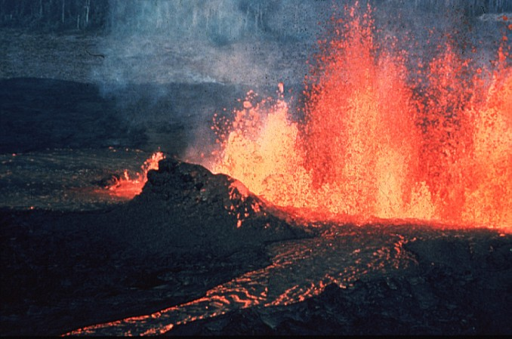
Early History of Earth
Early Earth was inhospitable
Probably very hot
Volcanoes might have frequently spewed lava and gases, relieving some of the pressure in Earth’s hot interior
The atmosphere probably contained little free oxygen

Slide 4
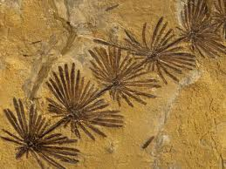
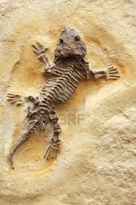
History in Rocks
Scientists cannot be sure how the Earth formed, there is no direct evidence of the earliest years of Earth’s history
A fossil is evidence of an organism that lived long ago
Because fossils can form in many different ways, there are many types of fossils
Scientists study fossils to learn about ancient species

Slide 5
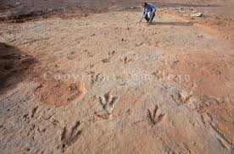
Paleontologists are scientists who study ancient life using fossils
They use fossils to learn about:
The kinds of organisms that lived in the past, and sometimes their behavior
Ancient climate and geography

Slide 6
For fossils to form
Organisms usually have to be buried in small particles of mud, sand, or clay soon after they die
These particles are compressed over time and harden into sedimentary rock
Today, fossils still form at the bottom of lakes, streams, and oceans

Slide 7
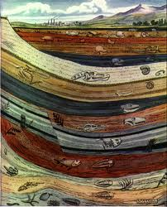
The Age of a Fossil
The fossils in different layers of sedimentary rock vary in age

Slide 8
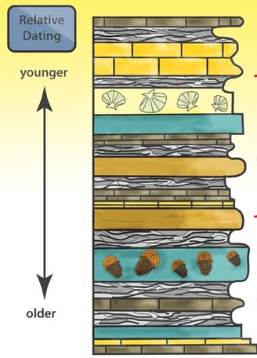
Relative dating: the fossil in the top layers are younger than lower layers
True if the rock layers have not been disturbed
A geologic law
Scientists can determine the order of appearance and extinction of the species that formed fossils in the layers

Slide 9
Radiometric dating: uses radioactive isotopes present in rocks and fossils
Scientists use radiometric dating techniques to find specific ages of fossils
Every radioactive isotope has a characteristic decay rate, scientists use this rate of decay as a type of clock
The decay rate of a radioactive isotope is called its half life
Compare the amount of a radioactive isotope and the new element into which it decays

Slide 10
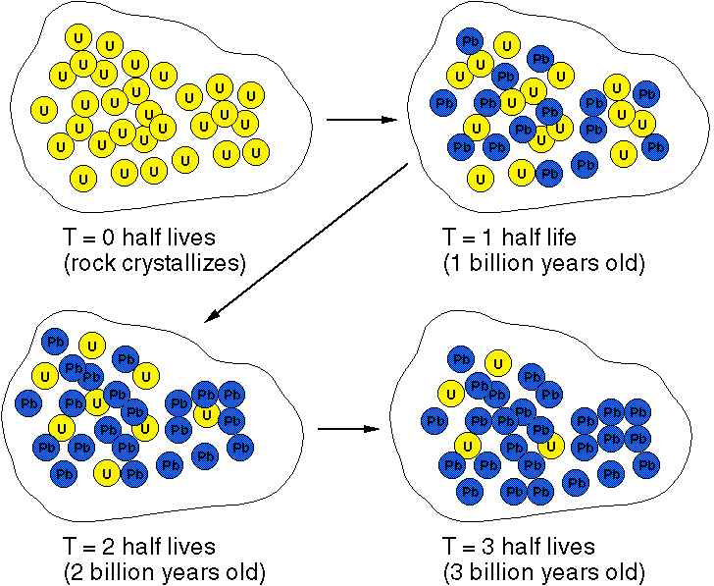

Slide 11
Potassium-40 is used to date rocks containing very old fossils
Decays to argon-40
Half life of 1.3 billion years
Carbon-14 is used to date fossils less than 50,000 years old
Half life of 5730 years

Slide 12
Dating technique frequently produces inconsistent dates because the initial amount of radioisotope in the rock can never be known
Analyze a rock using as many methods as possible to obtain reasonably consistent results about the rock’s age

Slide 13
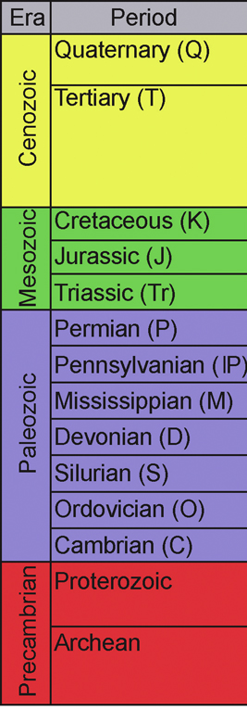
A Trip Through Geologic Time
The Geologic Time Scale
Divided into four eras:
Precambrian
Paleozoic
Mesozoic
Cenozoic

Slide 14
Each era is subdivided into periods
The divisions in the Geologic Time Scale are distinguished by the organisms that lived during the time period
Several mass extinctions fall between time divisions

Slide 15
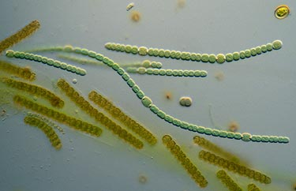
Precambrian era
The oldest fossils are found in Precambrian rocks
At the beginning of the Precambrian era, unicellular prokaryotes appear to have been the only life forms on Earth
Fossils resemble modern species of photosynthetic cyanobacteria

Slide 16
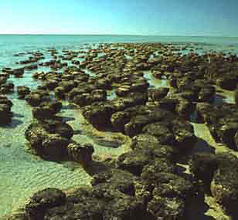
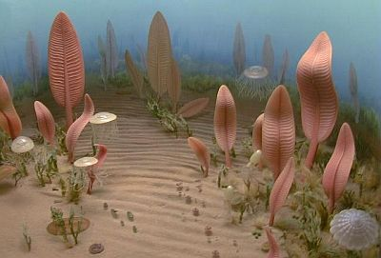
Stromatolites are fossils of dome-shaped structures
By the end of the Precambrian, multicellular eukaryotes, such as sponges and jellyfishes, filled the oceans

Slide 17
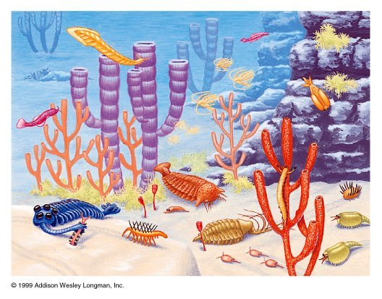
Paleozoic era
The earliest part of the Paleozoic era is called the Cambrian period
“Cambrian explosion”: enormous increase in the diversity of life

Slide 18
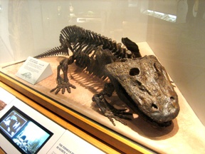
During the first half of the Paleozoic, fishes, the oldest animals with backbones, appeared in Earth’s waters
Ferns and early seed plants also appeared
Around the middle of the Paleozoic, four-legged amphibians appeared
During the last half of the era, reptiles appeared on land

Slide 19
The largest mass extinction recorded by the fossil record marked the end of the Paleozoic.
90% of the marine species disappeared
70% of the land species disappeared

Slide 20
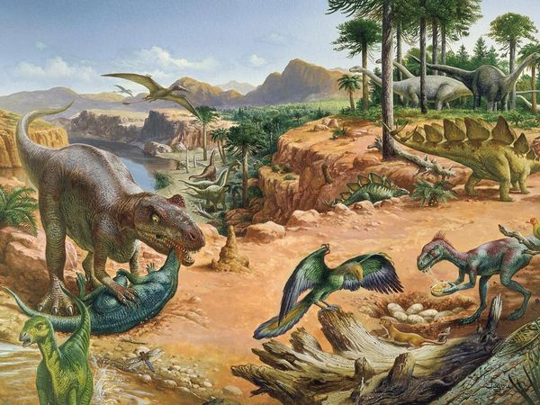
Mesozoic era
Triassic period: mammals appeared
Jurassic period: “Age of Dinosaurs”

Slide 21
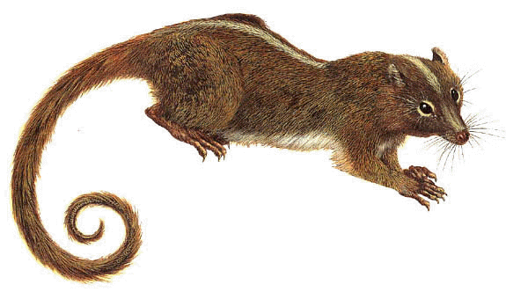
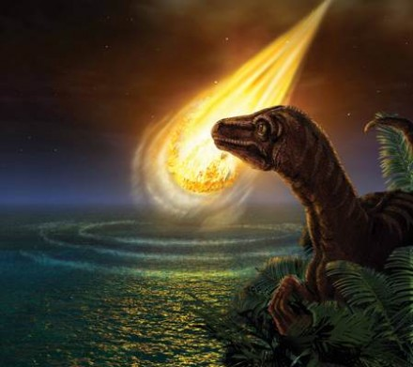
Cretaceous period: mass extinction
Many new types of mammals and the first flowering plants appeared
Mass extinction of dinosaurs and 2/3 of all living species
A large meteorite collision might have been the cause

Slide 22
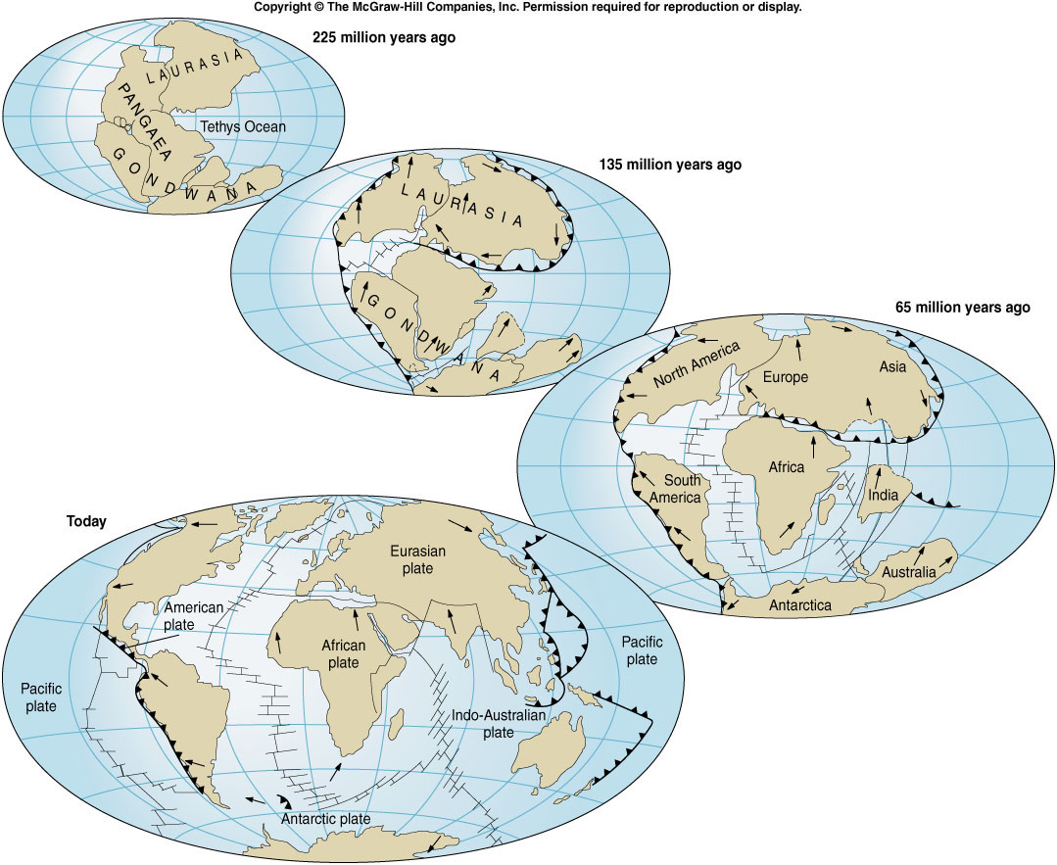
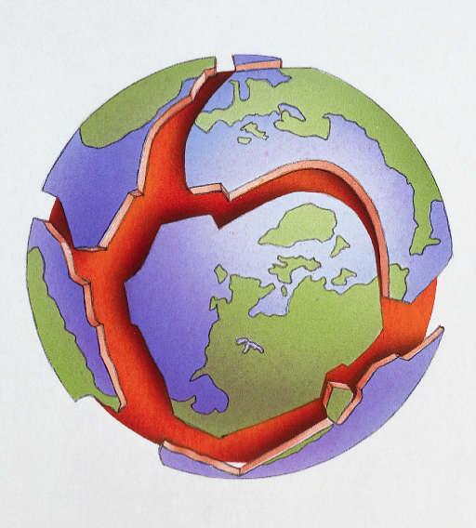
Geological events
The theory of continental drift suggests that Earth’s continents have moved, and are still moving today at a rate of about six centimeters per year
The geological explanation for how the continents move is called plate tectonics
Earth’s crust consists of several rigid plates that drift on top of molten rock
These plate are continually moving

Slide 23
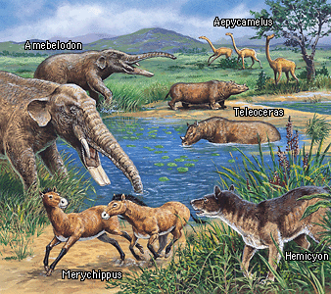
Cenozoic era
Current era where mammals flourish
Primates appeared

Slide 24
14.2 The Origin of Life

Slide 25
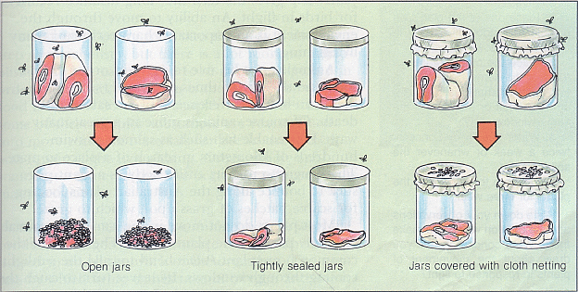
Origins: The Early Ideas
Spontaneous generation – the idea that nonliving material can produce life
Came from the observation that maggots would appear on meat
In 1668, Francesco Redi disproved that meat produced maggots, only flies produce flies
Controlled experiment used uncovered and covered jars

Slide 26
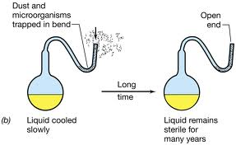
Mid-1800s: Louis Pasteur proved biogenesis – living organisms come only from other living organisms
Setup an experiment in which air, but no microorganisms, was allowed to contact a broth that contained nutrients
The results showed that microorganisms do not simply arise in broth

Slide 27
Origins: The Modern Ideas
No one will ever know for certain how life began on Earth
Scientists hypothesize that two developments must have preceded the appearance of life on Earth
Simple organic molecules (molecules that contain carbon) must have formed
Molecules become organized into complex organic molecules such as proteins, carbohydrates, and nucleic acids

Slide 28
In the 1930s, Alexander Oparin hypothesized that life began in the oceans that formed on early Earth
Suggested that the sun, lightning, and Earth’s heat triggered chemical reactions that produced organic molecules which were washed into the oceans to form “primordial soup”

Slide 29
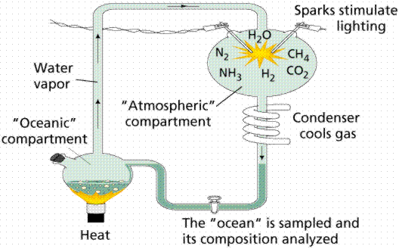
In 1953, Stanley Miller and Harold Urey tested this theory
Mixed water vapor with ammonia, methane, and hydrogen gases
Sent electric current through the mixture
Cooled the mixture into a liquid
After a week, they analyzed the chemicals in the flask and found several kinds of amino acids, sugars, and other small organic molecules

Slide 30
Problems with this experiment:
The chemical combination used was not present in the atmosphere during early Earth
Did not produce living material
Continued exposure to the electrical current resulted in a tar like substance - he had to isolate the amino acids from the environment he had created them in because it would have destroyed them.
Would not have naturally been removed
Had to remove many contaminants and impurities to obtain pure compounds. Otherwise, his apparatus would have produced many destructive cross-reactions.

Slide 31
In the 1950s various experiments were performed that showed:
If the amino acids are heated without oxygen they will link up and form complex molecules called proteins
A similar process also produces ATP and nucleic acids
These experiments convinced scientists that complex organic molecules might have originated in pools of water where small molecules had concentrated and been warmed.

Slide 32
How did complex chemicals combine to form cells?
American biochemist Sidney Fox produced protocells by heating solutions of amino acids
A protocell is a large, ordered structure, enclosed by a membrane, which carries out some life activities, such as growth and division.

Slide 33
The Evolution of Cells
The first true cells
The first forms of life may have been prokaryotes that evolved from a protocell.
Anaerobic organisms that could survive without oxygen
Heterotrophs
Ate organic molecules in the ocean for food
Archaebacteria are prokaryotes that live in harsh environments, such as deep-sea vents and hot springs.
The first autotrophs were probably similar to present-day archaebacteria.
Probably made glucose by chemosynthesis

Slide 34
Photosynthesizing prokaryotes
As the first photosynthetic organisms increased in number, the concentration of oxygen in Earth’s atmosphere began to increase.
Allowed for aerobic organisms to thrive
Lightning would have converted much of the oxygen into ozone molecules that would have formed the thick layer of gas that now exists
Ozone layer shields organisms from harmful effects of ultraviolet radiation

Slide 35
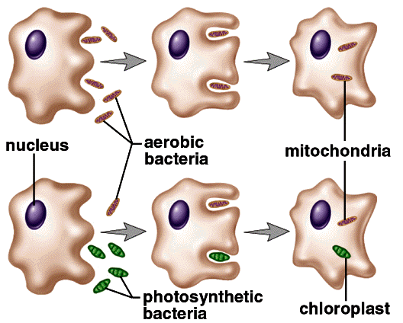
The endosymbiont theory
The complex cells of eukaryotes probably evolved from prokaryote cells
The endosymbiont theory was proposed by American biologist Lynn Margulis in the early 1960s
A prokaryotes ingested some aerobic bacteria which produced energy for the prokaryote
Over a long time, the aerobes become mitochondria
Some prokaryotes also ingested cyanobacteria, which contain photosynthetic pigments
Over a long time, the cyanobacteria became chloroplasts

Slide 36
Today scientists observe that cyanobacteria and chloroplasts resemble each other in size and the ability to photosynthesize; mitochondria and some other bacteria also look similar, and contain similar DNA.
Chloroplasts and mitochondria have their own ribosomes and reproduce independently of their cells.

