Slide 1
Chapter 17: Organizing Life’s Diversity

Slide 2
17.1 Classification

Slide 3
How Classification Began
Biologists want to better understand organisms so they organize them into groups
Classification = the grouping of objects or information based in similarities
Taxonomy = the branch of biology that groups and names organisms based on studies of their different characteristics

Slide 4
Aristotle’s system
The Greek philosopher Aristotle (384-322 BC) developed the first widely accepted system of biological classification
Two groups
Plants : 3 subdivisions based on size and structure
Herbs
Shrubs
Trees
Animals: grouped according to where they lived
Air
Land
Water

Slide 5
Linnaeus’ system
Carolus Linnaeus (1707-1778)
System based on physical and structural similarities of organisms
Structural similarities reflect the evolutionary relationships of species

Slide 6
Two names for a species
Binomial nomenclature: two word naming system
First word identifies the genus of the organism
Genus: a group of similar species
Second word describes a characteristic of the organism

Slide 7
Scientific names
Written in Latin
Should be italicized in print and underlined when hand written
First letter of the genus name is uppercase, but the first letter of the descriptive name is lowercase
A species can have more than one common name, but only one scientific name so that there is no confusion

Slide 8
Biological Classification
Modern taxonomists try to identify the underlying natural relationships of organisms and use the information as a basis for classification
External and internal structure
Geographical distribution
Chemical makeup

Slide 9
Taxonomy: A framework
Classification provides a framework in which to study the relationships among living and extinct species
Taxonomy: A useful tool
Classifying organisms is a useful tool for scientists who work in agriculture, forestry, and medicine
Taxonomy and the economy
New sources of lumber, medicines, and energy results from the work of taxonomists

Slide 10
How Living Things are Classified
Taxonomic rankings
Organisms are ranked into taxa
The broader a taxon, the more general its characteristics and the more species it contains
The smallest taxon is species: organisms that look alike and successfully interbreed
Next largest taxon is genus: a groups of similar species that have similar features and are closely related
Family (next largest) consists of a group of similar genera

Slide 11
The larger taxa
An order is a taxon of similar families
A class is a taxon of similar orders
A phylum is a taxon of similar classes
Plant taxonomists use the taxon division instead
A kingdom is a taxon of similar phyla

Slide 12
3 domain system first proposed in 1990
groups organisms primarily based on differences in ribosomal RNA structure
Archaea
Archaebacteria kingdom
Bacteria
Eubacteria kingdom
Eukarya
Protista kingdom
Fungi kingdom
Plantae kingdom
Animalia kingdom

Slide 13
17.2 The Six Kingdoms

Slide 14
How are Evolutionary Relationships Determined?
Structural similarities
The presence of many shared physical structures implies that species are closely related and may have evolved from a common ancestor.
Breeding behavior
Breeding behavior provides important clues to relationships among species
Geographical distribution
The location of species on Earth helps biologists determine their relationships with other species

Slide 15
Chromosome comparisons
The number and structure of chromosomes provide evidence about relationships among species
Biochemistry
Closely related species have similar DNA sequences and therefore similar proteins
Comes from biochemical analysis

Slide 16
Phylogenetic Classification: Models
Phylogeny= the evolutionary history of a species
A classification system that shows the evolutionary history of species is a phylogenetic classification and reveals the evolutionary relationships of species.

Slide 17
Cladistics
Scientists who use cladistics assume that as groups that as groups of organisms diverge and evolve from a common ancestral group they retain some unique inherited characteristics: derived traits
A cladogram is a model of the phylogeny of a species
Show a probable phylogeny of a group of organisms from ancestral groups

Slide 18
Another type of model
A fanlike model
May communicate the time organisms became extinct or the relative number of species in a group
Incorporates fossil information and the knowledge gained from anatomical embryological, genetic, and cladistic studies

Slide 19
The Six Kingdoms of Organisms
Prokaryotes
Organisms with cells that lack distinct nuclei bounded by a membrane
Microscopic and unicellular organisms
Autotrophs and heterotrophs

Slide 20
Classified into two kingdoms
Archaebacteria
There are a few hundred species
Most of them live in extreme environments
Eubacteria
More than 10,000 species
Have strong cell walls and less complex genetic makeup than archaebacteria

Slide 21
Protists: A diverse group
A protist is a eukaryote that lacks complex organ systems and lives in moist environments
Unicellular and multicellular organisms
Autotrophs and heterotrophs

Slide 22
Fungi: Earth’s decomposers
A fungus is either a unicellular or multicellular eukaryote that absorbs nutrients from organic materials in the environment
Heterotrophs that do not move from place to place
More than 100,000 known species

Slide 23
Plants: multicellular oxygen producers
Multiccellular, photosynthetic eukaryotes
More than 500,000 known species
Includes flowering plants, mosses, ferns, and evergreen

Slide 24
Animals: multicellular consumers
Heterotrophs
Cells organized into tissues that are organized into systems

Slide 25
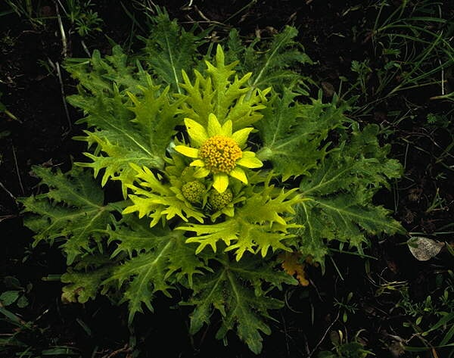
Which kingdom?

Slide 26
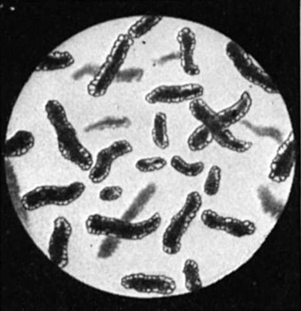
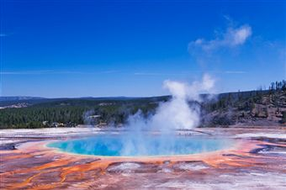
Which kingdom?

Slide 27
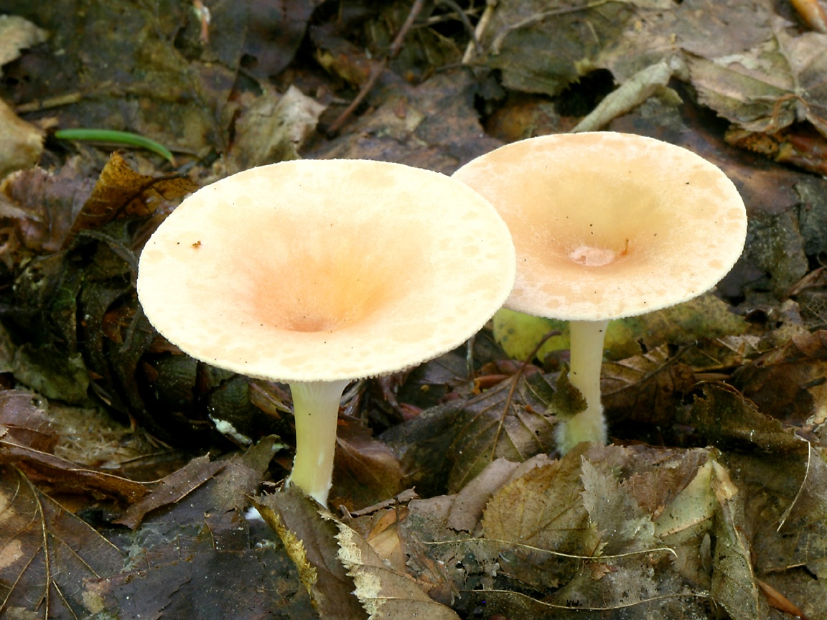
Which kingdom?

Slide 28
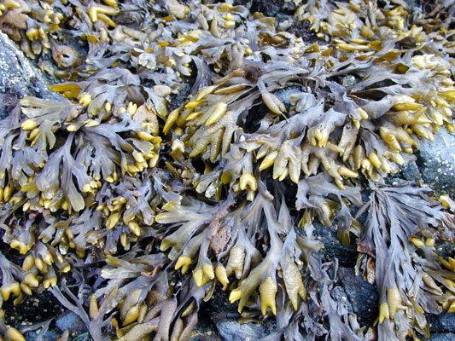
Which kingdom?

Slide 29
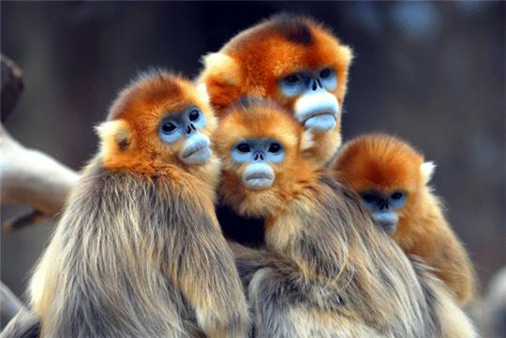
Which kingdom?

Slide 30
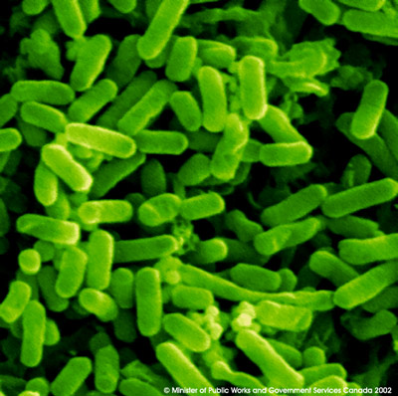
Which kingdom?

