Slide 1
Chapter 2: Principles of Ecology

Slide 2
2.1 Organisms and their Environment

Slide 3
What is Ecology?
People have enjoyed studying nature for thousands of years
Ecology = the scientific study of interactions among organisms and their environments
Ecological study reveals relationships among living and nonliving parts of the world.
Ecology combines information and techniques from many scientific fields, including mathematics, chemistry, physics, geology, and other branches of biology.

Slide 4
Aspects of Ecological Study
Living things can be found in the air, on land, and in both fresh and salt water
Biosphere: the portion of Earth that supports life
Although it is thin, the biosphere is very diverse and supports a wide range of organisms.
Abiotic factors = nonliving parts of an organism’s environment
What might some examples be?
Biotic factors = all the living organism that inhabit an environment
Ecologists investigate how biotic factors affect different species

Slide 5
Reading Check
How are populations and communities related?
Communities are made up of several populations
What are the three symbiotic relationships?
Commensalism, mutualism, parasitism
Trade your paper with a neighbor

Slide 6
Levels of organization in Ecology
All organisms depend on others for food, shelter, reproduction, or protection

Slide 7
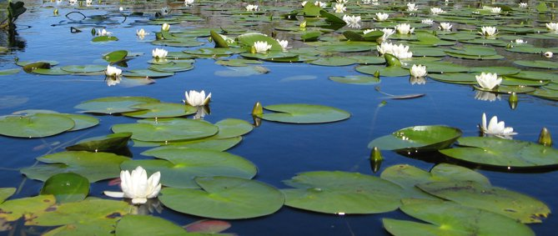
Biosphere
Ecosystems = made up of the interactions among the populations in a community and the community’s physical surroundings, or abiotic factors
Terrestrial and aquatic ecosystems
Aquatic: fresh and salt water

Slide 8
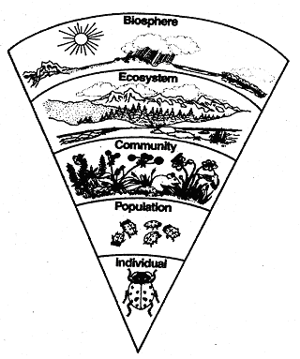
Communities = made up of several populations
A change in one population in a community will cause changes in the other populations
Populations = a group or organisms of one species that interbreed and live in the same place at the same time
Species have adaptations that reduce competition with a population
Organism/ Individual

Slide 9
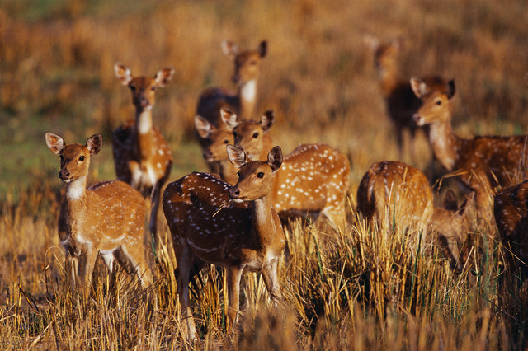
What level of organization might this be a picture of?
population

Slide 10
Organisms in Ecosystems
Habitat = the place where an organism lives out its life
Can change and even disappear due to both natural and human causes
Niche = the role and position a species has in its environment – how it meets its needs for food and shelter, how it survives, and how it reproduces.
Each species is unique in satisfying all its needs
Unique strategies and structures are important to a species’ niche and important for reducing competition with other species

Slide 11
Habitat vs. Niche
Choose an animal
Ex: starfish
Habitat = rocky marine tidal zone
Niche = predator that eats shellfish
Ex: bat
Habitat = cave
Niche = fertilizes flowers, eats insects

Slide 12
Living Relationships
Predator-prey: one eats the other
Symbiosis = the relationship in which there is a close and permanent association among organisms of different species
Means “living together”

Slide 13
Commensalism = symbiotic relationship in which one species benefits and the other species is neither harmed nor benefited
Mutualism = symbiotic relationship in which both species benefit
Parasitism = symbiotic relationship in which one organism derives benefit at the expense of the other

Slide 14
Symbiotic Relationships
Determine which type of relationship is shown in the pictures and then move to the part of the room that signifies your choice

Slide 15
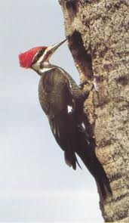
Commensalism - Mutualism - Parasitism
the tree is unaffected and the woodpecker benefits

Slide 16
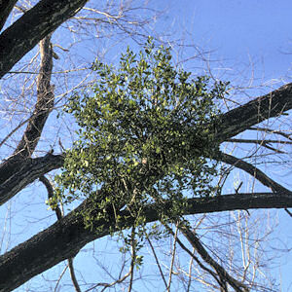
Commensalism - Mutualism - Parasitism
Mistletoe is an example of a plant parasite

Slide 17
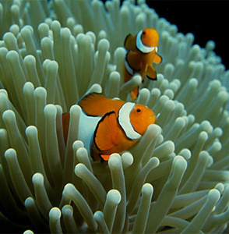
Commensalism - Mutualism - Parasitism
clownfish has shelter and provides food for the anemone

Slide 18
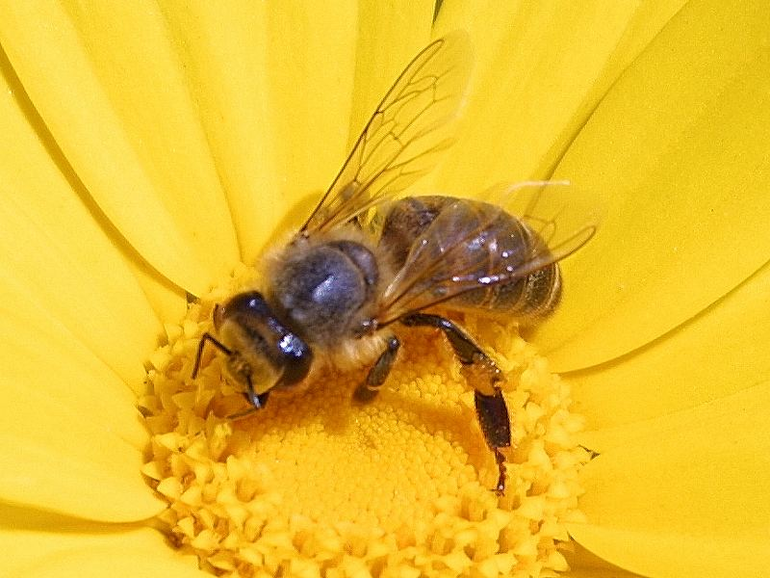
Commensalism - Mutualism - Parasitism
bees visit flowers in search of pollen and nectar and in the process flowers are pollinated

Slide 19
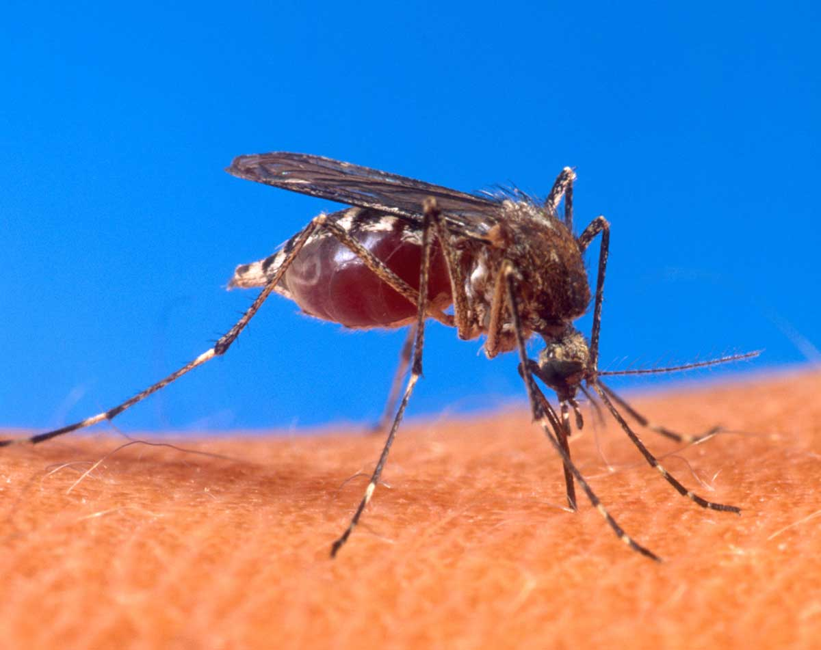
Commensalism - Mutualism - Parasitism
Humans and mosquitoes

Slide 20
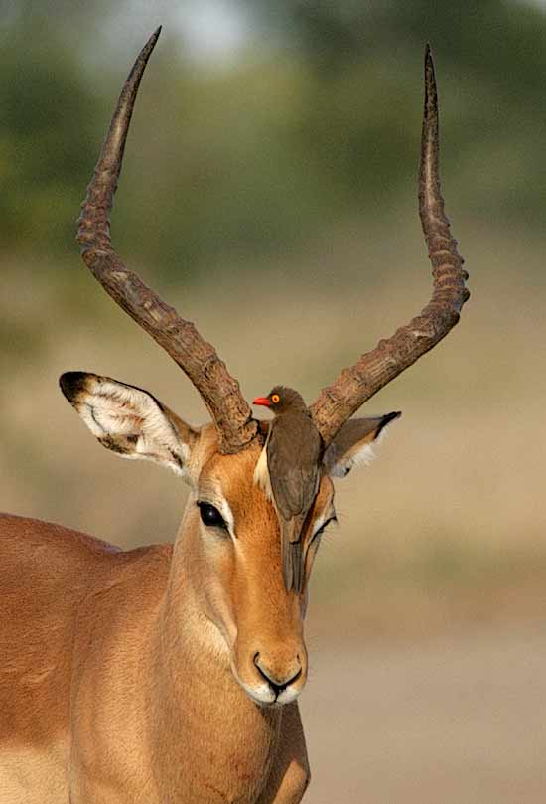
Commensalism - Mutualism - Parasitism
Oxpeckers remove and eat harmful ticks from the impala

Slide 21
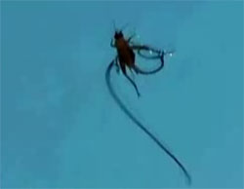
Commensalism - Mutualism - Parasitism
cricket and Gordian worm

Slide 22
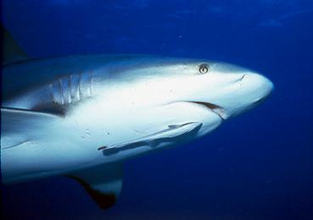
Commensalism - Mutualism - Parasitism
The remora fish gets a meal, while the shark gets nothing
remora fish and shark

Slide 23
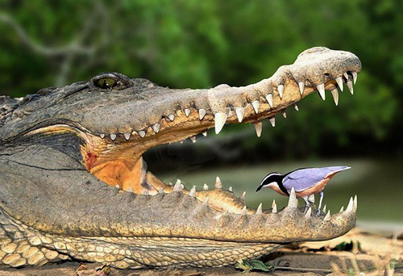
Commensalism - Mutualism - Parasitism
The Egyptian plover gets a meal and the crocodile gets its teeth cleaned.

Slide 24
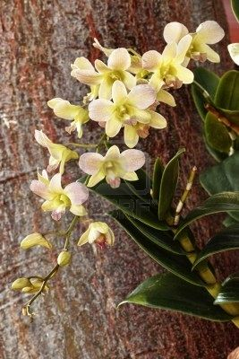
Commensalism - Mutualism - Parasitism
tropical orchids use trees or branches of trees for support without harm or benefit to the tree

Slide 25
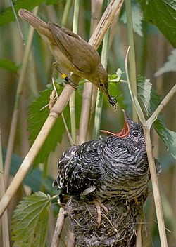
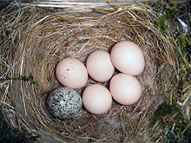
Commensalism - Mutualism - Parasitism
A Common Cuckoo being raised by a Reed Warbler.

Slide 26
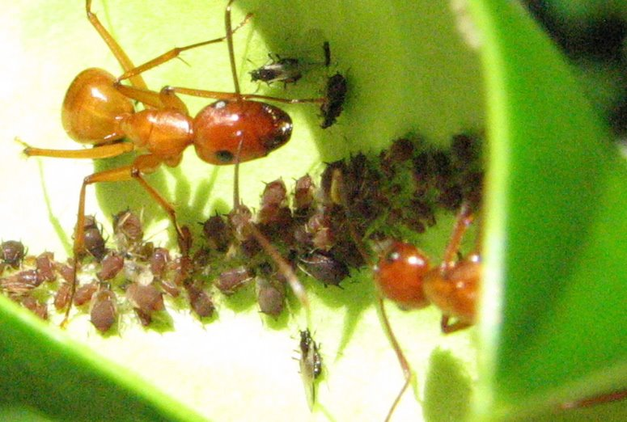
Commensalism - Mutualism - Parasitism
The ants feed on the sugary fluid released by the aphids, and the aphids are protected by the ants

Slide 27
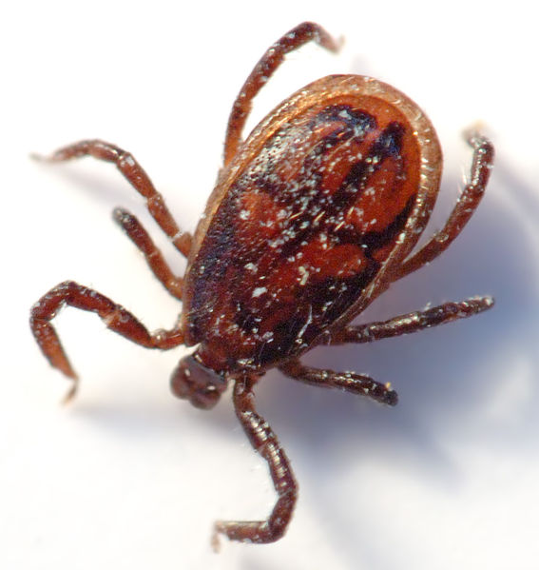
Commensalism - Mutualism - Parasitism
Tick on a dog

Slide 28
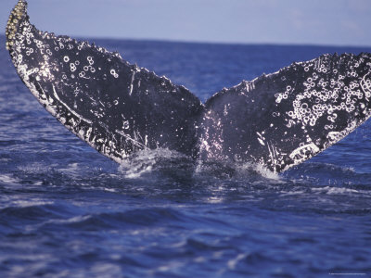
Commensalism - Mutualism - Parasitism
the barnacles benefit while the whale is unaffected

Slide 29
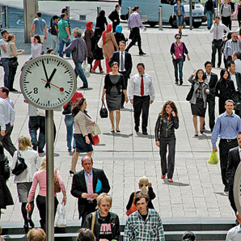
Commensalism - Mutualism - Parasitism

Slide 30
What type of relationship do humans have with each other?

Slide 31
2.2 Nutrition and Energy Flow

Slide 32
How Organisms Obtain Energy
Autotrophs = organisms that use energy from the sun or energy stored in chemical compounds to manufacture their own nutrients
Heterotrophs = organisms that cannot make their own food and must feed on other organisms
Scavengers = organisms that eat animals that have already died
Decomposers = break down the complex compounds of dead and decaying plants and animals into simpler molecules that can be more easily absorbed.

Slide 33
Matter and Energy Flow
Food chain = a simple model that scientists use to show how matter and energy move through an ecosystem
Have three to five links
A portion of the available energy is lost as heat at each link
Arrows indicate the direction of energy flow
Represents one possible route for the transfer of matter and energy in an ecosystem

Slide 34
Trophic level = feeding step
Many different species occupy each trophic level
Food Web = model that expresses all the possible feeding relationships at each trophic level in a community
More realistic model than a food chain

Slide 35
Ecological pyramids
Pyramid of energy: Each bar in the pyramid represents energy available within a trophic level
Pyramid of numbers: Each bar in the pyramid represents population size within a trophic level
Pyramid of biomass: Each bar in the pyramid represents the amount of biomass within a trophic level

Slide 36
Cycles in Nature
Matter, as well as energy, also moves through the organisms at each trophic level in the form of nutrients

Slide 37
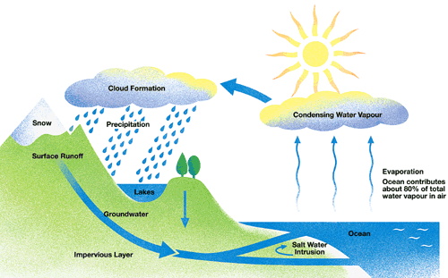
The water cycle
Life on earth depends on water

Slide 38
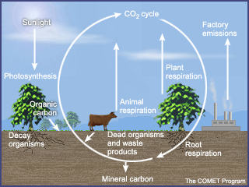
The carbon cycle
All life on earth is based on carbon molecules
Starts with autotrophs
Carbon dioxide is used in photosynthesis
Heterotrophs use carbon molecules for growth and energy and release carbon dioxide into the air

Slide 39
The nitrogen cycle
78% of the air is nitrogen
Plants use nitrogen to make important molecules such as protein
When organisms die, their nitrogen molecules return to the soil

Slide 40
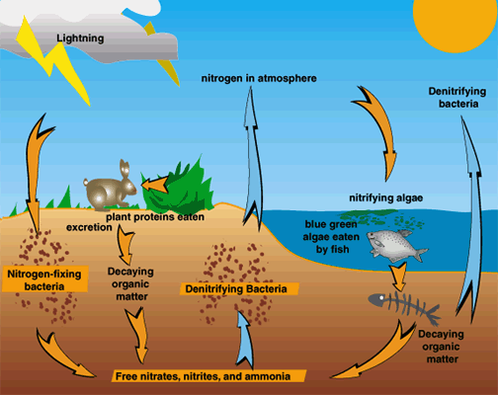

Slide 41
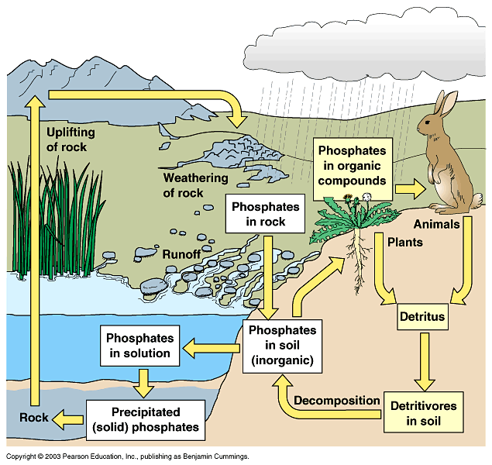
The phosphorus cycle
All organisms require phosphorous for growth and development

Slide 42
Cycles in two ways
Short-term: plants obtain phosphorous from the soil, animals eat the plants and then the phosphorus is returned to the soil when they die
Long-term: phosphates washed into the sea are incorporated in to rock , when the rock erodes the phosphorous becomes part of the local ecological system.

