Slide 1
Chapter 3: Communities and Biomes

Slide 2
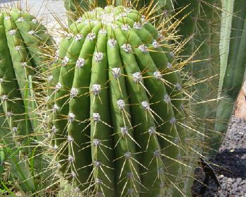
What are similarities and differences between the two plants?
What are the natural habitats for each plant?
What would happen if we planted each plant in the other’s habitat?

Slide 3
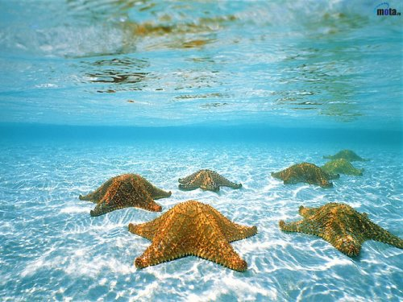
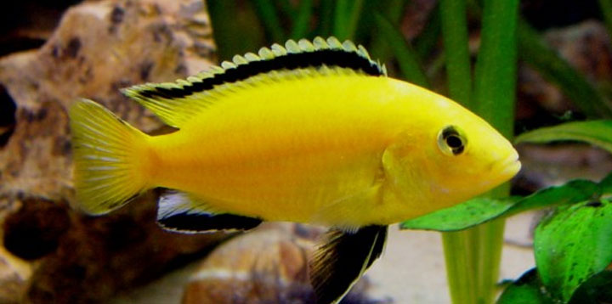
3.1 Communities
Living in the Community
Communities are interacting populations of different species
Abiotic and biotic factors interact and result in conditions that are suitable for life for some organisms and unsuitable for other organisms
Salinity

Slide 4
Limiting factors
Definition = any biotic or abiotic factor that restricts the existence, numbers, reproduction, or distribution of organisms
environmental factors that affect an organism’s ability to survive in its environment
Ex: food availability, predators, temperature, salinity, oxygen
Factors that limit one population in a community may also have an indirect effect on another population

Slide 5
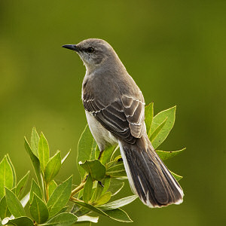
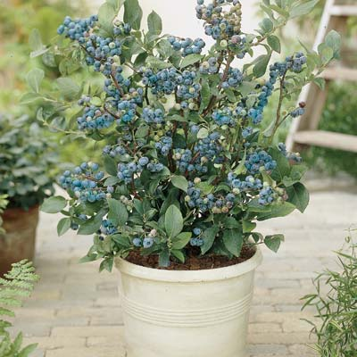
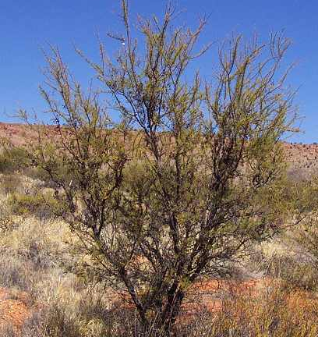
What is the limiting factor for the bird if it were to live in either place?

Slide 6
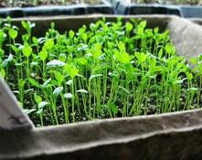
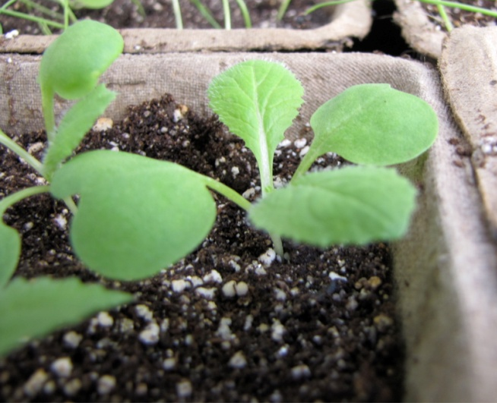
What is the limiting factor for the plant growing in the containers?

Slide 7
What are your personal limits for…
Temperature?
Humidity?
Light/darkness?

Slide 8
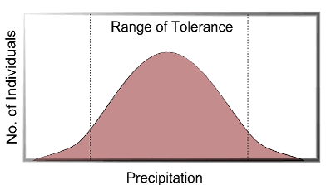
Ranges of Tolerance
The ability of an organism to withstand fluctuations in biotic and abiotic environmental factors is known as tolerance
The size of a population varies according to its tolerance for environmental change

Slide 9
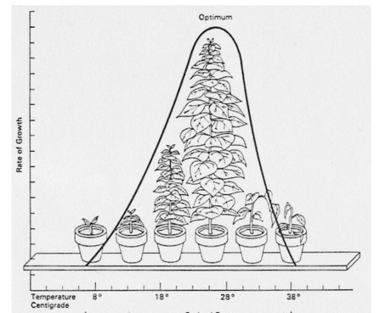
Write a caption for this diagram.

Slide 10
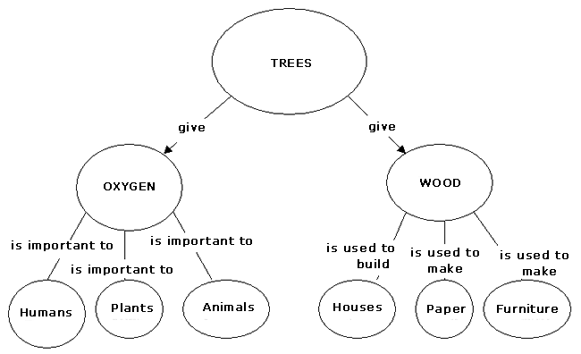

Slide 11
Succession: Changes over Time
Ecologists can accurately predict the changes that take place
Ecologists refer to the orderly, natural changes and species replacements that take place in the communities of an ecosystem as succession.
Succession occurs in stages
Different species at different stages create conditions that are suitable for some organisms and unsuitable for others.
Can take decades, or even centuries, to occur

Slide 12
Primary Succession
The colonization of new sites by communities of organisms
The first species in an area are called pioneer species
Initiate first patches of soil
Ex: lichen
Climax community = a stable, mature community that undergoes little or no change in species

Slide 13
Secondary succession
The sequence of community changes that takes place after a community is disrupted by natural disasters or human actions
Occurs in areas that previously contained life, on land that contains soil
Usually takes less time than primary succession

Slide 14
3.2 Biomes
Aquatic Biomes: Life in the Water
Biome = a large group of ecosystems that share the same type of climax community
Terrestrial biome: located on land
Aquatic biome: located in a body of water

Slide 15
Marine Biomes
Saltwater biome
Different part of the ocean differ in physical factors and in the organisms found there
The ocean contains the largest amount of biomass (living material) of any biome on Earth
Most of the biomass is made up of extremely small organisms

Slide 16
The portion of the marine biome that is shallow enough for sunlight to penetrate is called the photic zone
Exist along the coastlines of all landmasses
Include rocky shores, sandy beaches, and mudflats
Deeper water that never receives sunlight makes up the aphotic zone
Includes the deepest, least explored areas of the ocean

Slide 17
A mixing of waters
Where ever rivers join oceans, freshwater mixes with salt water
Estuary = a coastal body of water, partially surrounded by land, in which freshwater and saltwater mix.
The salinity ranges between saltwater and freshwater and changes with the tide
A wide range of organisms can live in estuaries

Slide 18
The effects of the tides
Intertidal zone = the portion of shoreline that lies between the high and low tide lines
The size of the zone depends on the slope of the land and the height of the tide
Intertidal ecosystems have high levels of sunlight, nutrients, and oxygen, but productivity may be limited by waves

Slide 19
In the light
As you move away from the intertidal zone and into deeper water, the ocean bottom is less and less affected by waves or tides
Nutrients washed from the land by rainfall contribute to the abundant life and high productivity of this region of the photic zone
Plankton = small organisms that live in waters of the photic zone
Include autotrophs and heterotrophs

Slide 20
In the dark
Almost 90 % of the ocean is more than a kilometer deep, where sunlight doesn’t reach
Many animals depend on plankton for food either directly or indirectly
What adaptations might help these organisms survive in this environment?

Slide 21
Freshwater biomes
Temperature variations within a lake are an abiotic factor that limits the kinds of organisms that can survive in deep lakes
Not enough light penetrates to the bottom to support photosynthesis
Population density is lower in deeper waters
Decay takes place at the bottom of a lake, bacteria break them down and recycle the nutrients they contain

Slide 22
Terrestrial Biomes
Temperature and precipitation influence the kind of climax community that develops in a particular part of the world

Slide 23
Life on the tundra
Tundra = a treeless land with long summer days and short periods of winter sunlight
Temperatures never rise above freezing for long
Only the topmost layer of soil thaws during the summer
Permafrost = a layer of permanently frozen ground underneath the topsoil layer
Soil lacking in nutrients
The process of decay is so slow due to the cold temperatures that nutrients are not recycled quickly.
Short growing season

Slide 24
Life on the taiga
Taiga = northern coniferous forest
a land of larch, fir, hemlock, and spruce trees
the lines between the tundra and taiga is indistinct
usually warmer and wetter than tundra
permafrost is usually absent
topsoil is acidic and poor in minerals
the abundance of trees in the taiga provides more food and shelter for animals than the tundra
More large species of animals are found in the taiga

Slide 25
Life in the desert
Desert = arid region with sparse to almost nonexistent plant life
Usually get less than 25cm of precipitation annually
Vegetation varies greatly, depending on the amount of precipitation
Many desert plants are annuals that germinate from seed and grow to maturity quickly after sporadic rainfall
Desert plants sometimes have spines, thorns, or poisons
Most desert mammals are small herbivores that remain under cover during the heat of the day, emerging at night to forage on plants

Slide 26
Life in the grassland
Grassland = large community covered with grasses and similar small plants
Also called prairies
Receives 25-75cm of precipitation
Experience a dry season: insufficient water exists to support the forest
This biome occupies more area than any other terrestrial biome
Soils have considerable humus content
Populated by large herds of grazing animals

Slide 27
Life in the temperate forest
Temperate forest = dominated by broad leaved foliage annually
Precipitation ranges from 70-150 cm annually
Soil consists of a top layer rich in humus and a deeper layer of clay

Slide 28
Life in tropical rain forests
Tropical rain forest = area of warm temperatures, wet weather, and lush plant growth.
Located near the equator
Average temperature is 25°C
Receive 200-600cm of rain annually
Why do tropical rain forests contain so many species?
Provide a multitude of habitats for diverse organisms
Year-round growing conditions
Most of the nutrients are contained in living material
Few nutrients in the soil

