Slide 1
Population Biology
Chapter 4

Slide 2
4.1 Population Dynamics

Slide 3
Calculate the growth of a population of 10 bacteria that doubles every 2 hours.
How any bacteria are there every 2 hours until 24 hours have past?

Slide 4
Hours | Population
0 | 10
2 | 20
4 | 40
6 | 80
8 | 160
10 | 320
12 | 640
14 | 1280
16 | 2560
18 | 5120
20 | 10240
22 | 20480
24 | 40960
Why don’t bacteria take over the world?
Run out of food, space, or other needs

Slide 5
Principles of Population Growth
Population growth = an increase in the size of a population over time
How fast do populations grow?
Populations of organisms do not experience linear growth
Exponential growth = as a population gets larger, it also grows faster
Results in a population explosion

Slide 6
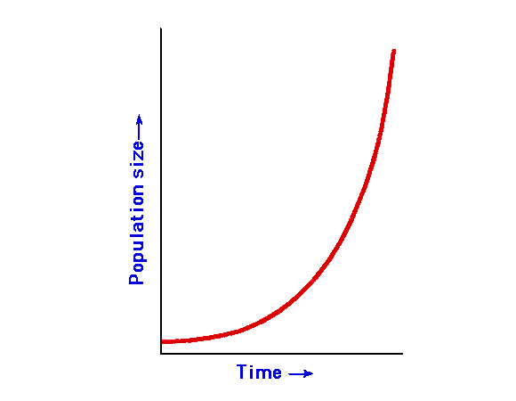

Slide 7
What environmental factors might effect population growth?

Slide 8
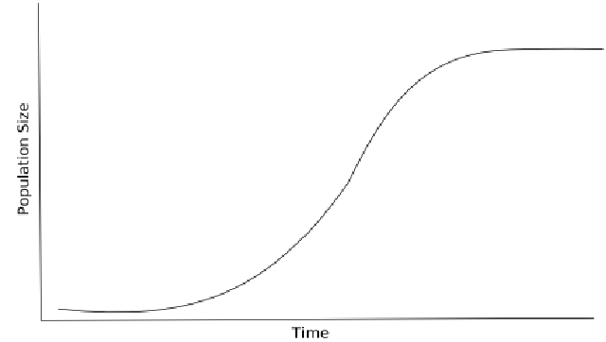
Limits of the environment
Eventually, limiting factors, such as availability of food and space, will cause a population to stop increasing
Leveling off of population size results in an S-shaped growth curve

Slide 9
Carrying capacity = the number of organisms of one species that an environment can support
When populations are under the carrying capacity of a particular environment, births exceed deaths until the carrying capacity is reached.
If the population temporarily overshoots the carrying capacity, deaths exceed births until population levels are once again below carrying capacity.

Slide 10
Carrying capacity activity
Each team represents a species in a different environment
The items up front represent resources available in each environment

Slide 11
Journal Response
How did the activity we did relate to what we’ve learned about carrying capacity, limiting factors, and population growth?

Slide 12
Patterns of population growth
Many animal and plant populations change in size
Beginning growth: the population increases, the few starting members have offspring, and the population grows
Rapid growth: there are many organisms, each reproducing, resulting in a fast increase in the number of individuals.
Growth is exponential.

Slide 13
Leveling off: as the population grows, it becomes more difficult for each organism to meets its needs. Growth slows. The graph resembles the letter S.
Carrying capacity: the environment cannot support more organisms. If population size is above the carrying capacity, organisms die.
Fluctuations: the number of organisms tends to rise above and below the carrying capacity

Slide 14
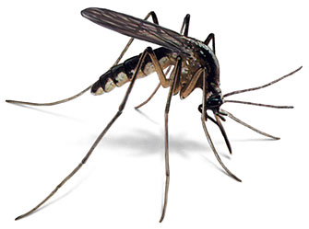
Ecologists study organisms’ reproduction pattern to determine patterns in population growth
Rapid life history pattern
Reproduce very rapidly
Many offspring
Unpredictable, rapidly changing environment
Typically have small body size, mature rapidly, reproduce early, and have a short life span
Ex: mosquitoes

Slide 15
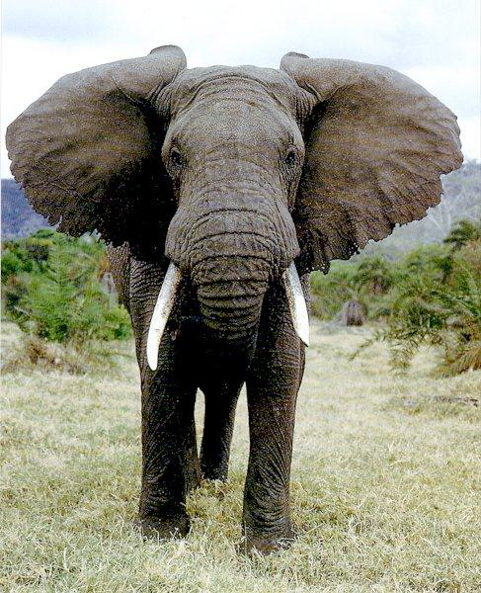
Long-lived life history pattern
Typically large organisms
Reproduce and mature slowly
Stable environment
Maintain population sizes near the carrying capacities of their environment
Ex: elephants, humans

Slide 16
Environmental limits to Population Growth
Limiting factors regulate the size of a population
Density-dependent factors = have an increasing effect as the population increases
Ex: disease, competition, parasites, food

Slide 17
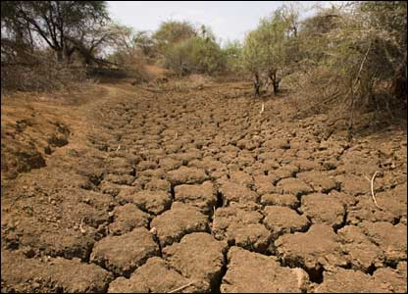
Density-independent factors = affect all populations, regardless of their density
Most are abiotic factors
Ex: temperature, drought, habitat destruction

Slide 18
Organism Interactions Limit Population Size
Population sizes are also limited by various interactions among organisms that share a community
Predation Affects Population Size
Populations of predators and prey experience changes in their numbers over a period of years
Predator-prey relationships often show a cycle

Slide 19
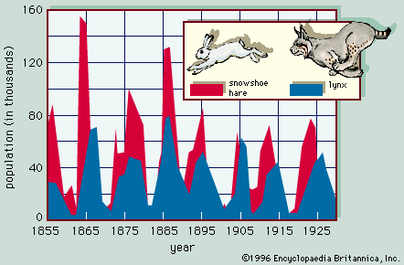

Slide 20
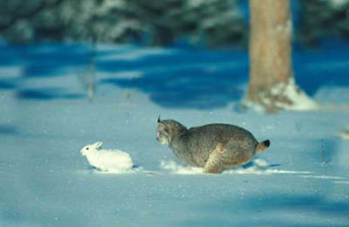
Lynx and snowshoe hare
Populations rise and fall almost together
Lynx population rises → predation increases → hare population decreases →lynx population decreases → predation decreases →hare population increases → cycle continues

Slide 21
The Effects of Competition
Organisms within a population constantly compete for resources
When population numbers are low, resources are plentiful
As population increases, competition for resources can become fierce

Slide 22
The Effects of Crowding and Stress
When populations become crowded, individuals may exhibit stress
Symptoms of stress:
Increased aggression
Decrease in parental care
Decreased fertility
Decreased resistance to disease

Slide 23
4.2 Human Population Growth

Slide 24
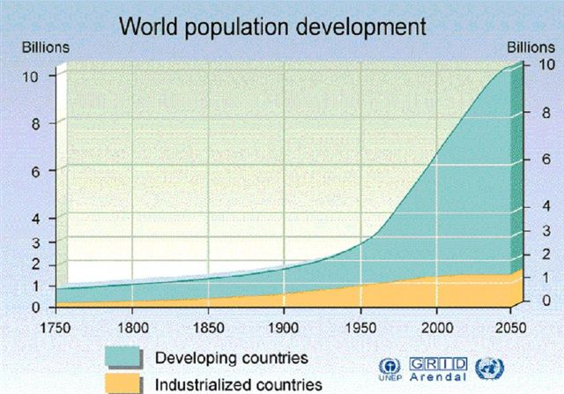
Demographic Trends
Demography = the study of human population growth characteristics
Although local human populations often show fluctuation, the worldwide human population has increased exponentially over the past several hundred years.

Slide 25
Population growth rate
Look at Table 4.2 (p.105) in your textbook
Identify the factors that contribute to high population growth rate.
Write down at least 2 factors

Slide 26
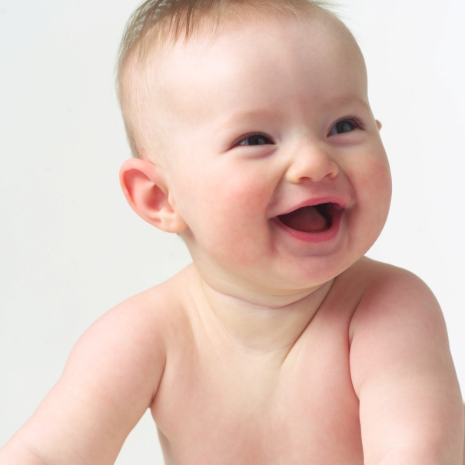
Effects if birthrates and death rates
Growth rate = birth rate – death rate
Fertility rate = number of offspring a female produces during her reproductive years

Slide 27
Does age affect population growth?
Age structure = proportions of a population that are at different ages levels
Age structure can be visualized by the use of graphs and can help predict how a population is growing
If the percentage of people in each category is fairly equal: stable population
Wide base/lots of young people = rapid growth

Slide 28
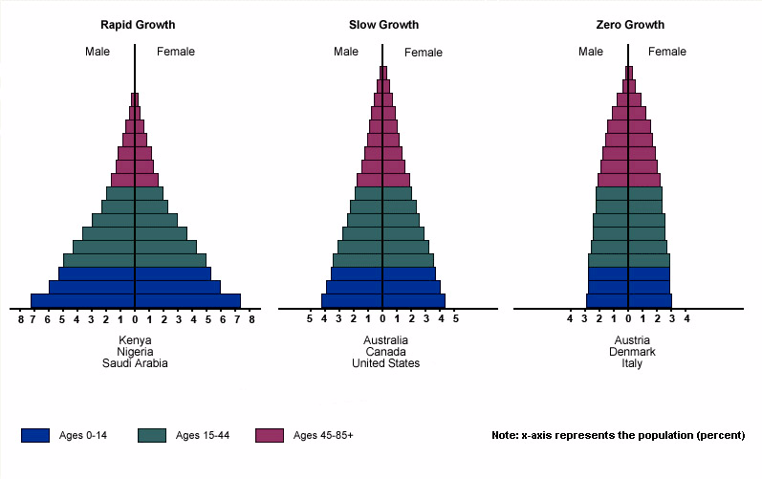
Developing countries Industrialized countries

Slide 29
Mobility has an effect on population size
Immigration = movement of individuals into a population
Emigration = movement from a population
Local populations can feel the effects of a moving population

Slide 30
Example Population Age Structure
Age Range | # of Females | # of Males
0-10 | 30 | 28
11-20 | 28 | 27
21-30 | 26 | 26
31-40 | 26 | 24
41-50 | 22 | 23
51-60 | 20 | 23
61-70 | 19 | 20
71-80 | 17 | 17
80+ | 16 | 14
Does this population exhibit rapid growth, slow growth, stable growth, or negative growth?

