Slide 1
Chapter 5
Biological Diversity and Conservation

Slide 2
5.1 Vanishing Species

Slide 3
Biological Diversity
Biodiversity = the variety of life in an area
The simplest and most common measure of biodiversity is the number of species that live in a certain area
Ex: one acre of rain forest may contain 400 plant species

Slide 4
Where is biodiversity found?
Areas around the world differ in biodiversity
Terrestrial biodiversity tends to increase as you move towards the equator
The richest environments for biodiversity are all warm places:
Tropical rain forests
Coral reefs
Large tropical lakes
The more space available, with all other factors kept the same, biodiversity increases

Slide 5
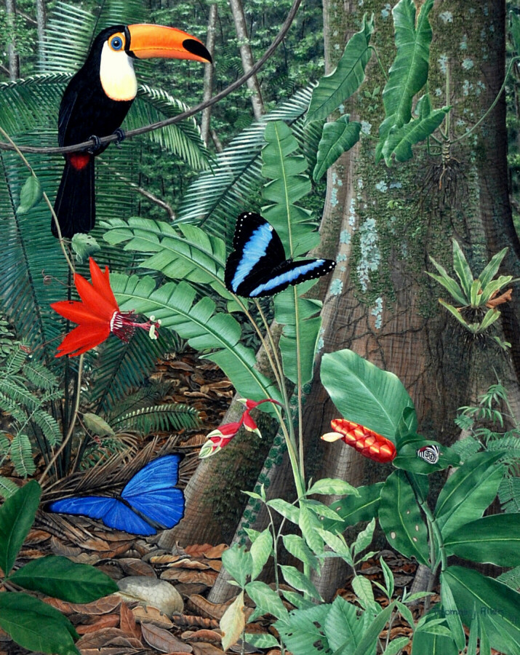
Write down the number of species that you see.
22

Slide 6
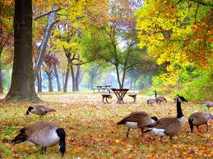
Write down the number of species that you see.
5

Slide 7
Importance of Biodiversity
Importance to nature
Organisms are adapted to live together in communities
If a species is lost from an ecosystem, the loss impacts other organisms
Biodiversity brings stability to an ecosystem

Slide 8
Importance to people
Humans depend on other organisms for their needs
Oxygen
Diverse diet
Materials
Clothing, building materials…
Health and medicine
Living things supply the world pharmacy

Slide 9
Challenge
Make a list of how humans depend on other organisms for needs

Slide 10
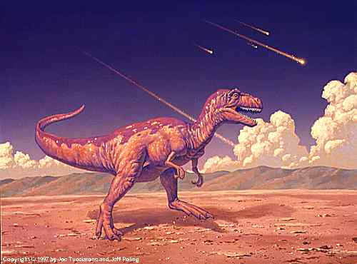
Loss of Biodiversity
Extinction = the disappearance of a species when the last of its members dies
Since 1980, almost 40 species of plants and animals in the US have become extinct
Extinction can occur as a result of natural processes or human behaviors

Slide 11
Threatened species = when the population of a species begins declining rapidly
Endangered species = when the population of a species is so low that extinction is possible

Slide 12
Threats to Biodiversity
Changes to habitats can threaten organisms with extinction
As populations of people increase, the impact from their growth and development influences the existence of other species

Slide 13
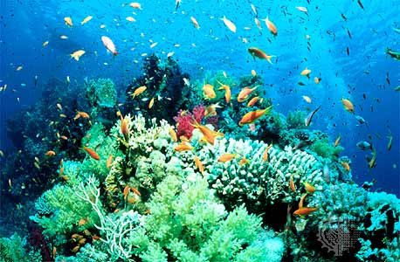
Habitat loss
The biggest threat to biodiversity
The essentials of life are lost for species depending on these habitats
Ex: coral reef

Slide 14
Habitat fragmentation
The separation of wilderness areas from other wilderness areas
Can be a result of human interaction
Fragmented areas are like islands

Slide 15
Biotic issues
represents problems for organisms that need large areas to gather food
Migrating species also need a large area

Slide 16
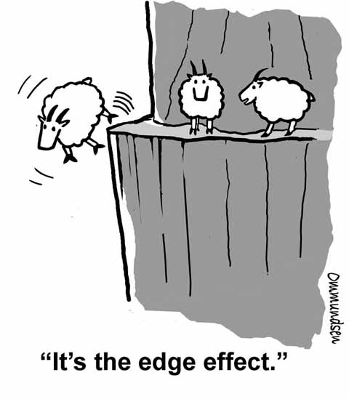
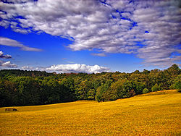
Abiotic issues
Can change the climate in an area
Edge effect = the different conditions along the boundaries of an ecosystem

Slide 17
Habitat degradation
The damage to a habitat by pollution
Three types of pollution are air, water, and land pollution

Slide 18
Air pollution
Cause breathing problems
Volcanic eruptions, forest fires, burning fossil fuels

Slide 19
What happened?

Slide 20
Acid precipitation = rain, snow, sleet and fog with low pH values
Responsible for the deterioration of forests and lakes
Sulfur dioxide and nitrogen oxides combine with water vapor to form acidic droplets of water vapor
Leaches calcium, potassium, and other valuable nutrients from the soil
Damages plant tissue

Slide 21
Ozone layer
Helps protect living organisms from damaging or lethal doses of ultraviolet radiation
Chemical formula = O₃
Contains 3 oxygen atoms
Chlorofluorocarbons (CFCs) are synthetic chemicals that break down the ozone layer

Slide 22
What are some examples of water pollution?
How do you know it’s pollution and it’s not supposed to be there?

Slide 23
Water pollution
Degrades aquatic habitats in streams, rivers, lakes, and oceans
Excess fertilizers and animal wastes from farms
The sudden availability of nutrients causes algal blooms, the excessive growth of algae. As the algae die, they sink and decay removing needed oxygen from the water.

Slide 25
Silt from eroded soils can clog the gills of fishes, cover coral reefs and prevent sufficient light from reaching photosynthetic organisms
Detergents, heavy metals, and industrial chemicals in runoff

Slide 26
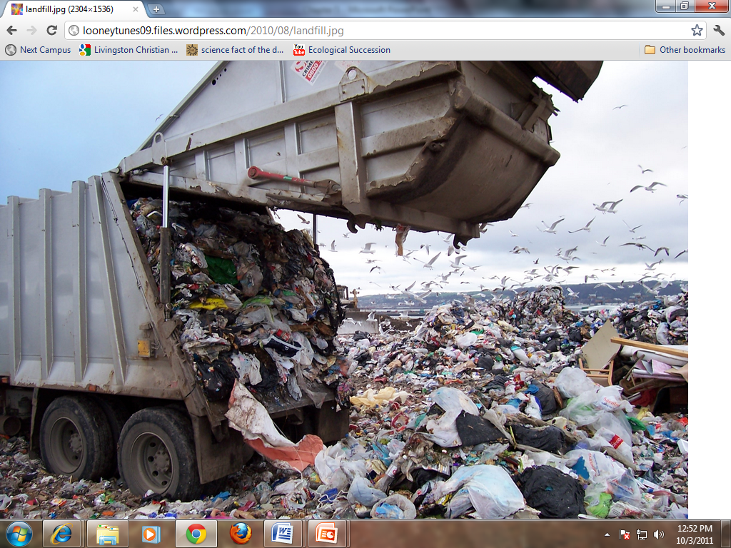
How much trash do you produce each day?

Slide 27
Land pollution
Trash = solid waste
The average American produces about 1.8 kg of solid waste daily
Landfill destroy wildlife habitats by taking up space and polluting the immediate area

Slide 28
DDT: commonly sprayed on crops to control insects and on water to kill mosquito larvae
DDT was passed from prey to predator
High levels caused birds such as the bald eagle to lay eggs with very thin shells that cracked easily, killing chicks

Slide 29
Introduction of exotics
People, either on purpose or by accident, sometimes introduce a new species into an ecosystem
Causes problems for the native species
Exotic species = organisms that are not native to a particular area
Lack of competition and predators
May take over niches f native species and eventually replace the native species completely
Ex: sea lamprey, zebra mussels

Slide 30
Exotic Pets
Choose an animal:
Sugar Glider
Rhesus monkey
Tiger
What’s the appeal of owning it?
What are the dangers of owning it?
What is its natural habitat?
What special care would it need?

Slide 31
5.2 Conservation of Biodiversity

Slide 32
Strategies of Conservation Biology
Conservation biology = a new field that studies methods and implements plans to protect biodiversity
Effective conservation strategies are based on principles of ecology
Many species are in danger due to the actions of humans, so working with people is an important part of conservation biology
Focus on ecology, law, politics, sociology, and economics

Slide 33
Legal protections of species
U.S. Endangered Species Act (1973)
Made it illegal to harm any species on the endangered or threatened species lists
Made it illegal for federal agencies to fund any project that would harm organisms on these lists
Harm includes changing an ecosystem

Slide 34
Convention on International Trade in Endangered Species (CITES)
Established lists of species for which international trade is prohibited or controlled
Endorsed by 120 countries

Slide 35
How might we be able to preserve habitats?

Slide 36
Preserving habitats
Focuses on protecting whole communities and whole ecosystems as the best way to conserve species
Nature preserves are an effective way of doing this
Yellowstone National Park = first national park in 1872
As human population increases, national parks preserve habitats and prevent extinction

Slide 37
Sustainable use = strives to let people use the resources of wilderness areas in ways that will not damage the ecosystem
Habitat corridors = natural strips that allow the migration of organisms from one area to another
Help overcome the problem of habitat fragmentation

Slide 38
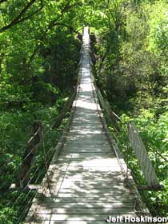
How is a habitat corridor like a bridge?

Slide 39
Reintroduction programs
Release organisms into an area where their species once lived
The factors that lead to the decline of the organisms must be removed if the reintroduction is to be a success
The most successful reintroduction occur when organisms are taken from an area and transported to a new suitable habitat

Slide 40
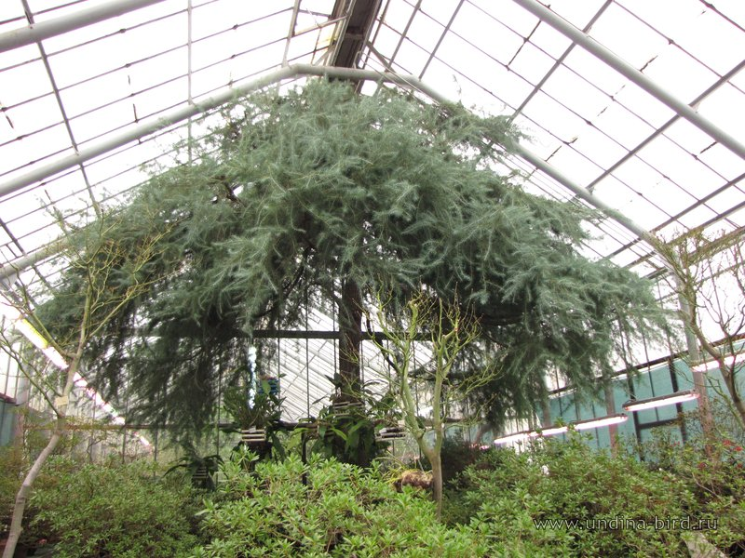
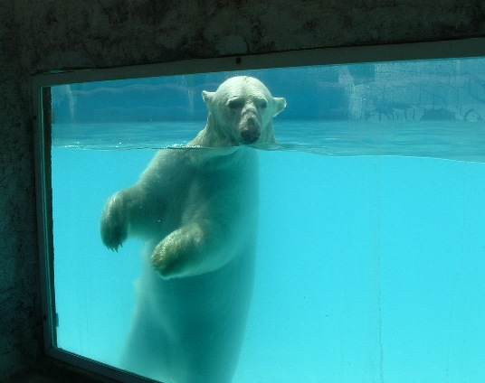
Sometimes all the organisms in wild areas are gone, and the only members of the species are in zoos
An organism that is held by people is in captivity
Both plants and animals

Slide 41
Flip Chart
Write the main ideas in the space above each topic
Conservation of Biodiversity
Legal protection of species
Preserving habitats
Reintroduction programs

