Slide 1
Chapter 8: Cellular Transport and the Cell Cycle

Slide 2
8.1 Cellular Transport

Slide 3
Osmosis: Diffusion of Water
The diffusion of water across a selectively permeable membrane is called osmosis.
Regulating the water flow through the plasma membrane is an important factor in maintaining homeostasis within the cell.
What controls osmosis
Water flows towards the area of lower concentration
Continues to move until there is equal concentration

Slide 4
Cells in an isotonic solution
In an isotonic solution, the concentration of dissolved substances in the solution is the same as the concentration of dissolved substances inside the cell.
Cells in isotonic solution do not experience osmosis
Retain their normal shape

Slide 5
Cells in a hypotonic solution
In a hypotonic solution, the concentration of dissolved substances is lower in the solution outside the cell than the concentration inside the cell.
There is more water outside the cell than inside
Cells experience osmosis
Water moves into the cell
The cell swells and its internal pressure increases

Slide 6
Cells in hypertonic solution
In a hypertonic solution, the concentration of dissolved substances outside the cell is higher than the concentration inside the cell.
Experience osmosis – water flows out

Slide 7
Animal cells
Cells shrivel because of decreased pressure in the cells
Plant cells
Lose water mainly from the central vacuole
The plasma membrane and cytoplasm shrink away from the cell wall
Results in a drop of pressure

Slide 8
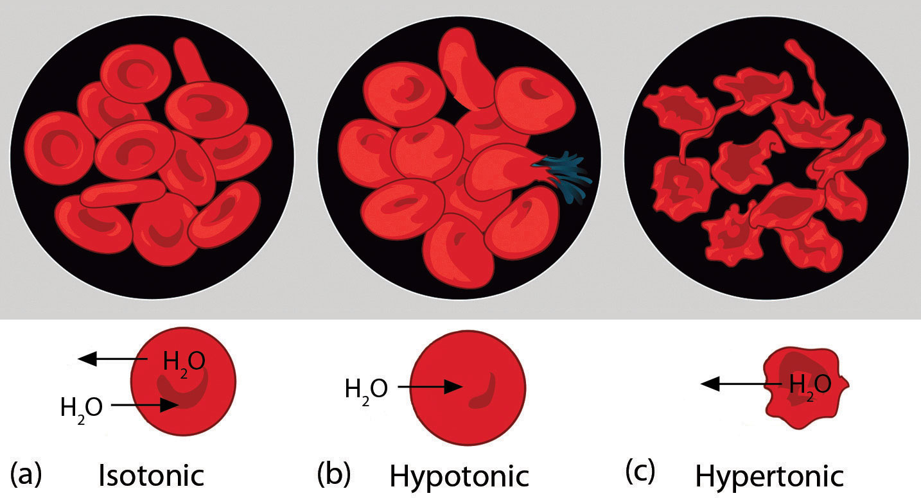

Slide 9
Passive Transport
Movement of particles across membranes by diffusion is called passive transport
Passive transport proteins
Transport proteins help substances move through the plasma membrane
The passive transport of materials across the plasma membrane with the aid of transport proteins is called facilitated diffusion
Common method of moving sugar and amino acids across membranes
Facilitated diffusion is driven by a concentration gradient

Slide 10
Active Transport
Movement of materials through a membrane against a concentration gradient is called active transport and requires energy from the cell.
How active transport occurs
A transport protein called a carrier protein first binds with a particle of the substance to be transported
Chemical energy allows the cell to change the shape of the carrier protein so that the particle is released on the other side of the membrane.

Slide 11
Transport of large particles
Endocytosis is a process by which a cell surrounds and takes in material from its environment.
Material does not pass directly through the membrane – it is enclosed by a portion of the cell’s membrane.
Forms a vacuole

Slide 12
Exocytosis is the expulsion or secretion of materials from a cell
Used to expel wastes from the interior to the exterior environment
Used to secrete substances such as hormones produced by the cell
Both endocytosis and exocytosis require energy

Slide 13
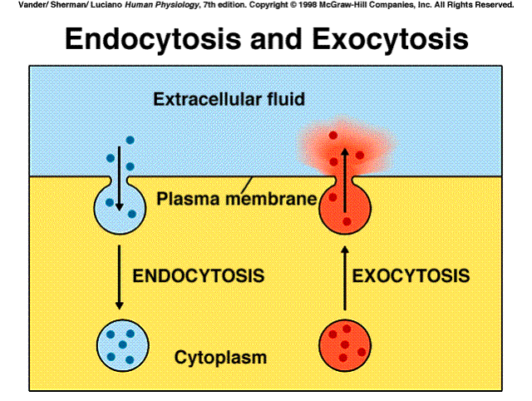

Slide 14
8.2 Cell Growth and Reproduction

Slide 15
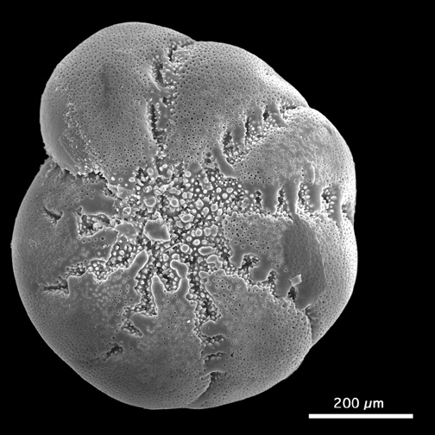
Cell Size Limitations
Cells come in a variety of sizes
Most living cells are between 2 and 200 μm in diameter
Diffusion limits cell size
Diffusion becomes inefficient as the distances become larger

Slide 16
DNA limits cell size
There is a limit as to how quickly the blueprints for proteins can be copied in the nucleus and made into proteins in the cytoplasm
In many large cells, more than one nucleus is present to ensure that cell activities are carried out quickly and efficiently

Slide 17
Surface area-to-volume ratio
As a cell’s size increases, its volume increases much faster than its surface area.
If cell size doubled,
the cell would requires eight times more nutrients
would have eight times more waste to excrete
surface area would increase 4 times
not enough area for the necessary nutrients to diffuse through
result in cell death
cells divide before they become too large to function properly

Slide 18
Cell Reproduction
Cell division is the process by which new cells are produced from one cell
Results in two cells that are identical to the original, parent cell
All organisms grow and change; worn-out tissues are repaired or are replaced by newly produced cells.

Slide 19
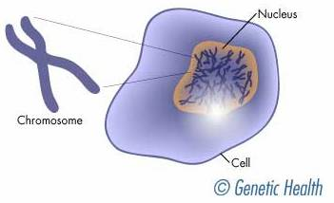
Discovery of chromosomes
Chromosomes: cell structures that carry the genetic material that is copied and passed from generation to generation of cells
Contain DNA
Darkly colored when stained

Slide 20
The structure of eukaryotic chromosome
For most of a cell’s lifetime, chromosomes exist as chromatin, long strands of DNA wrapped around proteins
Before a cell can divide, the long strands of chromatin must be reorganized into tightly packed structures

Slide 21
The Cell Cycle
The cell cycle is the sequence of growth and division of a cell
As a cell proceeds through its cycle it goes through two general periods:
A period of growth
A period of division

Slide 22
Interphase
The majority of a cell’s life
Cell grows in size and carries on metabolism
Chromosomes are duplicated
Divided into 3 phases
G1: rapid growth and high protein production
S: chromosomes copied, DNA synthesis and replication
G2: cell prepares for division, organelles manufactured

Slide 23
Mitosis
Follows interphase
Period of nuclear division by which two daughter cells are formed, each containing a complete set of chromosomes.

Slide 24
The Phases of Mitosis
Prophase: the first phase of mitosis
Longest phase
The long, stringy chromatin coils up into visible chromosomes
Each duplicated chromosome is made up of two halves called sister chromatids.
Exact copies of DNA in each

Slide 25
Sister chromatids are held together by a structure called a centromere
Plays a role in chromosome movement during mitosis
The nucleus begins to disappear as the nuclear envelope and the nucleolus disintegrate
In animal cells, centrioles begin to migrate to opposite ends of the cell

Slide 26
Centrioles are small, dark, cylindrical structures that are made of microtubules and are located just outside the nucleus.
The spindle forms between the pairs of centrioles as they move
Thin fibers made of microtubules
A football-shaped, cage-like structure

Slide 27
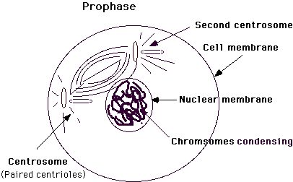

Slide 28
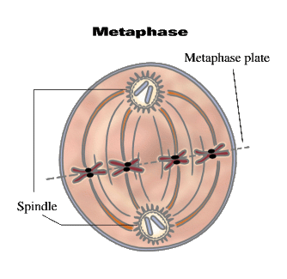
Metaphase: the second stage of mitosis
The shortest phase of mitosis
Doubled chromosomes become attached to the spindle fibers by their centromeres
Each sister chromatid is attached to its own spindle fiber
Pulled by the spindle fibers, the chromosomes begin to line up on the midline, or equator, of the spindle

Slide 29
Anaphase: the third phase of mitosis
Begins with the separation of sister chromatids
The centromeres split apart
Chromatid pairs from each chromosome separate from each other.
Pulled apart by the shortening of the microtubules in the spindle fibers.

Slide 30
Telophase: the fourth phase of mitosis
The final phase
Begins as the chromatids reach the opposite poles of the cell.
Chromosomes unwind
Spindle breaks down
Nucleolus reappears
New nuclear envelope forms around each set of chromosomes
A new double membrane beings to form between the two new nuclei

Slide 31
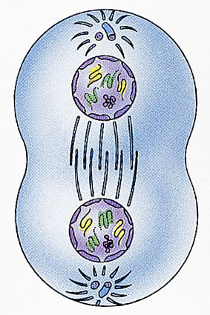

Slide 32
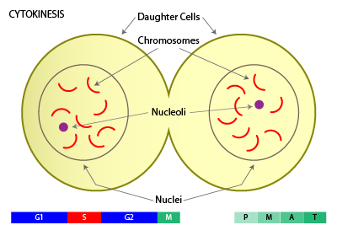
Division of the cytoplasm
The cell’s cytoplasm divides in a process called cytokinesis
Different in plants and animals
Animal cells:
The plasma membrane pinches in along the equator

Slide 33
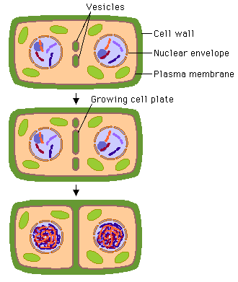
Plant cells:
Cell plate is laid down across the cell’s equator
A cell membrane forms around each cell
New cell walls form on each side of the cell plate

Slide 34
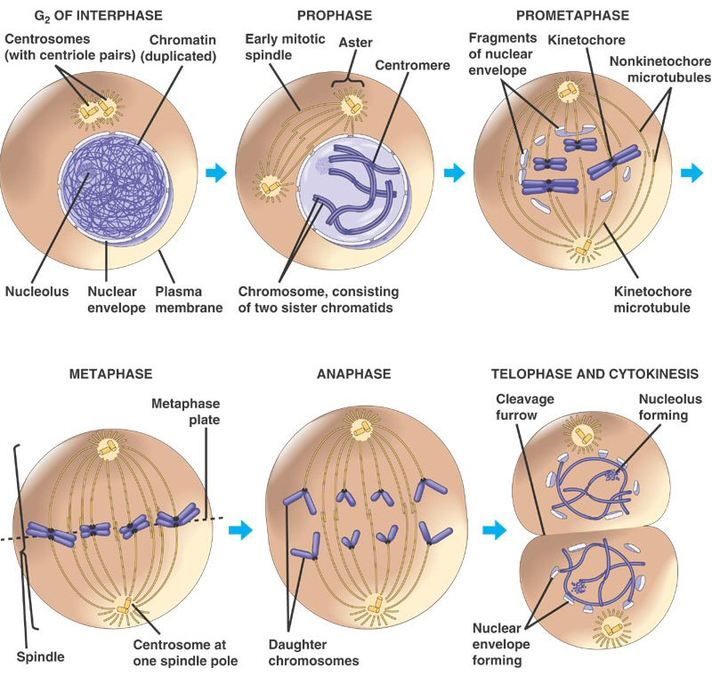

Slide 35
Results of mitosis
Guarantees genetic continuity (identical to parent)
Cell growth and reproduction result in groups of cells that work together as tissue to perform a specific function.
Tissues organize in various combinations to form organs that perform more complex roles within the organism.
Multiple organs that work together form an organ system.
All organ systems work together for the survival of the organism.

Slide 36
8.3 Control of the Cell Cycle

Slide 37
Normal Control of the Cell Cycle
Enzymes control the cell cycle
A series of enzymes monitor a cell’s progress from phase to phase during the cell cycle
Occasionally, cells lose control of the cell cycle due to:
Failure to produce certain enzymes
Overproduction of enzymes
Production of enzymes at the wrong time

Slide 38
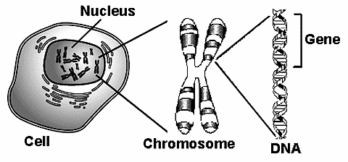
This uncontrolled dividing of cells can result in cancer
Enzymes production is directed by genes located on the chromosomes
A gene is a segment of DNA that controls the production of a protein.

Slide 39
Cancer: A Mistake in the Cell Cycle
Cancerous cells form masses of tissue called tumors that deprive normal cells of nutrients.
Caner is the second leading cause of death in the US
The causes of cancer
Both genetic and environmental factors are involved
Environmental factors include exposure to cigarette smoke, air and water pollution, and exposure to ultraviolet radiation.
Damaged genes

Slide 40
Cancer prevention
Diets low in fat and high in fiber content can reduce the risk of many kinds of cancer
Vitamins and minerals may also help prevent cancer
Carotenoids
Vitamins A, C, and E
Calcium

Slide 41
