Slide 1
Chapter 1: Bacteria

Slide 2
Section 1: What are bacteria?

Slide 3
Bacteria are microscopic, living cells
Bacteria live almost everywhere, even in extreme environments like thousands of meters underground, hot springs with temperatures over 100°C, and very acidic water.

Slide 4
Bacteria can be sphere-shaped (cocci), rod-shaped (bacilli), or spiral-shaped (spirilla).
They are smaller than plant or animal cells.
They are prokaryotic since they do not have membrane-bound internal structures.

Slide 5
Some bacteria have a capsule around the cell wall while others have an outer slime layer
The gel-like substance covering some bacteria enables them to live together in colonies.
Many have whip-like tails called flagella to help them move

Slide 6
Most bacteria reproduce by fission
Create two new identical cells
Some bacteria exchange genetic material before dividing

Slide 7
Bacteria can be producers that make their own food, consumers that break down dead organisms, or parasites in living organisms that absorb nutrients from their host.
Most bacteria are aerobes which use oxygen during respiration
Some bacteria are anaerobes which do not need oxygen; some anaerobes cannot survive in the presence of oxygen

Slide 8
Bacteria are classified into two kingdoms
Eubacteria
Diverse group
Larger of the two bacterial kingdoms

Slide 9
Cyanobacteria produce their own food and are commonly called blue-green bacteria;
Some may be yellow, black, or red in color
Provide food and oxygen for aquatic life
An overabundance of cyanobacteria produces a bloom, which can be harmful to aquatic life
Consumer eubacteria are grouped by cell wall thickness or thinness

Slide 10
Archaebacteria
Bacteria are often found in extreme locations and are divided into groups based on where they live or how they get energy
Some live in salty, acidic, or very hot environments
One anaerobic group produces methane gas

Slide 11
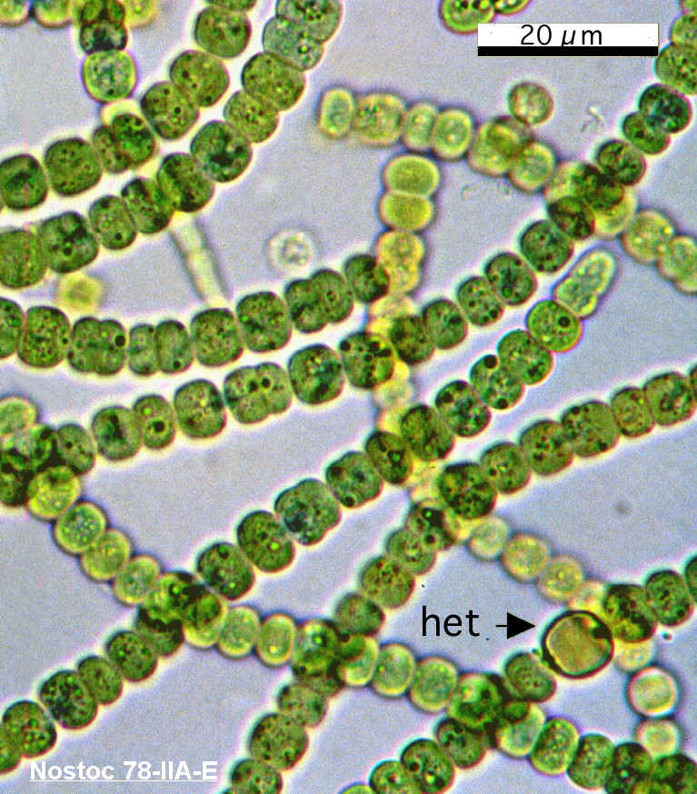
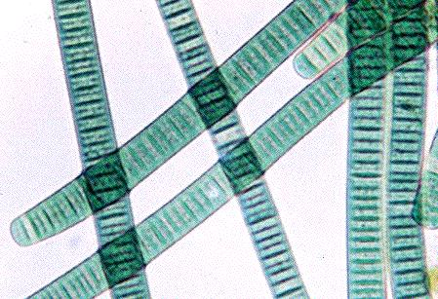
Observing Cyanobacteria Activity
Oscillatoria
Nostoc

Slide 12
Section 2: Bacteria in Your Life

Slide 13
Most bacteria are helpful rather than harmful
Bacteria are necessary for human health
Many bacteria aid digestion and some produce vitamins
Some bacteria produce antibiotics, which are used to treat diseases

Slide 14
Bacteria help keep nature in balance
Bacterial saprophytes use dead organisms as food and energy sources, thus recycling nutrients for use by other organisms.
Nitrogen-fixing bacteria in the soil and plant roots change nitrogen from the air to a form that plants and animals can use.

Slide 15
Bacteria can be used to clean up environmental pollution through bioremediation
Some bacteria break waste down into harmless compounds
Certain bacteria can eat pollutants

Slide 16
Many foods are made using bacteria.
Bacteria are used in dairy products such as yogurt and cheese
Sauerkraut and pickles are also among foods made with bacterial help

Slide 17
Bacteria are used in industry
Bacteria grown in large, carefully controlled containers called bioreactors are used to make medicines and many other products
Methane-producing bacteria can digest wastes and provide a source of fuel

Slide 18
Bacteria that cause disease are called bacterial pathogens
Toxins, or poisons, are made by some bacterial pathogens
Can cause disease
Some pathogens form thick walled structures called endospores when environmental conditions are unfavorable
Can survive for very long time periods
Pasteurization, a process of limited heating, can kill most harmful bacteria in food

Slide 19
Vaccines can prevent some bacterial infections
Vaccines are made from damages or dead bacterial cells
Once injected, they enable white blood cells in the body to recognize a particular type of bacteria and attack if it appears at a later time

