Slide 1
Chapter 2: Analyzing Data

Slide 2
2.1 Units and Measurements

Slide 3
SI Units
Because scientists need to report data that can be reproduced by other scientists, they need standard units of measurement
In 1960, scientists updated the metric system
Revised international unit system is called the Système Internationale d’Unités, which is abbreviated SI.

Slide 4
Base Units and SI Prefixes
There are seven base units in SI
A base unit is a defined unit in a system of measurement that is based on an object or event in the physical world.
Independent of other units
To better describe the range of possible measurements, scientists add prefixes to the base units
Table 2

Slide 5
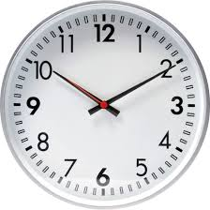
Time
The SI base unit for time is the second (s)
Many chemical reactions take place in less than a second

Slide 6
Length
The SI base unit for length is the meter (m)
A meter is close in length to a yard

Slide 7
Mass
The SI base unit for mass is the kilogram (kg)
A kilogram is equal to about 2.2 pounds
Scientists often measure quantities in grams (g) or milligrams (mg)

Slide 8
Temperature
Temperature is a quantitative measurement of the average kinetic energy of the particles that make up an object
Several different kinds of temperature scales have been developed – Kelvin, Celsius, and Farenheit
In the United States, the Fahrenheit scale is used to measure temperature
Water freezes at 32°F and boils at 212°F

Slide 9
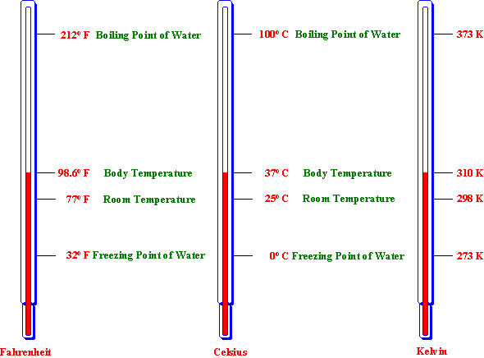

Slide 10
The Celsius scale is used throughout much of the rest of the world
Based on the freezing and boiling points of water
Defined freezing point of water as 0°C and the boiling point of water as 100°C
Distance between these two points divided evenly into 100 equal units, or degrees.
Convert from Celsius to Fahrenheit
°F = 1.8 (°C) + 32

Slide 11
The SI base unit for temperature is the kelvin (K)
Zero kelvin is a point where all particles are at their lowest possible energy state
Water freezes at 273 K and boils at 373 K
Convert between Kelvin and Celsius
K = °C + 273

Slide 12
Derived Units
Not all quantities can be measured with SI base units
A unit that is defined by a combination of base units is called a derived unit

Slide 13
Volume
Volume is the space occupied by an object
The derived unit for volume is the cubic meter (m³)
The volume of an irregularly shaped solid can be determined using the water displacement method
For everyday use, a more useful unit of volume is the liter
A liter (L) is equal to one cubic decimeter (dm³)
In the laboratory, volume is often measured in milliliters (mL)
1ml = 1cm³

Slide 14
Density
Density is the amount of mass per unit volume
Common units of density are grams per cubic centimeter (g/cm³) for solids and grams per milliliter (g/mL) for liquids and gases.
Density equation:
Density = mass/volume

Slide 15
2.2 Scientific Notation and Dimensional Analysis

Slide 16
Scientific Notation
Scientific notation can be used to express any number as a number between 1 and 10 (known as the coefficient) multiplied by 10 raised to a power (known as the exponent).
For numbers greater than 1, a positive exponent is used to indicate how many times the coefficient must be multiplied by 10 in order to obtain the original number.
For numbers less than 1, a negative exponent indicates how many times the coefficient must be divided by 10 in order to obtain the original number.

Slide 17
Determining the exponent:
Count the number of places the decimal point must be moved to result in a coefficient between 1 and 10
Positive exponent if the decimal moves left
Negative exponent if the decimal moves right

Slide 18
Addition and Subtraction
Exponents must be the same before adding or subtracting
Each place the decimal shifts to the left increases the exponent by 1
Each place the decimal shifts to the right decreases the exponent by 1

Slide 19
Multiplication and Division
Do not need to have the same exponent
For multiplication, multiply the coefficients, and then add the exponents
For division, divide the coefficients, and then subtract the exponent of the divisor from the exponent of the dividend.
Any number raised to a power of 0 is equal to 1

Slide 20
Dimensional Analysis
Dimensional analysis is a systematic approach to problem solving that uses conversion factors to move, or convert, from one unit to another
A conversion factor is a ratio of equivalent values having different units
Ex: 3 teaspoons / 1 Tablespoon
Multiplying a quantity by a conversion factor changes the units of the quantity without changing its value

Slide 21
Most conversion factors are written from relationships between units
Prefixes: 1000 meter = 1 kilometer
1km/1000m and 1000m/1km
Derived units: density of 2.5g/mL
2.5g/1mL and 1mL/2.5g
A percentage is a ratio relating the number of parts of one component to 100 total parts: 10% sugar fruit drink
10g sugar/100g fruit drink and 100g fruit drink/10g sugar

Slide 22
Using conversion factors
A conversion factor used in dimensional analysis must accomplish two things: it must cancel one unit and introduce a new one
While working through a solution, all of the units except the desired unit must cancel
When converting a value with a large unit to a value with a smaller unit, the numerical value must decrease
When converting a value with a small unit to a value with a larger unit, the numerical value must increase

Slide 23
2.3 Uncertainty in Data

Slide 24
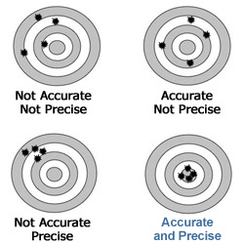
Accuracy and Precision
Accuracy refers to how close a measured value is to an accepted value
Precision refers to how close a series of measurements are to one another

Slide 25
Error and percent error
Error is the difference between an experimental value and an accepted value
Error= experimental value – accepted value
Percent error = expresses error as a percentage of the accepted value
Percent error = |error| / accepted value x 100

Slide 26
Significant Figures
The precision of a measurement is indicated by the number of digits reported
The reported digits are called significant figures
Significant figures include all known digits plus one estimated digit

Slide 27
Recognizing significant figures
Nonzero numbers are always significant
3758 (4 sig figs)
All final zeros to the right of the decimal are significant
3.400 (4 sig figs)
230 (2 sig figs)

Slide 28
Any zero between significant figures is significant
208 (3 sig figs)
Placeholder zeros are not significant. To remove placeholder zeros, rewrite the number in scientific notation.
0.00054 (2 sig figs)
Counting numbers and defined constants have an infinite number of significant figures
12 atoms or 2 min

Slide 29
Rounding Numbers
A solution should not have more significant figures than the original data with the fewest significant figures, rounding to the correct value.

Slide 30
Rounding numbers
If the digit to the right of the last significant figure is less than five, do not change the last significant figure
34.71 → 34.7
If the digit to the right of the last significant figure is greater than five, round up the last significant figure.
1.728 → 1.73

Slide 31
If the digits to the right of the last significant figure are a five followed by a nonzero digit, round up the last significant figure.
8.1654 → 8.17
If the digits to the right of the last significant figure are a five followed by 0 or no other number at all, look at the last significant figure. If it is odd, round it up; if it is even do not round up.
49.3750→ 49.38
49.3250 → 49.32

Slide 32
Addition and subtraction
The answer must have the same number of digits to the right of the decimal as the original value having the fewest number of digits to the right of the decimal.
Arrange the numbers in columns so that the decimals line up, then complete the calculation
Identify the value with the fewest places after the decimal point
Round the answer to the same number of places

Slide 33
Multiplication and Division
Your answer must have the same number of significant figures as the measurement with the fewest significant figures.

Slide 34
2.4 Representing Data

Slide 35
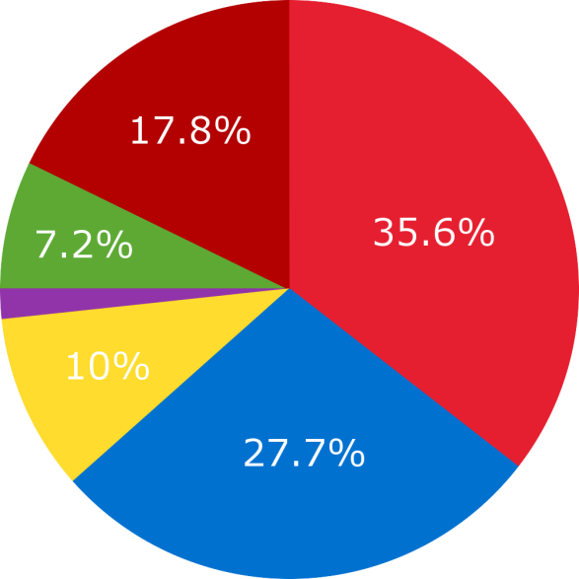
Graphing
A graph is a visual display of data
Circle graph
Sometimes called a pie chart
Useful for showing parts of a fixed whole
Parts are typically labeled as percents

Slide 36
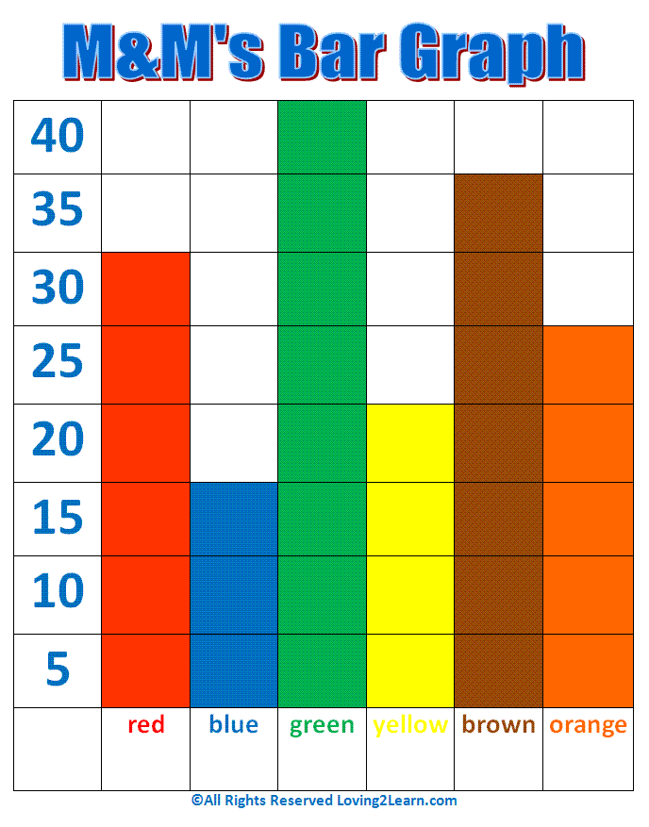
Bar graph
Used to show how a quantity varies across categories (ex. time or location)
The quantity being measured appears on the vertical (y) axis
The independent variable appears on the horizontal (x) axis
The relative heights of the bars show how the quantity varies

Slide 37
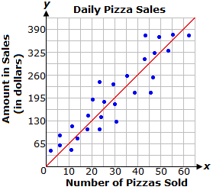
Line graph
The points on a line graph represent the intersection of data for two variables
Independent variable plotted on x-axis, and the dependent variable plotted on y-axis.
The best fit line shows trend of the graph
Drawn so that about as many points fall above the line as fall below the line

Slide 38
Relationships between variables
If the best-fit line is straight, there is a linear relationship between the variables
Variables are directly related
If the best-fit lines rises to the right, then the slope of the line is positive
Indicates that the dependent variable increases as the independent variable increases
A negative slope indicates that the dependent variable decreases as the independent variable increases

Slide 39
Slope equation:
Slope = rise/run = Δy/Δx = (y₂ – y₁)/( x₂ – x₁)
When the best-fit line is curved, the relationship between the variables is nonlinear

Slide 40
Interpreting Graphs
Identify the independent and dependent variables
Look at the ranges of the data
When points on a line graph are connected, the data are considered continuous
Reading data from in between measured points is called interpolation
Extending a line beyond the plotted points in order to estimate values is called extrapolation

