Slide 1
Chapter 5: Electrons in Atoms

Slide 2
5.1 Light and Quantized Energy

Slide 3
The Atom and Unanswered Questions
Rutherford’s nuclear model did not explain how the atom’s electrons are arranged in space around the nucleus or why electrons are not pulled into the oppositely charged nucleus.

Slide 4
Wave Nature of Light
Visible light is a form of electromagnetic radiation
A form of energy that exhibits wavelike behavior as it travels through space
Ex: microwaves, x-rays

Slide 5
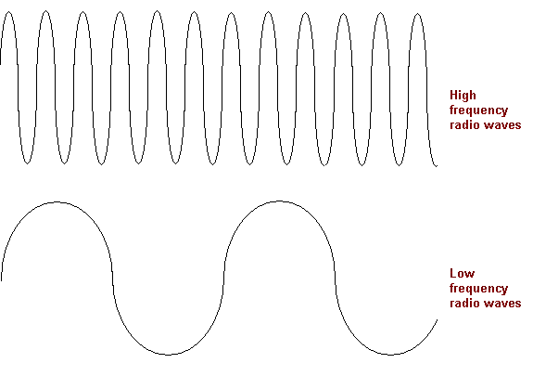
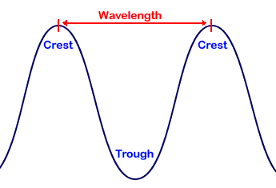
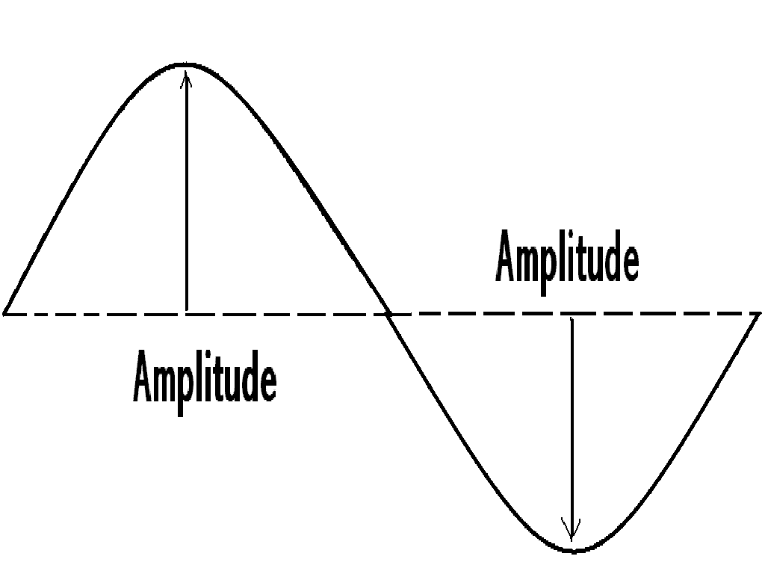
Wavelength
Represented by λ , the Greek letter lambda
The shortest distance between equivalent points on a continuous wave
Expressed in meters, centimeters, or nanometers
Frequency
Represented by v the Greek letter nu
The number of waves that pass a given point per second
Hertz (Hz) is the SI unit of frequency
One wave per second
Amplitude is the wave’s height from the origin to a crest, or from the origin to a trough

Slide 6
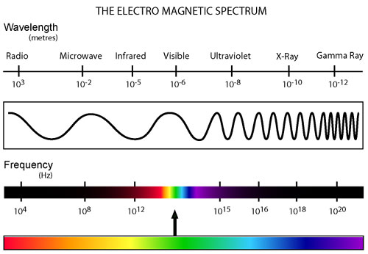
All electromagnetic waves travel at the same speed
Speed of light = 3.0 x 10⁸ = c
c= λ v
The electromagnetic spectrum includes all forms of electromagnetic radiation

Slide 7
Particle Nature of Light
The quantum concept
A quantum is the minimum amount of energy that can be gained or lost by an atom
Planck demonstrated mathematically that a relationship exists between the energy of a quantum and the frequency of the emitted radiation
E_{quantum} = hv
E is energy
h is Plank’s constant
v is frequency
energy increases as frequency increases
Plank’s constant has a value of 6.626 x 10⁻³⁴ J*s

Slide 8
The photoelectric effect
In the photoelectric effect, electrons, called photoelectrons, are emitted from a metal’s surface when light of a certain frequency, or higher than a certain frequency, shines on the surface.
Not explained by the wave model of light
Einstein proposed that light has both wavelike and particlelike properties
Photon = a massless particle that carries a quantum of energy
E_{photon} = hv
A beam of light is made up of photons

Slide 9
Atomic Emission Spectra
Neon
Neon atoms absorb energy and become excited. These excited atoms return to their stable state by emitting light to release the absorbed energy. If the emitted light is passed through a glass prism, the atomic emission spectrum is produced.
The atomic emission spectrum of an element is the set of frequencies of the electromagnetic waves emitted by atoms of the element
Not a continuous range of colors
Each element’s atomic emission spectrum is unique
Can be used to determine if an element is part of an unknown compound
Can be used to identify an element

Slide 10
5.2 Quantum Theory and the Atom

Slide 11
Bohr’s Model of the Atom
Energy states of hydrogen
Bohr proposed that the hydrogen atom has only certain allowable energy states
Ground state = the lowest allowable energy state of an atom
Excited state = when an atom gains energy

Slide 12
Related the hydrogen atom’s energy states to the electron within the atom
Electron moves around the nucleus in only certain allowed circular orbits
The larger the electron’s orbit, the higher the atom’s energy state, or energy level
Bohr assigned a number, n, called a quantum number, to each orbit
First orbit, n = 1
Second orbit, n = 2

Slide 13
The hydrogen line spectrum
When energy is added from an outside source, the electron moves to a higher –energy orbit
When the atom is in an excited state, the electron can drop from the higher-energy orbit to a lower-energy orbit.
The atom emits a photon corresponding to the difference between the energy levels associated with the two orbits
ΔE = E_{higher energy orbit} – E_{lower energy orbit} = E_{photon} = hv
Because only certain atomic energies are possible, only certain frequencies of electromagnetic radiation can be emitted

Slide 14
Limits of Bohr’s model
Explained hydrogen’s spectral lines, but not any other element
Did not fully account for the chemical behavior of atoms
Evidence indicates that electrons do not move around the nucleus in circular orbits
The movements of electrons in atoms are not completely understood, but Bohr’s model laid the groundwork for later atomic models

Slide 15
The Quantum Mechanical Model of the Atom
Scientists in the mid-1920s formulated new and innovative explanations of how electrons are arranged in atoms
Louis de Broglie (1892-1987)
The de Broglie equation predicts that all moving particles have wave characteristics
Electrons and other moving particles have wave characteristics
De Broglie equation: Particle Electromagnetic-Wave Relationship
λ= h /mv

Slide 16
The Heisenberg Uncertainty Principle
Werner Heisenberg showed that it is impossible to take any measurement of an object without disturbing the object
The act of observing the electron produces a significant, unavoidable uncertainty in the position and motion of the electron
The Heisenberg uncertainty principle states that it is fundamentally impossible to know precisely both the velocity and position of a particle at the same time
Means that it is impossible to assign fixed paths for electrons, the only quantity that can be known is the probability for an electron to occupy a certain region around the nucleus.

Slide 17
The Schrödinger wave equation
Erwin Schrödinger (1887-1961) derived an equation that treated the hydrogen atoms’ electron as a wave, and applied well to other elements
The atomic model in which electrons are treated as waves is called the wave mechanical model of the atom, or the quantum mechanical model of the atom.
Each solution to the equation is known as a wave function, which is related to the probability of finding the electron within a particular volume of space around the nucleus

Slide 18
Electron’s probable location
The wave function predicts an atomic orbital
Atomic orbital = a three dimensional region around the nucleus that describes the electron’s probable location
The boundary is fuzzy so the orbital does not have an exact defined size

Slide 19
Hydrogen’s Atomic Orbitals
Principal quantum number
The Bohr atomic model assigns quantum numbers to electron orbits
The principal quantum number (n) indicates the relative size and energy of atomic orbitals
As n increases, the orbital becomes larger, the electron spends more time farther from the nucleus, and the atom’s energy increases
n specifies the atom’s major energy levels called principal energy levels
an atom’s lowest principal energy level is assigned a principal quantum number of 1
up to seven energy levels have been detected for hydrogen

Slide 20
Energy sublevels
Principal energy levels contain energy sublevels
Principal energy level 1 consists of a single sublevel
Principal energy level 2 consists of two sublevels
Principal energy level 3 consists of three sublevels
The number of energy sublevels in a principal energy level increases as n increases

Slide 21
Shapes of orbitals
Sublevels are labeled s, p, d or f according to the shape of the atom’s orbitals
s = spherical
p = dumbbell shaped
not all d and f orbitals have the same shape

Slide 22
Subscripts of x, y, and z relate to the orientations of the orbitals along the x, y, and z coordinate axes.
The spherical orbitals do not have orientations, but p, d, and f orbitals have multiple orientations
S has only 1 orbital
P has 3 orbitals
D has 5 orbitals
F has 7 orbitals
Each orbital can contain at most 2 electrons
S = 2 total electrons
P = 6 total electrons
D = 10 total electrons
F = 14 total electrons
Table 2 (p.155)
The maximum number of orbitals related to each principal energy level equals n²

Slide 23
5.3 Electron Configuration

Slide 24
Ground-State Electron Configurations
The arrangement of electrons in atoms can be done using a few specific rules
Electron configuration = the arrangement of electrons in an atom
Low-energy systems are more stable than high-energy systems; electrons tend to assume the arrangement that gives the atom the lowest energy possible.
The most stable, lowest-energy arrangement of the electrons is called the element’s ground-state electron configuration

Slide 25
The aufbau principle
States that each electron occupies the lowest energy orbital available
The first step in determining an element’s ground state electron configuration is learning the sequence of atomic orbitals from lowest energy to highest energy.

Slide 26
This sequence is known as an aufbau diagram, and shows the energy of each sublevel with each box representing an atomic orbital
All orbitals related to an energy sublevel are of equal energy
The energy sublevels within a principal energy level have different energies
In order of increasing energy, the sequence of energy sublevels within a principal energy level is s, p, d, and f.
Orbitals related to energy sublevels within one principal energy level can overlap orbitals related to energy sublevels within another principal energy level

Slide 27
The Pauli exclusion principle
Electrons in orbitals can be represented by arrows in boxes
Each electron in an atom has an associated spin
An arrow pointing up represents the electron spinning in one direction, an arrow pointing down represents the electron spinning in the opposite direction.

Slide 28
The Pauli exclusion principle states that a maximum of two electrons can occupy a single atomic orbital, but only if the electrons have opposite spins
An atomic orbital containing paired electrons with opposite spins is written ↑↓ .
The maximum number of electrons related to each principal energy level equals 2n².

Slide 29
Hund’s rule
States that single electrons with the same spin must occupy each equal-energy orbital before additional electrons with opposite spins can occupy the same orbitals
Ex:

Slide 30
Electron Arrangement
There are two methods to represent electron configuration: orbital diagrams or electron configuration notation.

Slide 31
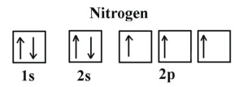
Orbital diagram
Box for each orbital
Empty box = unoccupied orbital
Single arrow = one electron
Double arrow = filled orbital
Each box is labeled with the principal quantum number and sublevel associated with the orbital
Ex: Nitrogen

Slide 32
Practice Problems
Sulfur
Lithium
Neon
Oxygen

Slide 33
Electron configuration notation
Designates the principal energy level and energy sublevel associated with each of the atom’s orbitals and includes a superscript representing the number of electrons in the orbital
Ex: carbon 1s²2s²2p²
Doesn’t show the orbital distributions of electrons related to a sublevel

Slide 34
Practice Problems write out the notation for each
Sulfur
Lithium
Neon
Oxygen
1s²2s²2p⁶3s²3p⁴
1s²2s¹
1s²2s²2p⁶
1s²2s²2p⁴

Slide 35
Noble gas notation
Method of representing electron configurations of noble gases using bracketed symbols
Ex: Helium [He]
1s²2s²2p⁶
The electron configuration for an element can be represented using the noble gas notation for the noble gas in the previous period and the electron configuration for the additional orbitals being filled
Ex: sodium [He]3s¹
1s²2s²2p⁶3s¹

Slide 36
Exceptions to predicted configurations
Can use the aufbau diagram to write correct ground-state electron configuration for all elements up to and including vanadium (atomic number 23).
Several elements after this point illustrate the increased stability of half-filled and filled sets of s and d orbitals
Ex: Chromium [Ar]4s¹3d⁵

Slide 37
Valence Electrons
Only certain electrons, valence electrons, determine the chemical properties of an element
Valence electrons are electrons in the atom’s outermost orbitals – generally those orbitals associated with the atom’s highest principal energy level

Slide 38
Because valence electrons are involved in forming chemical bonds, chemists often represent them visually using a shorthand method called the electron-dot structure.
Consists of the element’s symbol surrounded by dots representing the all of the atom’s valence electrons
Dots are placed one at a time on the four sides of the symbol (in any sequence) and then paired up until all are shown

Slide 39
Electron Configurations - Solutions
1) sodium 1s²2s²2p⁶3s¹
2) iron 1s²2s²2p⁶3s²3p⁶4s²3d⁶
3) bromine 1s²2s²2p⁶3s²3p⁶4s²3d¹⁰4p⁵
4) barium 1s²2s²2p⁶3s²3p⁶4s²3d¹⁰4p⁶5s²4d¹⁰5p⁶6s²
5) neptunium 1s²2s²2p⁶3s²3p⁶4s²3d¹⁰4p⁶5s²4d¹⁰5p⁶6s²4f¹⁴5d¹⁰6p⁶7s²5f⁵
6) cobalt [Ar] 4s²3d⁷
7) silver [Kr] 5s²4d⁹
8) tellurium [Kr] 5s²4d¹⁰5p⁴
9) radium [Rn] 7s²
10) lawrencium [Rn] 7s²5f¹⁴6d¹

Slide 40
Chapter Review
Vocabulary:
Electromagnetic spectrum
Wavelength
Frequency
Amplitude
Photoelectric effect
Photon
Atomic emission spectrum
Ground state
Quantum
Principal quantum number
Electromagnetic radiation
Atomic orbital
Principal energy levels
Energy sublevels
Valence electron
Electron dot-structure
Equations
c= λ v
E_{quantum} = hv
E_{photon} = hv
ΔE = E_{higher energy orbit} – E_{lower energy orbit}
λ= h /mv
Orbital diagrams
Aufbau principle
Pauli exclusion principle
Hund’s Rule

Slide 41
