Slide 1
Chapter 6

Slide 2
6.1 Development of the Modern Periodic Table

Slide 3
Development of the Periodic Table’s Development
Late 1700s: French scientist Antoine Lavoisier compiled a list of the 33 elements known at the time
1800s: increase in the number of known elements
Electricity was used to break down compounds into their components
Spectrometer was used to identify newly isolated elements
Chemists agreed upon a method for accurately determining the atomic masses of elements

Slide 4
John Newlands
Proposed an organizational scheme for the elements based on atomic mass
Noticed that when the elements were arranged by increasing atomic mass, their properties repeat every eighth element
Pattern is called periodic because it repeats in a specific manner
Named the periodic relationship the law of octaves
Did not work for all known elements

Slide 5
Meyer and Mendeleev
In 1869, Lothar Meyer and Dmitri Mendeleev each demonstrated a connection between atomic mass and the properties of elements.
Mendeleev also noticed that when the elements were ordered by increasing atomic mass, there was a periodic pattern in their properties.
By arranging the elements in order of increasing atomic mass into columns with similar properties, he created the first periodic table

Slide 6
Predicted the existence and properties of undiscovered elements
Left blank spaces in the table
Not completely correct
Several elements were not in the correct order
Arranging elements by mass resulted in several elements being placed in groups of elements with differing properties

Slide 7
Moseley
Henry Mosely determined why Mendeleev’s table didn’t work
Discovered that atoms of each element contain a unique number of protons in their nuclei (atomic number)
By arranging the elements in order of increasing atomic number there is a clear periodic pattern of properties
Periodic law = states that when the elements are arranged by increasing atomic number, there is a periodic repetition of their chemical and physical properties

Slide 8
The Modern Periodic Table
The table consists of boxes , each containing:
Element name
Symbol
Atomic number
Atomic mass

Slide 9
The boxes are arranged in order of increasing atomic number into a series of columns, called groups or families, and rows, called periods.
There are a total of seven periods
Each group is numbered 1 through 18.
Groups 1, 2, and 13 to 18 possess a wide range of chemical and physical properties and are referred to as the main group, or representative elements.
The elements in groups 3 to 12 are referred to as the transition elements.

Slide 10
Metals
Metals are elements that are generally…
Shiny when smooth and clean
Solid at room temperature
Good conductor of heat and electricity
Malleable and ductile – can be pounded into thin sheets and drawn into wires

Slide 11
Most representative elements and all transition elements are metals
Group 1 elements (except for hydrogen) are known as the alkali metals
Highly reactive so they usually exist as compounds with other elements
Alkaline earth metals are in group 2.
Highly reactive elements
Transition elements are divided into transition metals and inner transition metals.
The two sets of inner transition metals, known as the lanthanide series and actinide series, are located along the bottom of the periodic table

Slide 12
Nonmetals
Nonmetals are elements that are generally…
Gases at room temperature
Brittle, dull-looking solids
Poor conductors of heat and electricity
Group 17 is comprised of highly reactive elements that are known as halogens
Often found as part of compounds
The extremely unreactive group 18 elements are commonly called the noble gases.

Slide 13
Metalloids
Metalloids have physical and chemical properties of both metals and nonmetals
Found on the stair-step boundary between metal and nonmetals on the periodic table

Slide 14
6.2 Classification of the Elements

Slide 15
Organizing the Elements by Electron Configuration
Valence electrons
Electrons in the highest principal energy level of an atom are called valence electrons
Atoms in the same group have similar chemical properties because they have the same number of valence electrons
Each column in groups 1,2, and 13-18 on the periodic table elements has its own unique valence electron configuration

Slide 16
Valence electrons and period
The energy level of an element’s valence electrons indicates the period on the periodic table in which it is found
Ex: 3rd energy level = 3rd period

Slide 17
Valence electrons and group number
Group 1 elements have one valence electron; group 2 elements have two valence electrons. Group 13 elements have three valence electrons, group 14 elements have four valence electrons, and so on.
The noble gas elements in group 18 have eight valence electrons, except for helium which only has two.

Slide 18
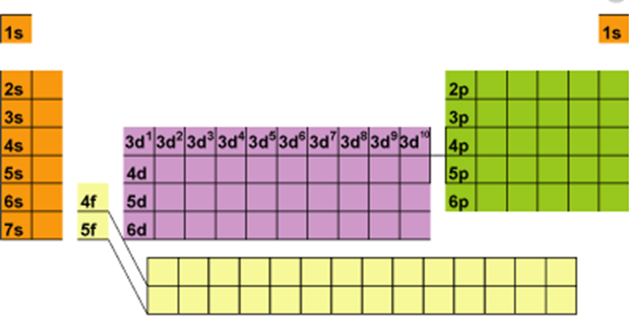
The s-, p-, d-, and f-Block Elements
S-block elements
Consists of groups 1 and 2, and the element helium
Because s orbitals hold two electrons at most, the s-block spans two groups

Slide 19
P-block elements
Comprised of groups 13-18
There are no p-block elements in period one because the p sublevel does not exist for the first principal energy level
Contains the noble gas elements which have completely filled energy levels
Arrangement results in very stable atomic structure

Slide 20
D-block elements
Contains the transition metals
Largest block
Characterized by a filled outermost s orbital (n) and filled or partially filled d orbitals (energy level n – 1)

Slide 21
F-block elements
Contain the inner transition metals
The electrons of the f sublevel do not fill their orbitals in a predictable manner

Slide 22
Periodic table
As you proceed down through the periods…
the principal energy level increases
the number of energy sublevels containing electrons increases

Slide 23
6.3 Periodic Trends

Slide 24
Many properties of the elements tend to change in a predictable way, known as a trend, as you move across a period or down a group.
Atomic Radius
The sizes of atoms are influenced by electron configuration
The electron cloud does not have a clearly defined edge
Atomic size is defined by how closely an atom lies to a neighboring atom

Slide 25
Trends within periods
In general, there is a decrease in atomic radii as you move left to right across a period
Caused by the increasing positive charge in the nucleus and the fact that the principal energy level within a period stays the same
No additional electrons come between the valence electrons and the nucleus, so the valence electrons are not shielded from the increased nuclear charge
Increased charge = increased attraction = smaller radii

Slide 26
Trends within groups
Atomic radii generally increase as you move down a group
The nuclear charge increases and electrons are added to orbitals corresponding to successively higher principal energy levels
Outermost orbital increases in size along with the principal energy level
Additional electrons shield the outer electrons from the pull of the nucleus

Slide 27
Ionic Radius
Atoms gain or lose one or more electrons to form ions
An ion is an atom or bonded group of atoms that has a positive or negative charge
When atoms lose electrons and form positively charged ions, they become smaller (radius decreases)
The valence electron lost may leave a completely empty outer orbital
The electrostatic repulsion between the now-fewer number of remaining electrons decreases, allowing them to be pulled closer to the nucleus.
When atoms gain electrons and form negatively charged ions, they become larger ( radius increases)
Addition of an electron increases the electrostatic repulsion, forcing them to move farther apart

Slide 28
Trends within periods
Elements on the left side form smaller positive ions and elements on the right side form larger negative ions
In general, as you move left to right across a period, the size of the positive ions gradually decreases
Beginning in group 15 or 16, the size of the much larger negative ions gradually decrease

Slide 29
Trends within groups
As you move down a group, an ion’s outer electrons are in higher principal energy levels, resulting in a gradual increase in ionic size
The ionic radii of both positive and negative ions increase as you move down a group

Slide 30
Ionization Energy
Ionization energy is the energy required to remove an electron from a gaseous atom
The energy is needed to overcome the attractive forces of the nucleus and the repulsive forces of the electrons
Ionization energy is an indication of how strongly an atom’s nucleus holds onto its valence electrons
High ionization energy = strong hold
Less likely to form positive ions
Low ionization energy = weak hold
Likely to form positive ions

Slide 31
Removing more than one electron
The energy required to remove the first outermost electron from an atom is called the first ionization energy
After the first electron from an atom, it is possible to remove additional electrons
The amount of energy required to remove a second electron from a 1+ ion is called the second ionization energy.

Slide 32
The energy required for each successive ionization increases
Does not increase smoothly, for each element there is an ionization for which the required energy increases dramatically
The ionization at which the large increase in energy occurs is related to the atom’s number of valence electrons
4 valence electrons: jump after fourth ionization energy

Slide 33
Trends within periods
First ionization energies generally increase as you move left to right across a period
Increased nuclear charge = increased hold
Trends within groups
First ionization energies generally decrease as you move down a group
Atomic size increases, with valence electrons farther from the nucleus, less energy is required to remove them

Slide 34
Octet rule
The octet rule states that atoms tend to gain, lose or share electrons in order to acquire a full set of eight valence electrons
The electron configuration of filled s and p orbitals of the same energy level is very stable
First period elements are an exception
Useful for determining the type of ions likely to form
Elements on the right side tend to gain electrons
Elements on the left side tend to lose electrons

Slide 35
Electronegativity
The electronegativity of an element indicates the relative ability of an its atoms to attract electrons in a chemical bond
Electronegativity generally decreases as you move down a group, and increases as you move left to right across a period
Values are expressed in terms of a numerical value of 3.98 or less
Units = Paulings

Slide 36
Fluorine is the most electronegative element
Cesium and francium are the least electronegative elements
In a chemical bond, the element with the greater electronegativity more strongly attracts the bond’s electrons

Slide 37
Chapter 6 Review
People
John Newlands
Henry Moseley
Dmitri Mendeleev
Classifications
Periodic law
Metal, nonmetal, metalloid
Transition elements
Transition metals
Inner transition metals
Representative elements
Alkali metals
Alkaline earth metals
Halogens
Noble gases
Electron configuration
Where sublevels (spdf) are located on the periodic table
Energy level and period relationship
Octet rule
When is an atom stable?
Periodic trends
Atomic radius
Ionic radius
Ionization energy
Electronegativity
What are they?
How are they related?

