Slide 1
Chapter 7: Ionic Compounds and Metals

Slide 2
7.1 Ion Formation

Slide 3
Valence Electrons and Chemical Bonds
The force that holds two atoms together is called a chemical bond.
Forms due to the attraction between
A positive nucleus and negative electrons of two atoms
or
A positive ion and a negative ion

Slide 4
Valence electrons
Electron-dot structures are helpful in illustrating the formation of chemical bonds
The difference in element reactivity relates to the octet – the stable arrangement of eight valence electrons in the outer energy level

Slide 5
Positive Ion Formation
A positive ion forms when an atom loses one or more valence electrons in order to attain a noble gas configuration
A positively charged ion is called a cation
Although an element’s electron configuration changes to that of another element, it is not changing into that element.
The number of protons determines the element

Slide 6
Metal ions
Metal atoms are reactive because they lose valence electrons easily
The group 1 and 2 metals are the most reactive metals
Transition metal ions
Commonly form 2+ ions
Lose the two valence electrons from the s sublevel
Also possible for electrons from the d sublevel to also be lost, so transition metals also commonly form ions of 3+ or greater

Slide 7
Pseudo-noble gas configurations
Besides the octet, other electron configurations can also provide some stability
Pseudo-noble gas configurations are relatively stable electron arrangements that are not noble gas configurations
Ex: Zinc
1s²2s²2s⁶3s²3p⁶4s²3d¹⁰ → loses 2 electrons → 1s²2s²2s⁶3s²3p⁶3d¹⁰

Slide 8
Negative Ion Formation
Nonmetals easily gain electrons to attain a stable outer electron configuration
An anion is a negatively charged ion
To designate an anion, the ending –ide is added to the root name of the element
Ex: chloride

Slide 9
 | Symbol | Electron configuration | Electron dot diagram | Ion with charge | Number of electrons gained or lost | Name of ion
Cesium | Cs | [Xe] 6s¹
Barium | Ba | [Xe] 6s²
Arsenic | As | [Ar] 4s²3d¹⁰4p³
Iodine | I | [Kr] 5s²4d¹⁰5p⁵
Zinc | Zn | [Ar] 3d¹⁰ 4s²
Phosphorus | P | [Ne] 3s² 3p³

Slide 10
7.2 Ionic Bonds and Ionic Compounds

Slide 11
Formation of an Ionic Bond
Anions are attracted to cations
The electrostatic force that holds oppositely charged particles together in an ionic compound is referred to as an ionic bond.
Compounds that contain ionic bonds are ionic compounds.
If ionic bonds occur between metals and the nonmetal oxygen, oxides form.
Most ionic compounds are called salts.

Slide 12
Binary ionic compounds
Many ionic compounds are binary: contain only two different elements
Contain a metallic cation and a nonmetallic anion

Slide 13
Compound formation and charge
The overall charge of an ionic compound is zero
Ex: calcium fluoride (CaF₂)
Calcium has the electron configuration of [Ar]4s² and needs to lose two electrons to attain the stable noble gas configuration
Fluorine has the electron configuration of [He]2s²2p⁵ and needs to gain one electron to attain the stable noble gas configuration
The number of electrons lost and gained must be equal, so two fluorine atoms are needed to accept the two electrons lost from the calcium ion.

Slide 14
Properties of Ionic Compounds
The chemical bonds in a compound determine many of its physical properties.
Physical structure
Large number of positive ions and negative ions exist together in a ratio determined by the number of electrons transferred from the metal atom to the nonmetal atom
Positive and negative ions are packed in a regular repeating pattern that balances the forces of attraction and repulsion between the ions

Slide 15
The strong attractions among the positive and negative ions results in the formation of a crystal lattice
A three-dimensional geometric arrangement of particles
Vary in shape due to the sizes and relative numbers of the ions bonded

Slide 16
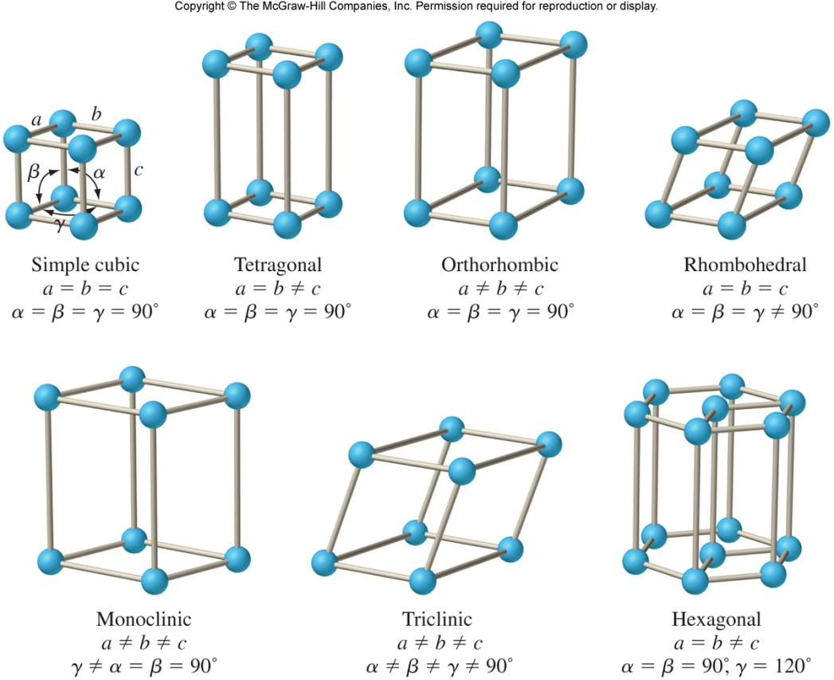
Crystal Lattice
Create a model of a crystal lattice out of KNex

Slide 17
Physical properties
The ability of a material to conduct electricity depends on the availability of freely moving charged particles
Whether ions are free to move determines whether an ionic compound conducts electricity
In solid state, ionic compounds are nonconductors
Ions have fixed positions
In liquid state (or dissolved in water), ionic compounds are conductors
Ions free to move
An ionic compound whose aqueous solution conducts an electric current is called an electrolyte.

Slide 18
Properties that depend on how strongly the particles are attracted to each other include melting points, boiling point, and hardness.
Ionic crystals have high melting and boiling points due to their strong ionic bonds
Ionic crystals are hard, rigid, brittle solids due to the strong attractive forces that hold the ions in place
When an external force is applied to the crystal strong enough to overcome the attractive forces, the crystal cracks or breaks apart

Slide 19
Energy and the ionic bond
During every chemical reaction, energy is either absorbed or released.
Energy absorbed = endothermic
Energy released = exothermic
Formation of ionic compounds from positive and negative ions is always exothermic.

Slide 20
Lattice energy
The energy required to separate one mol of the ions of an ionic compound is referred to as the lattice energy.
The strength of the forces holding ions in place is reflected by the lattice energy.
Directly related to the size of the ions bonded
Smaller ions produce stronger interionic attractions and greater lattice energies
Affected by the charge of the ion
Ionic bonds formed from the attraction of larger charges generally have a greater lattice energy

Slide 21
7.3 Names and Formulas for Ionic Compounds

Slide 22
Formulas for Ionic Compounds
The chemical formula for an ionic compound, called a formula unit, represents the simplest ratio of the ions involved
The overall charge of a formula unit is zero

Slide 23
Monatomic ions
Binary ionic compounds are composed of positively charged monatomic ions of a metal and negatively charged monatomic ions of a nonmetal.
Monatomic ion is a one-atom ion

Slide 24
Oxidation numbers
The charge of a monatomic ion is equal to its oxidation number, or oxidation state.
The oxidation number of an element in an ionic compound equals the number of electrons transferred from the atom to form the ion

Slide 25
Formulas for binary ionic compounds
In the chemical formula for any ionic compound, the symbol of the cation is always written first, followed by the symbol of the anion.
Subscripts represent the number of ions of each element in an ionic compound
no subscript = 1 ion
You can use the oxidation numbers to write formulas for ionic compounds
If you add the oxidation number of each ion multiplied by the number of these ions in a formula unit, the total must be zero.

Slide 26
Formulas for polyatomic ionic compounds
Polyatomic ions are ions made up of more than one atom
Ex: ammonium NH₄⁺
Table 9 Common Polyatomic Ion (p.221)
A polyatomic ion acts as an individual ion in a compound and its charge applies to the entire group of atoms
Never change subscripts of the atoms within the polyatomic ion
If more than one polyatomic ion is needed, place parentheses around the ion and write the appropriate subscript outside the parentheses
Ex: Mg(ClO₃)₂
Balance the number of ions so that the sum of the charges equals zero, using parentheses if necessary

Slide 27
Names for Ions and Ionic Compounds
Naming an oxyanion
An oxyanion is a polyatomic ion composed of an element, usually a nonmetal, bonded to one or more oxygen atoms.

Slide 28
Many contain the same nonmetal and have the same charges but differ in the number of oxygen atoms.
Naming rules:
Identify the ion with the greatest number of oxygen atoms. This ion is named using the root of the nonmetal plus the suffix –ate
Identify the ion with fewer oxygen atoms. This ion is named using the root of the nonmetal plus the suffix –ite
Ex: NO₃ ⁻ = nitrate NO₂⁻ = nitrite

Slide 29
Some halogens form four oxyanions with oxygen
Naming rules:
The oxyanion with the greatest number of oxygen atoms is named using the prefix per-, the root of the nonmetal, and the suffix –ate.
The oxyanion with one fewer oxygen atom is named with the root of the nonmetal, and the suffix –ate.
The oxyanion with two fewer oxygen atoms is named using the root of the nonmetal, and the suffix –ite.
The oxyanion with three fewer oxygen atoms is named using the prefix hypo-, the root of the nonmetal, and the suffix –ite.
Ex: ClO₄⁻ = perchlorate
ClO₃⁻ = chlorate
ClO₂⁻ = chlorite
ClO⁻ = hypochlorite

Slide 30
Naming ionic compounds
Chemical nomenclature is a systematic way of naming compounds
Naming Rules
Name the cation followed by the anion
For monatomic cations, use the element name
For monatomic anions, use the root of the element name plus the suffix –ide
To distinguish between multiple oxidation numbers of the same element, the oxidation number is written as a Roman numeral in parentheses after the name of the cation.
Applies to transition metals, and metals on the right side of the periodic table
Ex: Fe₂⁺ and O₂⁻ = FeO = iron(II)oxide
When the compound contains a polyatomic ion, simply use the name of the polyatomic ion in place of the anion or cation
Ex: NaOH = sodium hydroxide

Slide 31
7.4 Metallic Bonds and Properties of Metals

Slide 32
Metallic Bonds
Metals are not ionic, but share several properties with ionic compounds
Metals often form lattices in the solid state

Slide 33
A sea of electrons
Valence electrons are not shared or lost
Within the crowded lattice, the outer energy levels of the metal atoms overlap
The electron sea model proposes that all the metal atoms in a metallic solid contribute their valence electrons to form a “sea” of electrons.
Electrons not held by any specific atom and move easily from one atom to the next
Delocalized electrons are electrons that are free to move
A metallic bond is the attraction of a metallic cation for delocalized electrons

Slide 34
Properties of metals
The physical properties of metals can be explained by metallic bonding
The melting points of metals vary greatly
In general, metals have moderately high melting points and high boiling points
Extreme boiling points results because during boiling atoms must be separated from the group of cations and electrons, which requires more energy

Slide 35
Metals are malleable, which means they can be hammered into sheets, and ductile, which means they can be drawn into wire
The mobile particles involved in metallic bonding can be pushed or pulled past each other
The movement of mobile electrons around positive metallic cations makes metals good conductors of both electricity and heat
Delocalized electrons interact with light, absorbing and releasing photons, creating the property of luster in metals
As the number of delocalized electrons increases, so do the properties of hardness and strength

Slide 36
Metal Alloys
An alloy is a mixture of elements that has metallic properties.
Ex: Brass, bronze, stainless steel
The properties of alloys differ somewhat from the properties of the elements they contain
In a substitutional alloy, some of the atoms in the original metallic solid are replaced by other metal atoms of similar size
Ex: sterling silver
An interstitial alloy is formed when the small holes in a metallic crystal are filled with smaller atoms
Ex: carbon steel

