Slide 1
Chapter 1 Structure and Movement

Slide 2
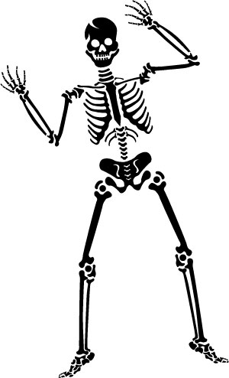
Section 1: The Skeletal System

Slide 3
All the bones in your body make up your skeletal system, which has five major functions.
Your skeleton gives shape and support to your body.
Your bones protect your internal organs.
Major muscles are attached to your bones.
Blood cells are formed in the marrow in the center of your bones.
Calcium and phosphorous compounds are stored in your skeleton for later use.

Slide 4
Bone structure
Periosteum – a tough, tight-fitting membrane that covers the bone’s surface
Contains small blood vessels that carry nutrients into the bone
Contains cells involved in the growth and repair of bone

Slide 5
Compact bone – the hard, strong layer under the periosteum
Gives bone its strength
Has a flexible framework containing deposits of calcium phosphate

Slide 6
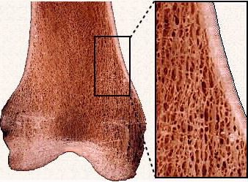
Spongy bone – found toward the ends of long bones
Has many small, open spaces that make bones lightweight
Filled with marrow, which produces blood cells

Slide 7
Cartilage – a rubbery layer of tissue found at the ends of bones, where they form joints
Cartilage acts as a shock absorber and reduces friction between bones when they rub together.
People with damaged cartilage feel pain when they move their joints

Slide 8
Your skeleton begins as cartilage, which is gradually broken down and replaced by bone.
Healthy bone tissue is always being formed and re-formed.
Osteoblasts build up bone by depositing calcium and phosphorus, which make bone tissue hard.
Osteoclasts break down bone tissue.

Slide 9
Joints – any place where two or more bones come together
Bones must be kept just far enough apart so they don’t rub against each other.
Ligament – a tough band of tissue that holds bones in place.

Slide 10
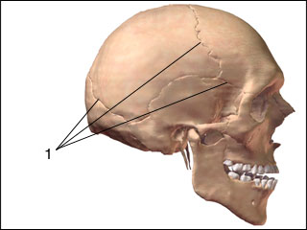
Types of joints
Immovable joint
Allows little or no movement
Example: the joints of the bones in your skull

Slide 11
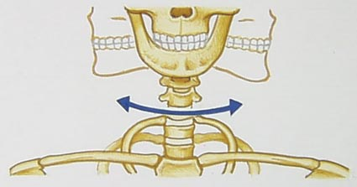
Pivot joint
One bone rotates in a ring of another stationary bone
Turning your head is an example of a pivot movement.

Slide 12
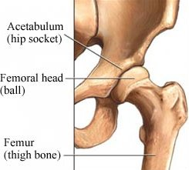
Ball-and-socket joint
The rounded end of one bone fits into a cuplike cavity on another bone
Example: hips

Slide 13
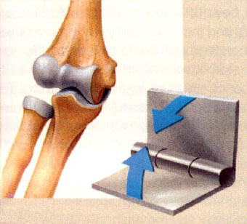
Hinge joint
Back-and-forth movement
Example: elbows

Slide 14
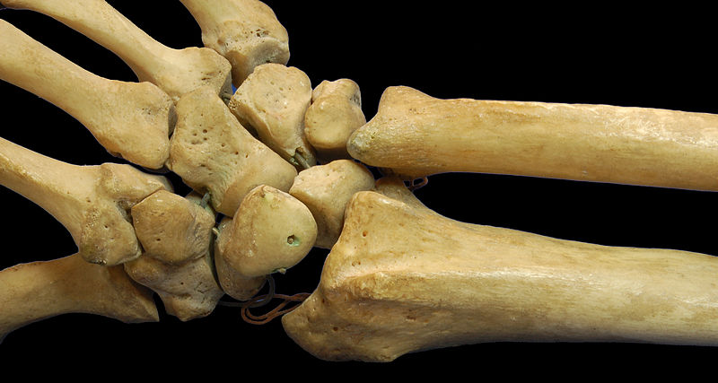
Gliding joint
One part of a bone slides over another bone
Example: wrists
Used the most in the body

Slide 15
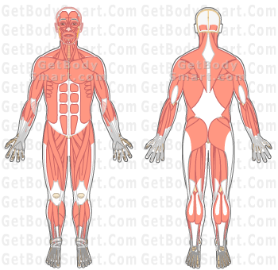
Section 2: The Muscular System

Slide 16
A muscle is an organ that can relax and contract, and provides the force to move your body parts.
Voluntary muscles – muscles that you are able to control
Involuntary muscles – muscles that you cannot control

Slide 17
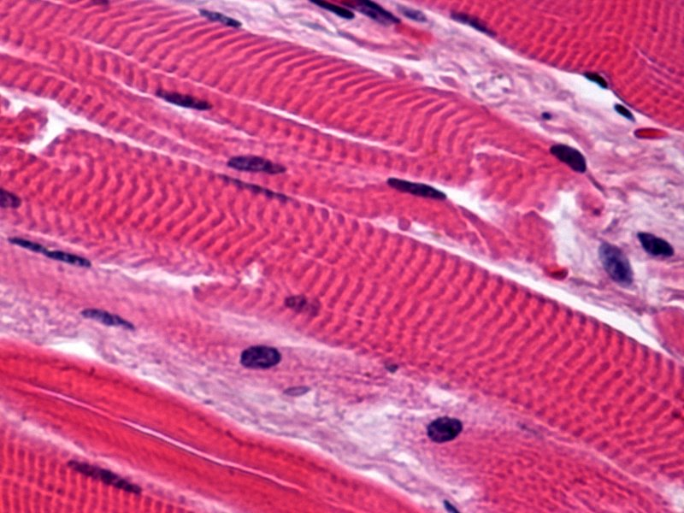
There are three types of muscle tissue.
Skeletal muscles move bones.
Most common type of muscle
Tendons are thick bands of tissue that attach muscle to bones
Voluntary muscles
Contract quickly and tire more easily
Look striped, or striated

Slide 18
Smooth muscles – found in internal organs
Example: intestines
Smooth muscles are involuntary muscles
Contract and relax slowly

Slide 19
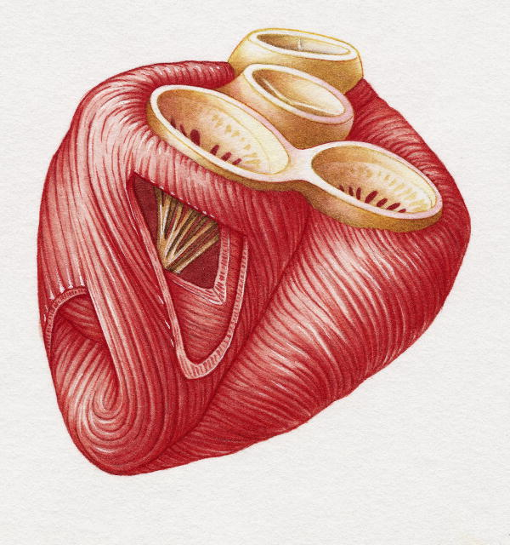
Cardiac muscle
Found only in the heart
Cardiac muscle is striated, like skeletal muscle

Slide 20
You move because pairs of muscles work together
When one muscle of a pair contracts, the other relaxes.
Muscles always pull.
Over time, muscles can become larger or smaller, depending on whether or not they are used.
Blood carries energy-rich molecules to the muscles so they can do their work.

Slide 21
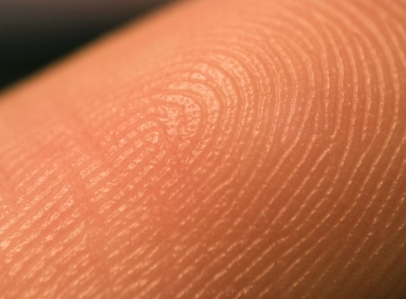
Section 3: Skin

Slide 22
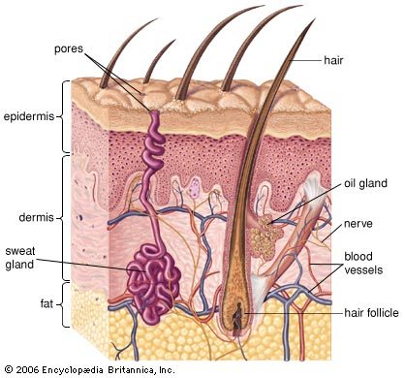
Your skin is the largest organ of your body
Skin is made up of three layers of tissue

Slide 23
Epidermis – the outer, thinnest layer
The outermost cells of your skin are dead and rub off when you touch anything.
New cells are constantly produced at the base of the epidermis.
Cells produce melanin, which is a pigment that protects your skin and gives it color.

Slide 24
Dermis – the middle layer
The dermis is thicker than the epidermis
The dermis contains blood vessels, nerves, muscles, oil, sweat glands, and other structures.

Slide 25
Fatty layer – insulates the body

Slide 26
Skin has many functions
Protection – forms a protective covering over the body that prevents injury
Many disease-causing organisms cannot pass through the skin
Prevents excess water loss

Slide 27
Sensory response – nerve cells in the skin detect and relay information to the brain
Formation of vitamin D, which helps your body absorb calcium
Regulation of body temperature
Blood vessels in the skin help release or hold heat.
Perspiration from the sweat glands eliminates excess heat that has been produced by muscle contractions.
Elimination of wastes through sweat glands

Slide 28
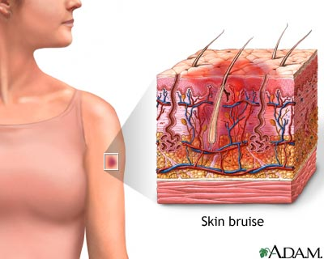
When injured, the skin produces new cells and repairs tears
Bruises happen when tiny blood vessels beneath the skin burst and leak into surrounding tissues.

Slide 29
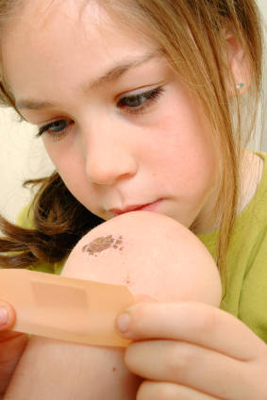
When you have a cut, a scab forms to prevent bacteria from entering your body
Cells in the surrounding blood vessels fight infection
Skin cells beneath the scab grow to fill in the gap of the torn skin.

Slide 30
Doctors are able to repair severe skin damage.
Skin grafts are pieces of skin that are cut from one part of a person’s own body and moved to the injured area.
Doctors sometimes use skin from cadavers to prevent infections until a victim’s skin heals.
Doctors are beginning to grow large sheets of epidermis from small pieces of the victim’s healthy skin.

