Slide 1
Chapter 2: Nutrients and Digestion

Slide 2
Section 1: Nutrition

Slide 3
Your body needs nutrients found in foods.
Nutrients provide energy and materials for cell development, growth, and repair.
You need energy for every activity and to maintain a steady internal temperature.

Slide 4
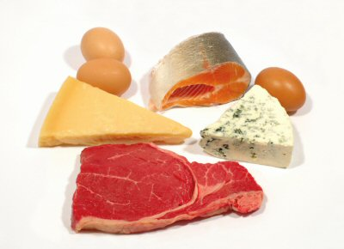
Classes of Nutrients
Proteins
Used for replacement and repair of body cells and for growth
Made up of amino acids
Found in eggs, milk, cheese, and meat
Essential amino acids must be supplied by food

Slide 5
Carbohydrates
The main source of energy for your body
Made up of carbon, hydrogen, and oxygen atoms
Energy holds these atoms together

Slide 6
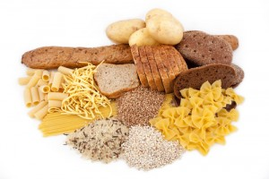
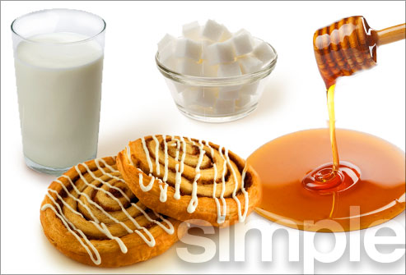
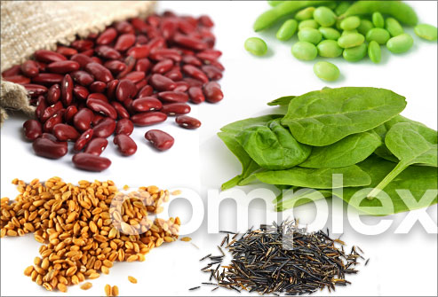
Sugars are simple carbohydrates
Sugars are found in fruits, honey, and milk
Starch and fiber and complex carbohydrates
Starches are found in potatoes and pasta
Fiber is found in whole-grain breads, beans, and peas.

Slide 7
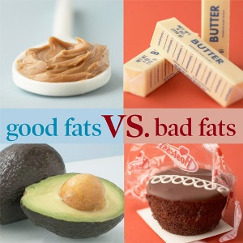
Fats
Also called lipids
Provide energy and help your body absorb vitamins
Because fat is a good storage unit for energy, any excess energy is converted to fat.
Classified as unsaturated or saturated based on their chemical structure
Saturated fats are associated with high cholesterol

Slide 8
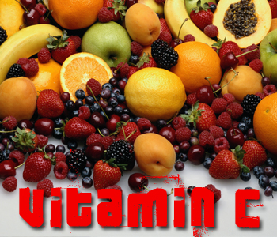
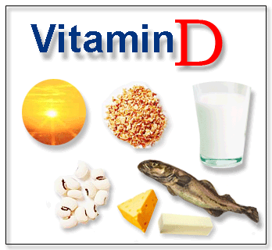
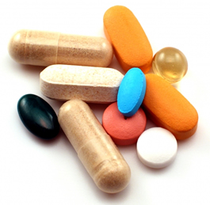
Vitamins
Needed for growth, regulating body functions, and preventing disease
A well-balanced diet usually gives your body all the vitamins it needs
Two groups: water – soluble and fat – soluble

Slide 9
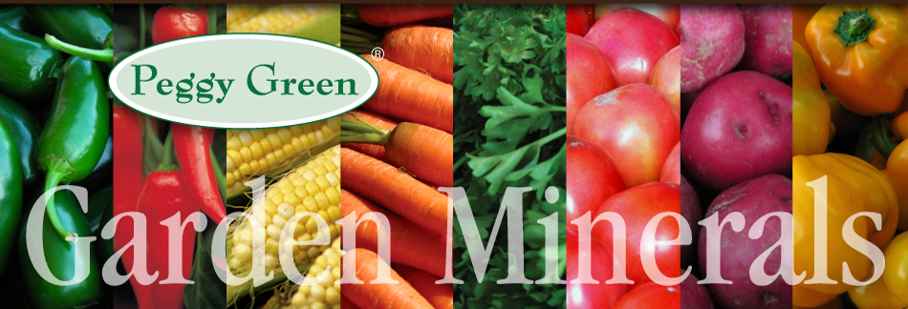
Minerals
Are inorganic nutrients
Regulate many chemical reactions in your body.
Calcium and phosphorous are used most by the body

Slide 10
Water
Required for survival
Cells need water to carry out their work
Most nutrients your body needs must be dissolved in water.
The human body is about 60 percent water
You lose water each day when you perspire, exhale, and get rid of wastes

Slide 11
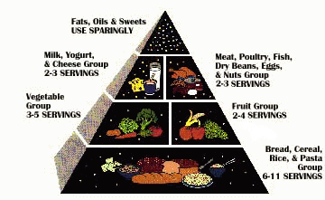
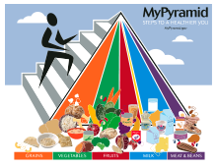
Food groups
Because no food has every nutrient, you should eat a variety of foods.
The food pyramid helps people select foods that supply all the nutrients they need
Foods that contain the same nutrients belong to a food group

Slide 12
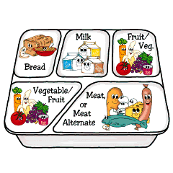
Five food groups
Bread and cereal
Vegetable
Fruit
Milk
Meat

Slide 13
Section 2: Digestive System

Slide 14
Digestion – breaks food down into small molecules that can be absorbed by blood
Mechanical digestion – food is chewed, mixed, and churned
Chemical digestion – chemical reactions break down food

Slide 15
Enzymes
Type of protein that speeds up the rate of a chemical reaction in your body
Many enzymes are involved in the digestion of carbohydrates, proteins, and fats

Slide 16
Organs of the digestive system
Accessory organs – food does not pass through them
Include the tongue, teeth, salivary glands, liver, gallbladder, and pancreas

Slide 17
Digestive tract
Mouth –your tongue, teeth, and saliva change food into a soft mass

Slide 18
Esophagus – muscular tube moves food to the stomach using peristalsis
Waves of muscle contractions

Slide 19
Stomach – food is digested mechanically by peristalsis and chemically by digestive solutions with the help of enzymes.
Food becomes a thin, watery liquid called chyme

Slide 20
Small intestine – villi increase the surface area to help absorption
Blood transports the absorbed nutrients to cells.

Slide 21
Large intestine – absorbs water from undigested chyme.
Peristalsis slows down so chyme can be in the large intestines as long as three days
The rectum and anus control the release of solid wastes from the body.

Slide 22
Bacteria live in many of the organs of your digestive tract and make vitamins your body needs.

