Slide 1
Chapter 4: Respiration and Excretion

Slide 2
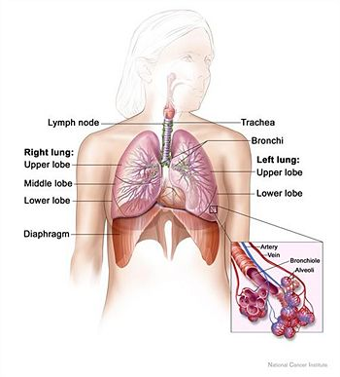
Section 1: The Respiratory System

Slide 3
Functions of the respiratory system – supply oxygen to the body
Breathing is the movement of the chest that brings air into the lungs and removes waste gases
Cellular respiration – oxygen is used by the cells to release energy from glucose
The waste products of cellular respiration are carbon dioxide and water

Slide 4
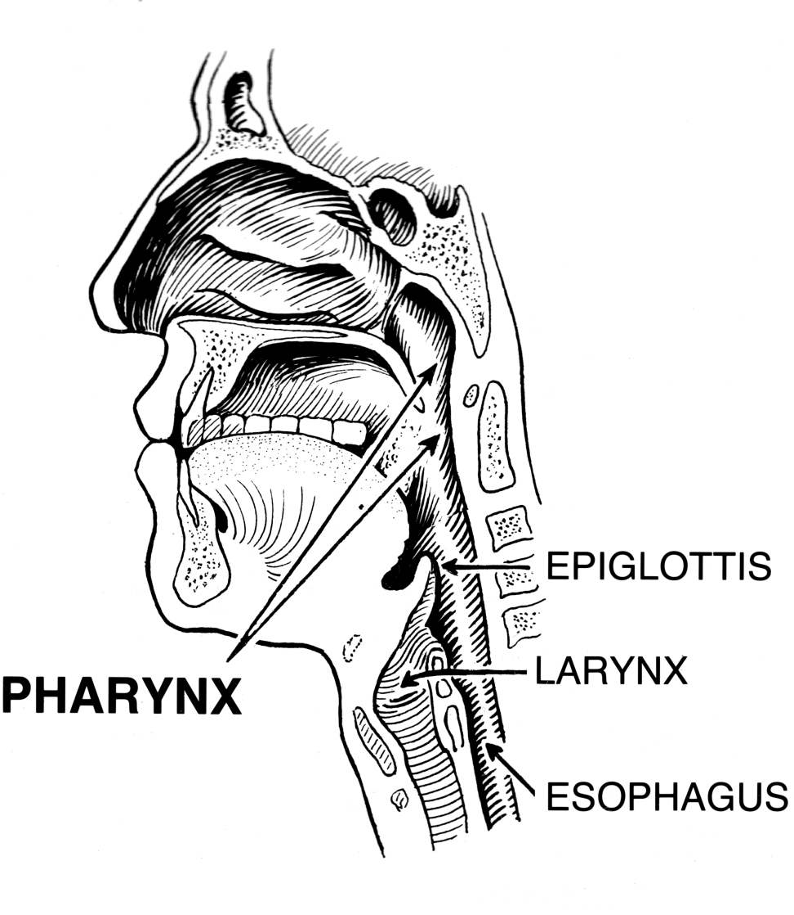
Organs of the respiratory system
The pharynx is a tube like passageway used by food, liquid, and air
Lower end has a tissue flap called the epiglottis, to prevent food or liquid from entering the airway

Slide 5
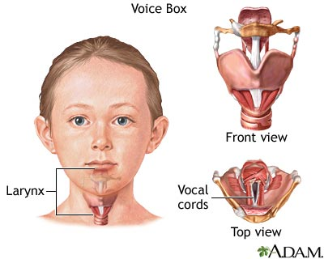
Air passes through the larynx, which contains the vocal cords used to speak

Slide 6
Trachea – tube held open by rings of cartilage
Lined with cilia and mucus membranes
At the lower end of the trachea, two short tubes called bronchi branch into smaller tubes
Smallest tubes are bronchioles, which end in clusters of alveoli
The alveoli are surrounded by capillaries
This is where oxygen enters the blood and waste products exit the blood

Slide 7
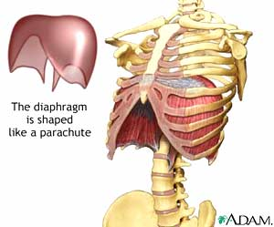
Why do you breathe?
Signals from your brain tell muscles in your chest and abdomen to contract and relax.
If carbon dioxide levels in the blood increase, your breathing rate increases
If carbon dioxide levels decrease, breathing rate decreases
Diaphragm – muscle that contracts and relaxes to move gas into and out of the lungs

Slide 8
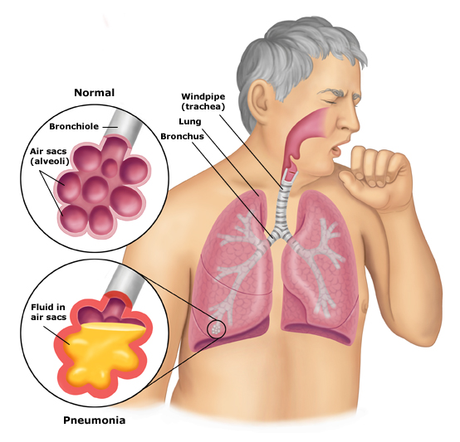
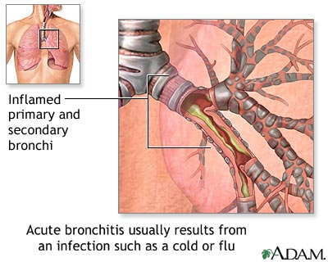
Diseases and Disorders of Respiratory System
Respiratory infections
Colds
The flu
Pneumonia

Slide 9
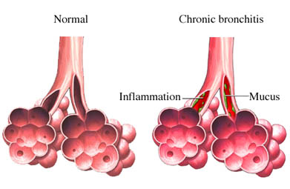
Chronic bronchitis
Bronchial tubes become irritated and swell
Too much mucus is produced
Excess coughing can damage cilia and form scar tissue
Reduce respiratory system function

Slide 10
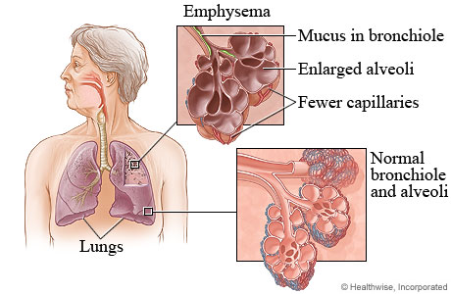
Emphysema
Disease of the alveoli, which enlarge and fail to function effectively
Causes shortness of breath
Can often lead to heart problems

Slide 11
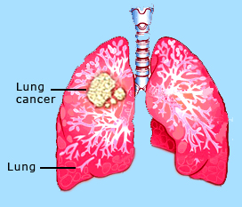
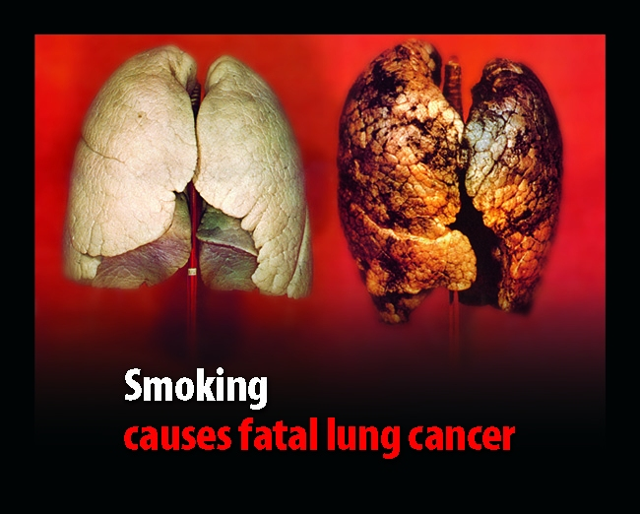
Lung cancer
Uncontrolled cell growth in lung tissue
Smoking is the greatest contributing factor
Tar and other ingredients in smoke are carcinogens

Slide 12
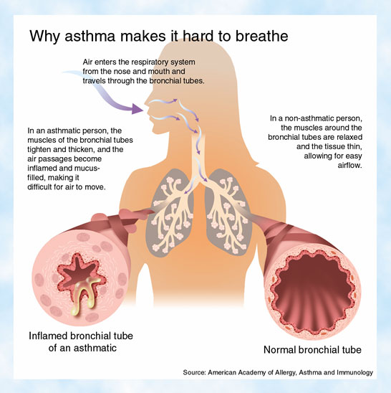
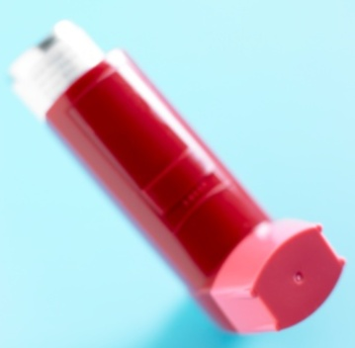
Asthma
Disorder in which bronchial tubes contract quickly, causing shortness of breath, wheezing, or coughing

Slide 13
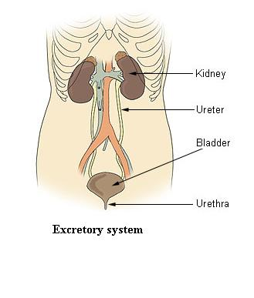
Section 2: The Excretory System

Slide 14
Functions of the excretory system – remove body wastes through the skin, and through the digestive, circulatory, respiratory, and urinary systems
Urinary system – gets rid of cell wastes which accumulate in the blood and controls blood volume

Slide 15
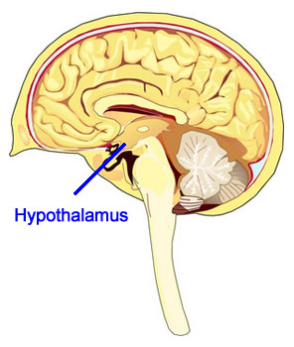
The part of the brain called the hypothalamus regulates amount of water in blood
If too much water, hormones from the hypothalamus tell kidneys to increase amount of urine and return less water to the blood
If too little water, hormones tell kidneys to decrease amount of urine and return more water to the blood

Slide 16
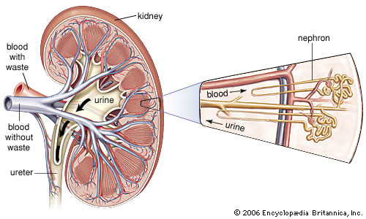
Organs of the urinary system
Two kidneys pass the blood through filtering units called nephrons

Slide 17
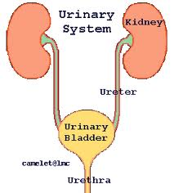
Urine drains from kidneys to the bladder through tubes called ureters
The urethra passes urine out of the body

Slide 18
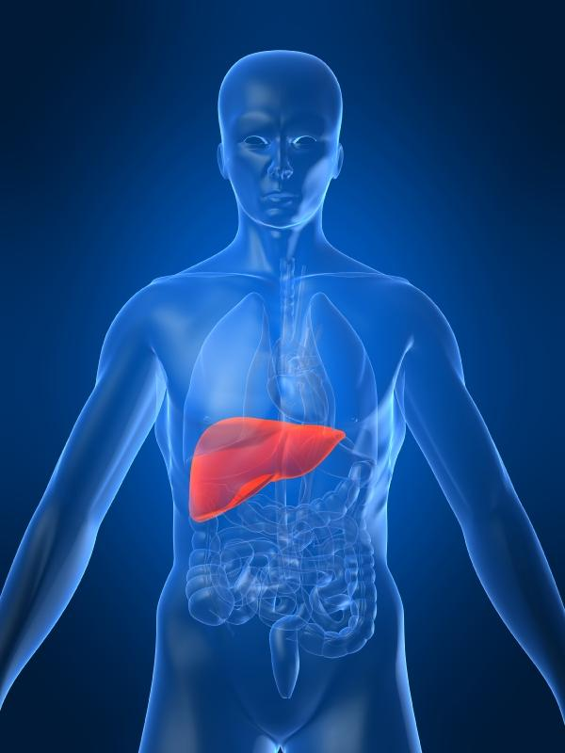
Other organs of excretion – liver produces a chemical called urea which ends up in urine

Slide 19
Urinary diseases and disorders
Infection often occur in the bladder but then spread to the kidneys
Ureters and urethra become blocked, interrupting the flow of urine and damaging the kidneys
Urine tests can detect urinary tract disorders and other health problems

Slide 20
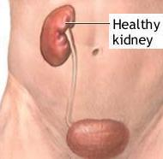
Kidney failure
A person with one kidney can live normally
If both kidneys fail, the person might need a dialysis machine to filter blood.

