Slide 1
Chapter 5: Control and Coordination

Slide 2
Section 1: The Nervous System

Slide 3
Your nervous system helps your body make adjustments to changes in your environment.
Stimulus – any change inside or outside your body that brings about a response.
Homeostasis – the regulation of steady conditions inside an organism.

Slide 4
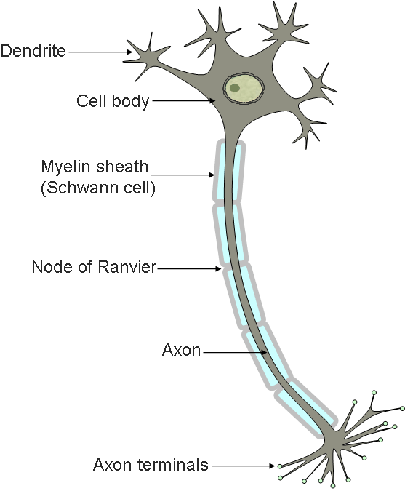
Neurons are made up of a cell body and branches called dendrites and axons.
Dendrites receive messages and send them to the cell body.
Axons carry messages away from the body.
Messages carried by nerve cells are called impulses.

Slide 5
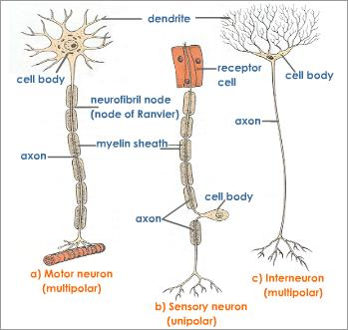
You have three kinds of nerve cells:
Sensory nerve cells receive information and send impulses to the brain or spinal cord.
Interneurons relay the impulses from sensory nerve cells to motor nerve cells.
Motor nerve cells conduct impulses from the brain to muscles and glands throughout your body.

Slide 6
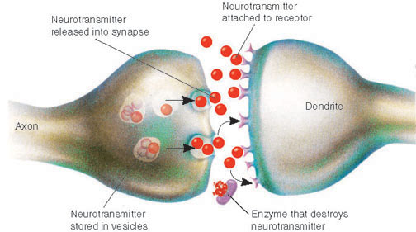
Nerve cells do not touch each other, yet still pass impulses to each other.
A synapse is a space between nerve cells.
When an impulse reaches the end of an axon, the axon releases a chemical
This chemical flows across the synapse and relays the impulse to the dendrite of the next neuron

Slide 7
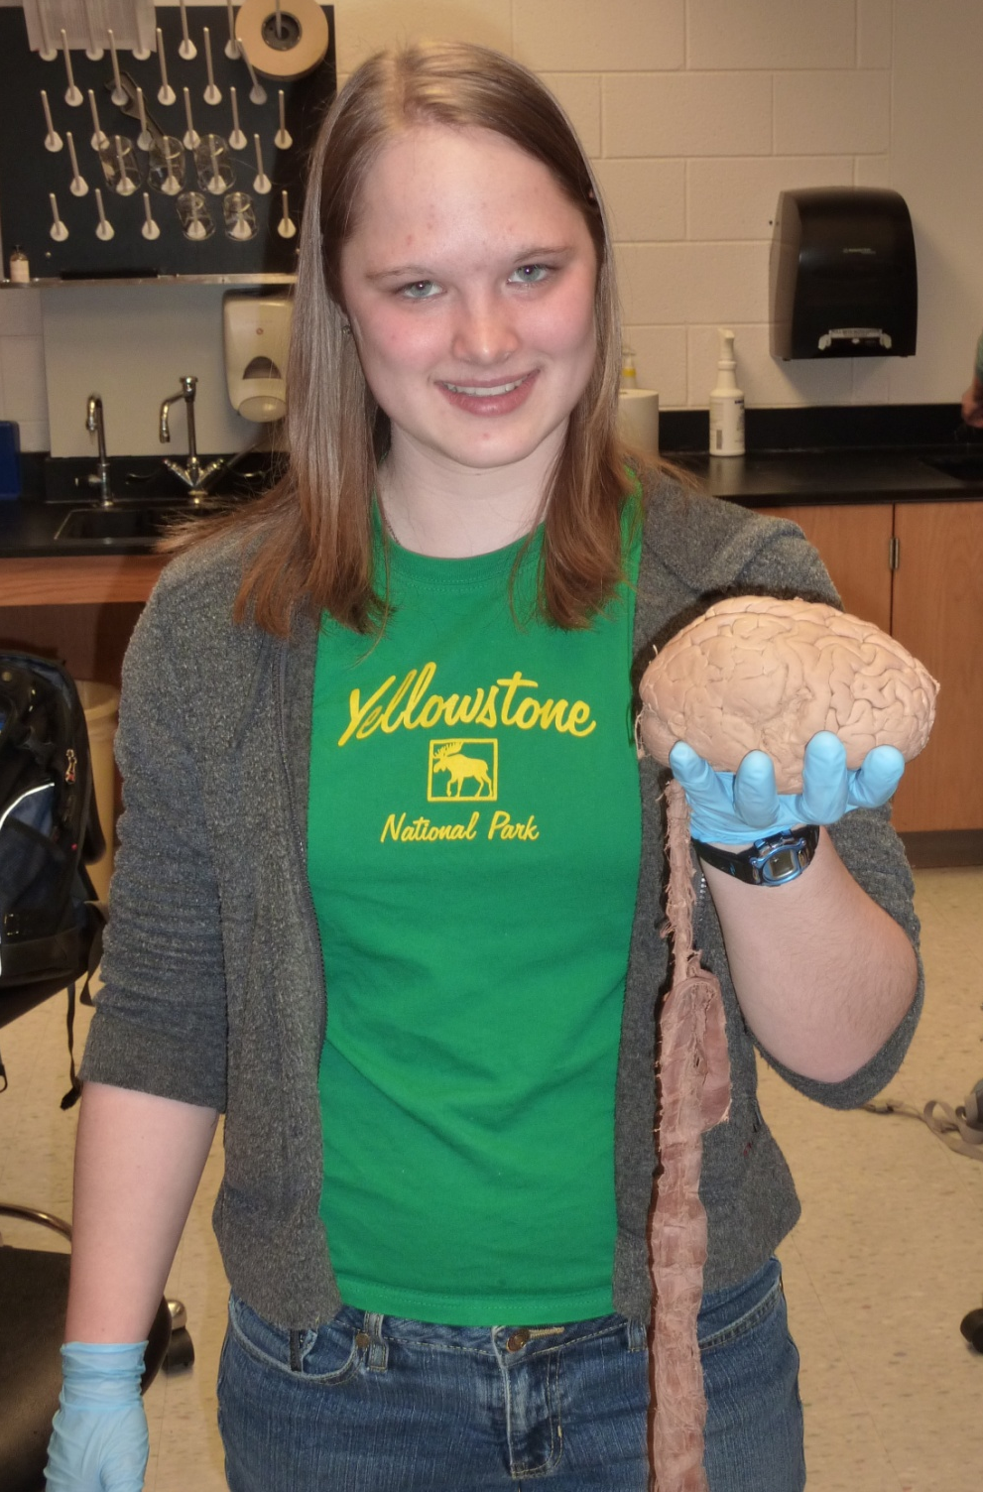
The central nervous system is made up of the brain and spinal cord
The brain coordinates all of your body activities.

Slide 8
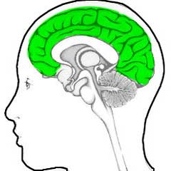
Cerebrum – the part of the brain that interprets impulses from the senses, stores memory, and controls movements.
Thinking takes place here.
Largest part of the brain.
Outer layer is called the cortex, which allows more complex thoughts to be processed.

Slide 9
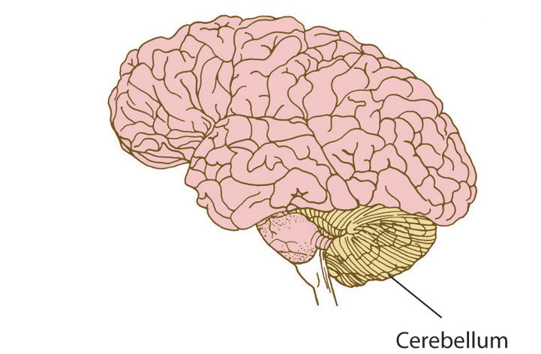
Cerebellum – the part of the brain located behind and under the cerebrum.
Interprets stimuli from the eyes, ears, muscles, and tendons
Coordinates voluntary muscles movements, maintains muscle tone, and helps maintain balance.

Slide 10
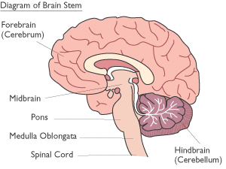
Brain stem – the part of the brain that extends from the cerebrum and connects it to the spinal cord.
Made up of the midbrain, the pons, and the medulla.
The midbrain and pons are pathways connecting different parts of the brain with each other.
The medulla controls involuntary actions such as heartbeat, breathing, and blood pressure.

Slide 11
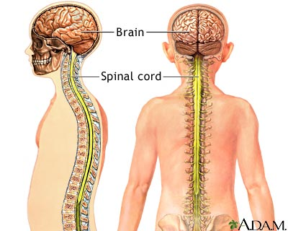
The spinal cord is made up of bundles of nerve cells that carry impulses to and from the brain.

Slide 12
The peripheral nervous system connects your brain and spinal cord to the rest of your body.
The somatic system controls voluntary actions.
The autonomic system controls involuntary actions.

Slide 13
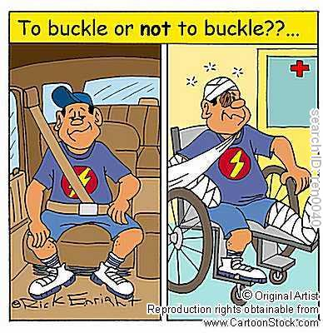
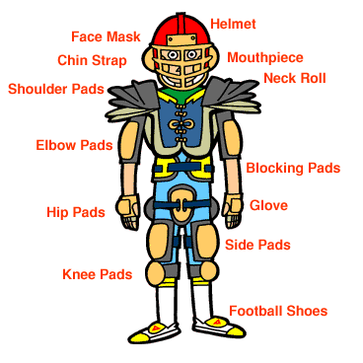
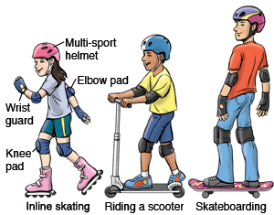
Any injury to the brain or spinal cord can be serious.
Injury to the spine can result in loss of muscle movement, called paralysis.
It is important to wear safety gear when playing sports or riding in a car or on a bicycle.

Slide 14
Reflex – an involuntary, automatic response to a stimulus controlled by the spinal cord.

Slide 15
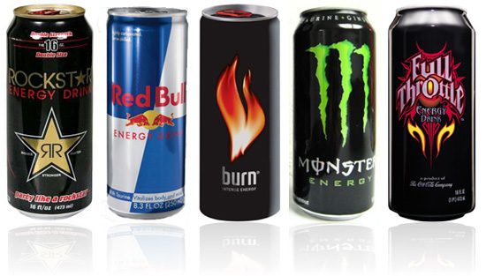
Drugs like alcohol and caffeine affect your nervous system
Alcohol slows the activities of the central nervous system.
Caffeine speeds up the activity of the central nervous system.

Slide 16
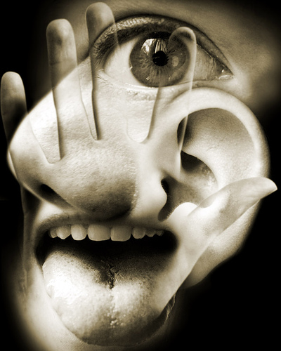
Section 2: The Senses

Slide 17
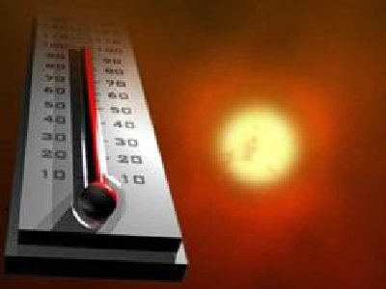
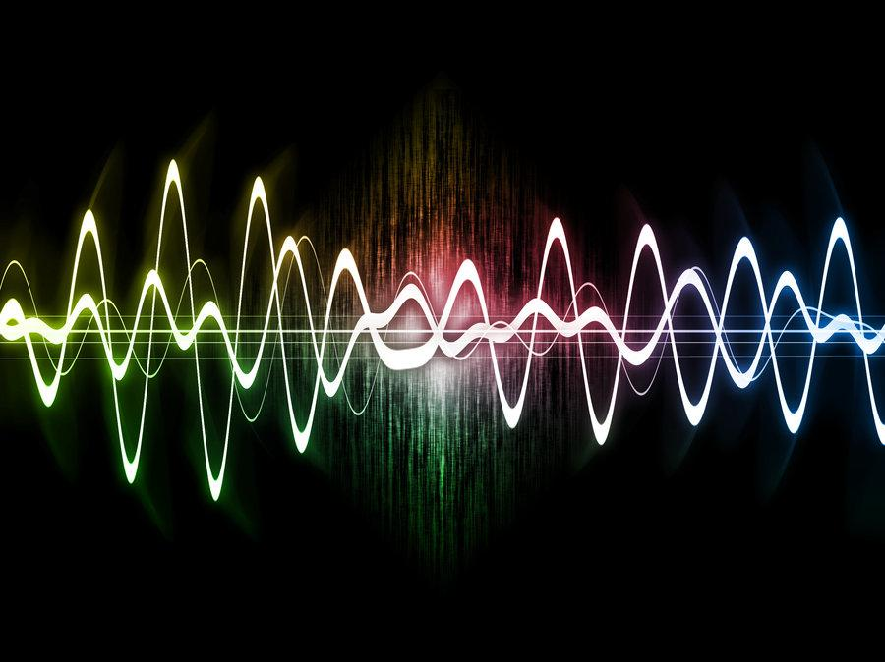
Light rays, sound waves, heat, chemicals, or pressure that come into your personal territory stimulate your sense organs.

Slide 18
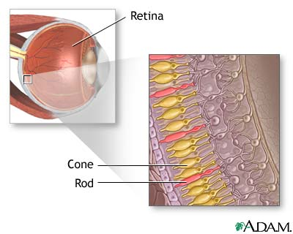
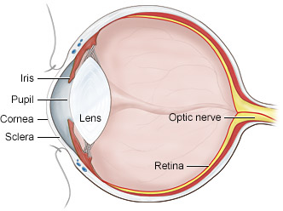
Your body has five senses:
Vision
Light energy enters your eye, and the cornea and lens focus it onto the retina.
The light stimulates the rods and cones, two types of cells found in your retina.
The rods and cones send impulses to the optic nerve, which carries them to the visual area of the cortex.
Your cortex interprets the image and you “see”

Slide 19
Nearsightedness occurs when light is focused in front of the retina.
Hard to see things far away
Concave lens, thicker at edge than in the middle, corrects nearsightedness

Slide 20
Farsightedness occurs when light is focused behind the retina.
Hard to see things close up
Convex lens, thicker in the middle than at edge, corrects farsightedness

Slide 21
Hearing – when an object vibrates, it produces sound waves necessary for hearing sound.
Your outer ear catches sound waves and funnels them down the ear canal to the middle ear.
In the middle ear, the sound waves cause the eardrum to vibrate, and these vibrations move through tiny bones – the hammer, anvil, and stirrup.

Slide 22
In the inner ear, the vibrations cause the fluids in the cochlea to vibrate, stimulating nerve endings.
The stimulated nerve endings send impulses to the brain, where the stimulus is interpreted.
The cristae ampullaris and maculae in the middle ear control the body’s balance.

Slide 23
Smell
Food and other objects give off molecules into the air.
These molecules stimulate nerve cells, called olfactory cells, in your nasal passages.
The olfactory cells send impulses to the brain, where the stimulus is interpreted.

Slide 24
Taste
Taste buds on your tongue are the major sensory receptors for taste
When the solution of saliva and food washes over the taste buds, impulses are sent to the brain, where the stimulus is interpreted.

Slide 25
Touch
Sensory receptors are found in internal organs and skin.
Sensory receptors pick up changes in touch, pressure, pain, and temperature and send impulses to the brain or spinal cord.

