Slide 1
Chapter 6: Regulation and Reproduction

Slide 2
Section 1: The Endocrine System

Slide 3
Functions of the endocrine system – help regulate and coordinate body systems
Hormones – chemical messengers manufactured in glands throughout the body
Endocrine glands release hormones directly into the blood because they are ductless

Slide 4
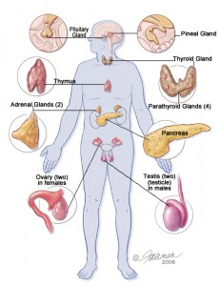
The pituitary gland regulates hormone production, reproduction, and growth
The pineal gland regulates wake and sleep patterns
The thyroid gland regulates metabolism and calcium uptake
The parathyroid glands regulate calcium levels in the body
The thymus regulates the production of infection-fighting cells

Slide 5
The pancreas regulates blood sugar
The adrenal glands help the body adapt to physical and emotional stress
The testes regulate the development of male sexual traits and the production of sperm with testosterone
The ovaries regulate the female reproductive cycle and sex characteristics with estrogen and progesterone.

Slide 6
Negative-feedback system – endocrine system gives itself messages to control the production and release of hormones

Slide 7
Section 2 : The Reproductive System

Slide 8
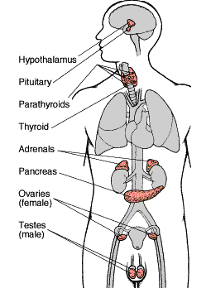
Endocrine system hormones are key factors in the function of human reproduction systems

Slide 9
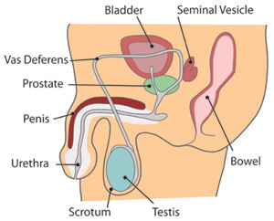
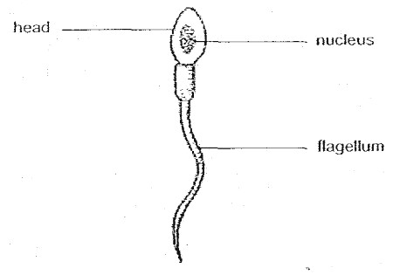
Male reproductive system – has both internal and external organs
Testes – organs that produce male hormone testosterone and reproductive cells called sperm
Internal organs combine sperm with a fluid energy source producing semen

Slide 10
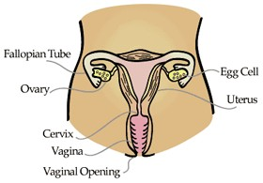
Female reproductive system – internal organs called ovaries produce egg cells
Once a month the ovulation process releases an egg
A hollow, pear-shaped, muscular organ in which fertilized eggs develop is called the uterus
The vagina, or birth canal, is a muscular tube that opens to the outside of the body

Slide 11
Menstrual cycle – monthly cycle of changes in the female reproductive system
Endocrine hormones including estrogen and progesterone control the menstrual cycle

Slide 12
Menstruation, which is the release of blood and uterine lining tissue, occurs in phases
Phase 1 begins when menstrual flow starts and usually last about 4 to 6 days
Phase 2 involves thickening of the uterus lining and ovulation, or egg release
Phase 3 continues with uterine preparation and ends with decreasing hormone levels and uterine lining breakdown if no fertilized egg arrives

Slide 13
Menopause – the gradual shutdown of the ovaries which ends ovulation and menstrual periods

Slide 14
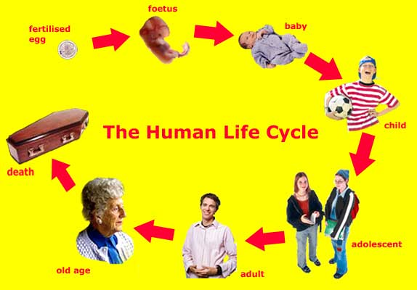
Section 3 : Human Life Stages

Slide 15
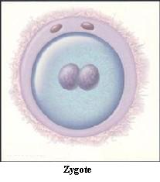
Fertilization – the uniting of a sperm and an egg – begins entire process of growth and development.
Nucleus of sperm and nucleus of egg create fertilized cell called a zygote

Slide 16
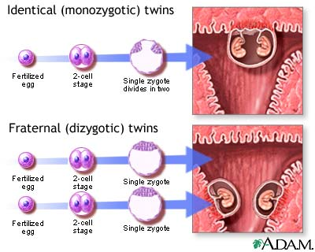
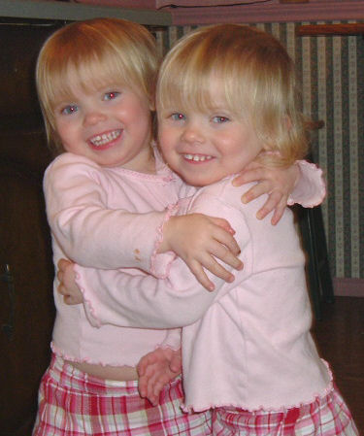
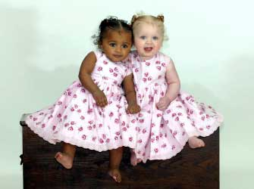
Multiple births result from multiple egg releases (fraternal twins) or division of zygote (identical twins).

Slide 17
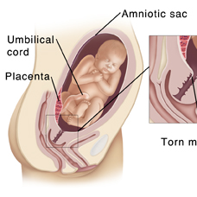
Period of development before birth – called pregnancy
Zygote moves from oviduct to uterus where it attaches and becomes an embryo
Umbilical cord connects embryo to placenta which provides nourishment from the mother and removes wastes from the embryo
Amniotic sac cushions embryo and stores nutrients and wastes
A thin protective membrane
Embryo is called a fetus after two months of development

Slide 18
Birthing process
Muscular contractions of the uterus push the baby out through the vagina
The umbilical cord is cut after the baby’s birth, and the scar that forms is called the navel
Babies who cannot be delivered through birth canal are delivered by caesarian section

Slide 19
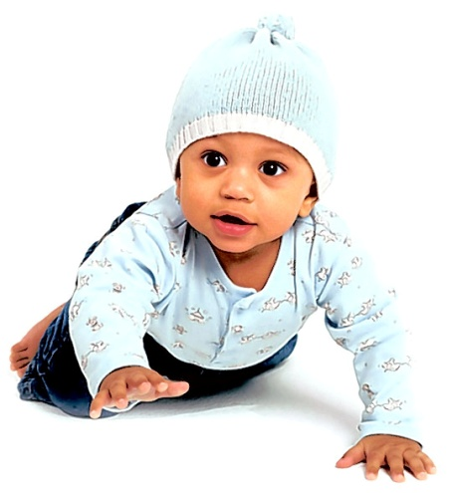
Stages after birth
Infancy – about first 18 months of life
Newborns experience fetal stress as they adapt to life outside the uterus
First four weeks known as neonatal period
Dependent on humans for their survival
Infants quickly increase physical coordination, mental development, and size

Slide 20
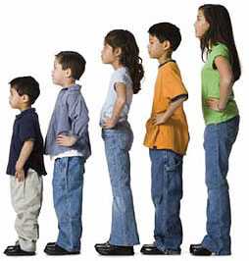
Childhood – from 18 months to puberty (approximately 12 years old) when physical and mental development continues
Adolescence – begins with puberty (reproductive maturity) and ends about age 16 to 18; hormones produce secondary sex characteristics.

Slide 21
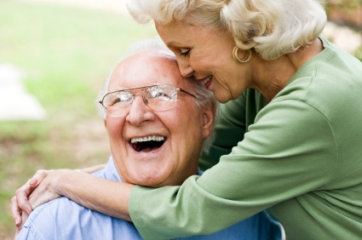
Adulthood – from approximately age 18 and continues through old age
Muscles and skeleton cease growing
In middle adulthood (30 to 60 years) body begins to slowly decline
Older adulthood – after age 60, physical body systems decline; average life span is 75.

