Slide 1
Chapter 1: Exploring and Classifying Life

Slide 2
Section 1: What is science?

Slide 3
Science – an organized way of studying things and finding answers to questions.
Critical thinking – a process that uses certain skills to solve problems

Slide 4
Scientific methods – an organized way to solve a problem using a series of steps
State the problem.
Gather information.
Form a hypothesis – a prediction that can be tested.

Slide 5
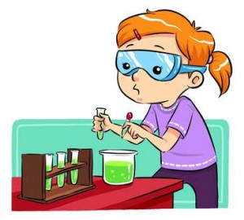
Test the hypothesis with an experiment.
Variable is something in an experiment that can change
Control is the standard of comparison in an experiment; cannot change.

Slide 6
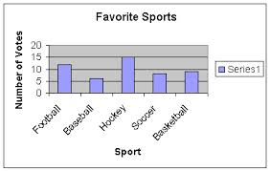
Analyze data.
Draw conclusions.
What is a conclusion you could make based on this data?

Slide 7
Theories and laws
Scientific theory – an explanation of things or events based on scientific knowledge; the result of many observations and experiments.
Scientific law – a statement about how things work in nature

Slide 8
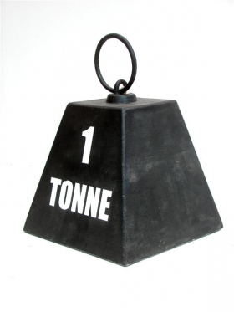
International System of Units (SI) – standard system of measurements used by scientists
Length = millimeter, centimeter, meter, kilometer
Volume = milliliter, liter
Mass = grams, kilogram, tonne

Slide 9
Section 2: Living Things

Slide 10
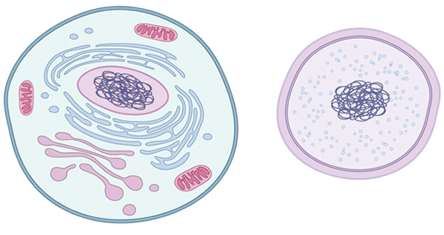
How are living things, or organisms, alike?
Living things are organized.
Cell – the smallest unit of an organism that carries on the functions of life.
Each cell has an orderly structure and contains hereditary material.

Slide 11
Living things respond.
Stimulus – anything that causes some change in an organism
Response – the way an organism reacts to a stimulus, often results in movement
Homeostasis – maintaining the proper conditions inside an organism
Stimulus Response

Slide 12
Living things take in and use energy.
Living things grow and develop.
Growth of many-celled organisms is due to an increase in the number of cells.
Growth of one-celled organisms is due to an increase in the size of the cell.
Development – changes that take place during the life of an organism.
Ex: a baby learning to walk or talk
Living things reproduce.

Slide 13
What do living things need?
A place to live that provides for all of the organism’s needs
Raw materials, like water, proteins, fats, and sugars
Most living things are made up of more than 50% water

Slide 14
Section 3: Where does life come from?

Slide 15
Spontaneous generation – early theory that living things could come from nonliving things
In 1668, Francesco Redi performed an experiment which showed that fly eggs do not come from meat.
In 1768, Lazzaro Spallanzani designed an experiment to show that tiny organisms come from other tiny organisms in the air.
Disproved by Louis Pasteur in the mid-1800s
Biogenesis – theory that living things can only come from other living things

Slide 16
Alexander I. Oparin’s hypothesis on the origins of life – gases in Earth’s early atmosphere combined to form more complex compounds found in living things
Gases: ammonia, hydrogen, methane, and water vapor
Stanley L. Miller and Harold Urey tested Oparin’s hypothesis and showed that chemicals found in living things could be produced
Showed that substances present in living things could be made from nonliving things in the environment
For centuries, scientists have tried to find the origins of life, and some scientists are still investigating ideas about life’s origins.

Slide 17
Section 4: How are living things classified?

Slide 18
Classification systems
Aristotle classified organisms more than 2,000 years ago.
Carolus Linnaeus introduced a system based on similar structures of organisms
Modern systems based on phylogeny – the evolutionary history of an organism, how it has changed over time.

Slide 19
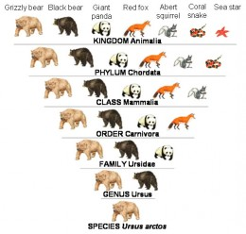
Today’s classification system separates organisms into 6 kingdoms.
Modern classification system:
Kingdom – first and largest category
Phylum
Class
Order
Family
Genus
Species – smallest classification category
Organisms that belong to the same species can mate and produce fertile offspring.

Slide 20
Binomial nomenclature – two-word system used by Linnaeus used to name species
First word indicates the genus, or group of similar species.
Second word tells something about the species – what it looks like, where it is found, or who discovered it.
Example: Homo sapiens

Slide 21
Why use scientific names?
To avoid mistakes
To show organisms in the same genus are related
To give descriptive information
To allow information to be organized easily

Slide 22
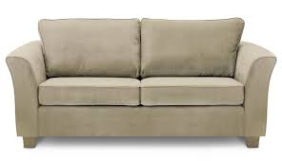
What do you call this?

Slide 23
Tools for identifying organisms
Field guides – descriptions and illustrations of organisms
Dichotomous keys – detailed lists of identifying characteristics that include scientific names.

