Slide 1
Chapter 2: Cells

Slide 2
Section 1: Cell Structure

Slide 3
All living cells have several characteristics in common.
Common cell structures – outer covering called cell membrane and internal gelatinlike cytoplasm
The size and shape of a cell relates to its function

Slide 4
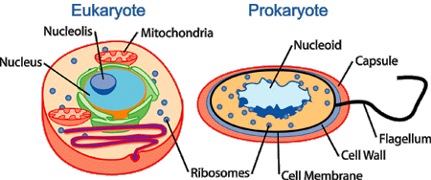
Two cell types
Prokaryotic cells lack membrane-bound internal structures
Eukaryotic cells contain membrane-bound internal structures

Slide 5
Cell organization
Composed of cellulose, a cell wall grows, changes shape, and protects the cells of plants, algae, fungi, and most bacteria.
Cell membrane – protective layer around all cells
For cells with cell walls, the cell membrane is inside the cell wall
A cell membrane allows food and oxygen into the cell and waste products out of the cell

Slide 6
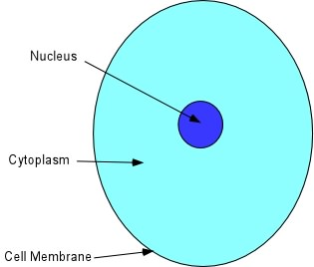
Cytoplasm – gelatinlike substance inside cell membrane
Cytoskeleton – scaffolding-like structure in cytoplasm which helps cell keep and change its shape
In the cytoplasm, eukaryotic cells have organelles which help with cell life processes

Slide 7
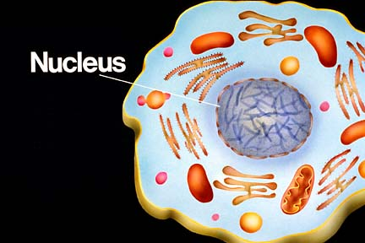
Nucleus – contains instructions for everything the cell does; includes DNA
Directs all cell activities and processes

Slide 8
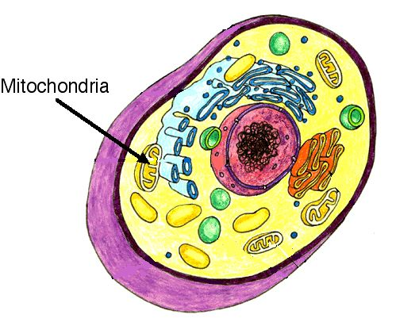
Energy-processing organelles – help cells do their work
Green organelles in plant cells contain chloroplasts to make food
Chlorophyll is the pigment in chloroplasts that captures light energy and produces sugar molecules for food
Organelles which release energy from food are called mitochondria

Slide 9
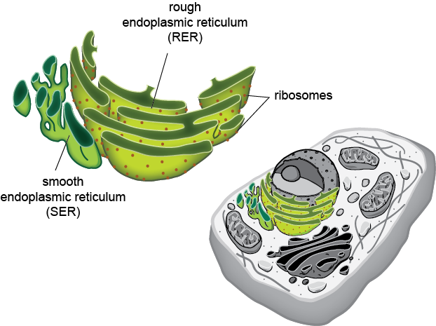
Manufacturing organelles
Ribosomes make proteins for cell activities
Have a two-part structure
Some ribosomes attach to the rough part of the endoplasmic reticulum, a series of smooth or rough membranes that move materials around in a cell.

Slide 10
Transporting and storing organelles
Golgi bodies move substances out of a cell or to other parts of a cell
Package substances for transport
Vacuoles – membrane-bound temporary storage spaces
Can store water, waste, and other materials

Slide 11
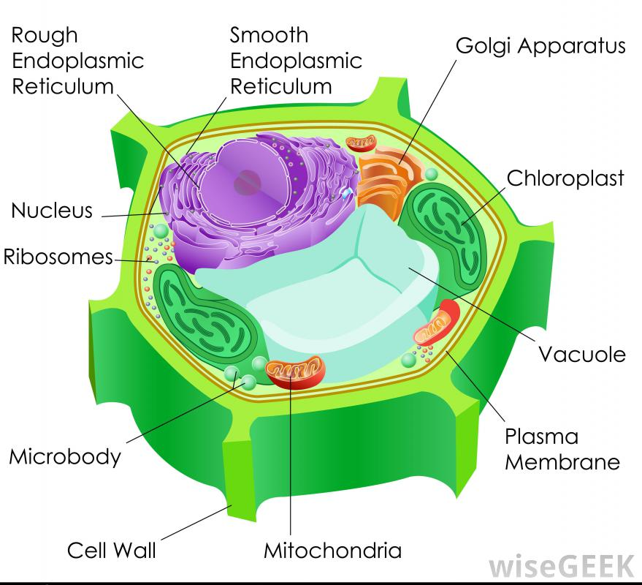

Slide 12
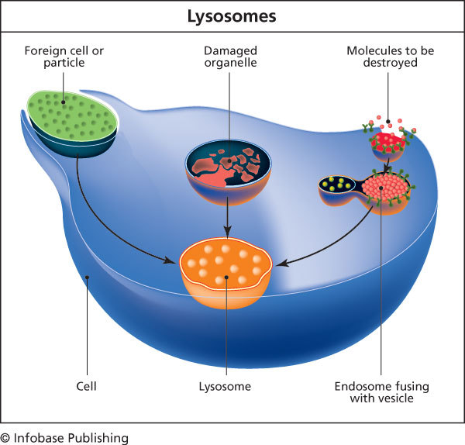
Recycling organelles – lysosomes break down food molecules and cell wastes

Slide 13
From cell to organism
Tissue – group of similar cells working together on one job
Different types of tissues working together make up an organ
A group of organs working together on a particular function form a system

Slide 14
Section 2: Viewing Cells

Slide 15
Magnifying cells
Early microscopes – lenses made images larger but not always clear
The first microscope was invented in the late 1500s

Slide 16
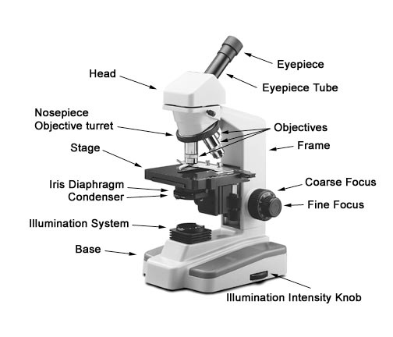
Modern microscopes that use lenses to bend light
A simple microscope has one lens while a compound microscope has multiple lenses.

Slide 17
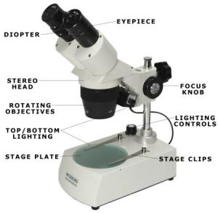
A stereomicroscope, which has two eyepieces, creates a three dimensional image.
Powers of the eyepiece multiplied by objective lenses determine total magnification

Slide 18
Electron microscopes – more powerful than other microscopes
Use a magnetic field in a vacuum to bend electronic beams
Can magnify up to one million times
Images must be photographed or produced electronically

Slide 19
Development of the cell theory
Robert Hooke looked at cork under a microscope and named the little boxes he saw “cells” in 1665.
The cell theory resulted from many scientists’ observations and conclusions – mainly Matthias Schleiden, Theodor Schwann, and Rudolf Virchow.
In the 1830s, Schleiden studied plant parts and concluded that all plants are made up of cells.
Schwann studied many different animal parts under a microscope and concluded that all animals are made up of cells in the 1830s.
Later, Virchow proposed that every cell came from a cell that already existed.

Slide 20
Cell Theory:
The basic unit of organization (structure and function) is the cell
All organisms are composed of one or more cells
New cells come from old cells through cell division.

Slide 21
Section 3: Viruses

Slide 22
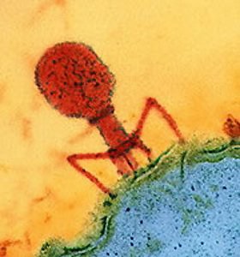
Virus – a nonliving strand of hereditary material surrounded by a protein coating
Virus multiplication – viruses can make copies of themselves only inside a living host cell.

Slide 23
Active viruses – make the host cell create new viruses, which kills the host cell
Virus attaches to a host cell
Hereditary material of virus enters the host cell
Hereditary material of virus causes the host cell to make viral hereditary material and proteins
New viruses form inside the host cell
Host bursts and new viruses are released

Slide 24
Latent viruses – hide in the host cell without destroying it
Virus hereditary material becomes part of the host cell hereditary material so that as the host cell reproduces the viral DNA is copied.
Latent viruses can become active and then destroy the host cells

Slide 25
Virus effects on organisms
Most viruses infect only specific kinds of cells
Viruses are often carried to the host through the air
The virus and host cell must fit together exactly to begin a viral infection
Bacteriophages attach to bacteria and inject their hereditary material

Slide 26
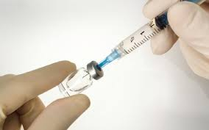
Fighting viruses
Vaccines – weakened virus particles which allow the host to fight some diseases
Treating viral diseases
Antibiotics are not effective treatments for viral infections
Infected cells sometimes produce interferons, which are proteins that can protect noninfected cells
Antiviral drugs often have adverse side effects, limiting their use.
Public health measures can prevent or slow disease spread

Slide 27
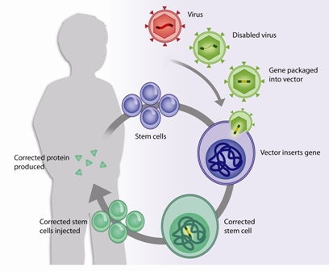
Research with viruses – gene therapy uses viruses to replace defective cell hereditary material with normal cell hereditary material

Slide 28
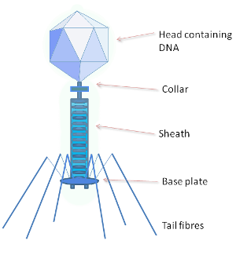
Bacteriophage Model

