Slide 1
Chapter 3: Cell Processes

Slide 2
Section 1: Chemistry of Life

Slide 3
Everything around you is made of matter and energy.
Matter is anything that has mass and takes up space.
Energy can hold matter together or break it apart.

Slide 4
Matter is made of atoms.
The center of an atom is a nucleus, which contains protons and neutrons.
Protons have a positive charge
Neutrons have a neutral charge (no charge)
Outside the nucleus are electrons, which are involved in chemical reactions.
Electrons have a negative charge

Slide 5
Elements – made up of only one kind of atom
Cannot be broken down into a simpler form by ordinary chemical reactions
Arranged in a chart called the periodic table of elements

Slide 6
Compounds
Made of two or more elements in exact proportions
Have different properties from the elements they are made up of

Slide 7
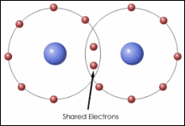
Molecular compounds
The smallest part of a molecular compound is a molecule.
Molecule – a group of atoms held together by the energy of chemical bonds
Form when atoms share electrons

Slide 8
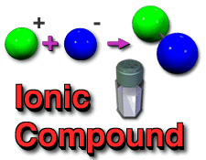
Ionic compounds
Ions – electrically charged atoms, positive or negative
Ions of opposite charges attract one another to form electrically neutral compounds

Slide 9
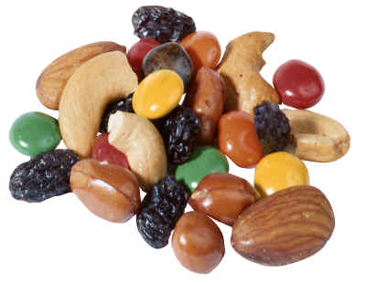
Mixture – combination of substances in which individual substances keep their own properties
Solution – mixture in which two or more substances are mixed evenly
Suspension – forms when a liquid or gas has another substance spread throughout it

Slide 10
Organic compounds – contain carbon and hydrogen and are usually associated with living things or things that once were alive; four groups of organic compounds make up all living things:
Carbohydrates – supply energy for cell processes
Lipids – store and release large amounts of energy

Slide 11
Proteins – are the building blocks of many structures
Amino acids – smaller molecules that make up proteins
Enzymes – proteins that regulate nearly all chemical reactions in cells
Nucleic acids – store important coded information in cells
Inorganic compounds – usually made from elements other than carbon

Slide 12
Importance of water
Living things are composed of more than 50 percent water and depend on it to survive
All chemical reactions take place in water solutions
Most living things use water to transport materials through their bodies

Slide 13
Section 2: Moving Cellular Materials

Slide 14
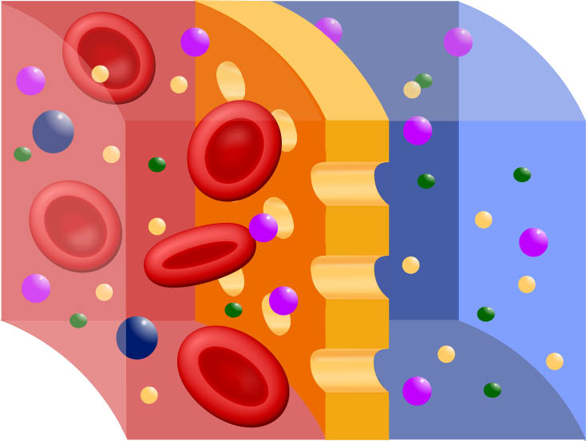
Cells have a permeable membrane that regulates what goes into or out of the cell

Slide 15
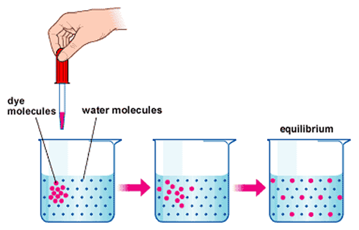
Passive transport – the movement of substances through a cell membrane without the use of energy
Diffusion – when molecules move away from areas where there are more of them into areas where there are fewer of them
Stops when the molecules of one substance are spread evenly throughout another substance, and equilibrium occurs.

Slide 16
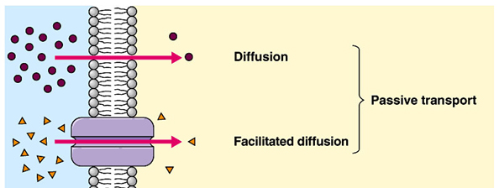
Osmosis – the diffusion of water through a cell membrane
In facilitated diffusion, transport proteins move substances into and out of the cell

Slide 17
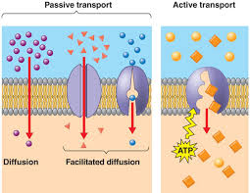
Active transport requires energy to move a substance through a cell membrane

Slide 18
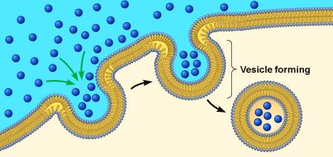
Endocytosis and exocytosis
Endocytosis – the process in which a substance is taken into a cell by surrounding it with the cell membrane, forming a sphere called a vesicle

Slide 19
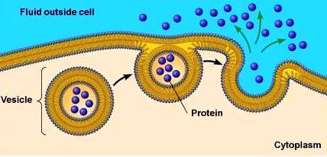
Exocytosis – the process in which the membrane of the vesicle fuses with the cell’s membrane and the vesicle’s contents are released outside the cell

Slide 20
Section 3: Energy for Life

Slide 21
Cells use chemical reactions to change the chemical energy stored in food into forms needed to perform activities
Metabolism – the total of all chemical reactions in an organism
Chemical reactions require enzymes

Slide 22
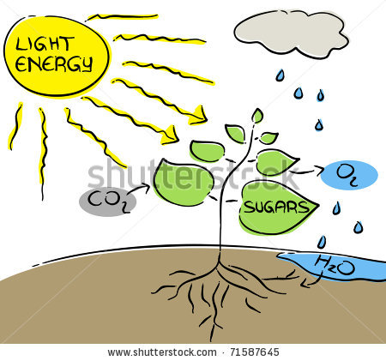
Photosynthesis – the process that plants and other organisms use to convert sunlight energy into chemical energy or sugars to be used as food
Producers – organisms that make their own food
Consumers – organisms that can’t make their own food
Chlorophyll and other pigments are used in photosynthesis to capture sunlight which is used to produce sugar and oxygen.

Slide 23
Respiration – the process in which chemical reactions break down food molecules into simpler substances and release stored energy
Respiration of carbohydrates begins in the cytoplasm
Carbohydrates are broken down into glucose molecules.
Glucose molecules are sugar molecules
Each glucose molecule is broken down into two simpler molecules, releasing energy.

Slide 24
Respiration moves into the mitochondria
The two simpler molecules are broken down again, releasing more energy
This process uses oxygen and produces CO₂ and water as wastes

Slide 25
Fermentation – cells that do not have enough oxygen for respiration use this process to release some of the stored energy in glucose molecules
Entire process occurs in cytoplasm
Produces lactic acid, alcohol, and carbon dioxide as wastes

Slide 26
Photosynthesis and respiration – almost the opposite of each other
Photosynthesis produces sugars and oxygen, which are used in respiration
Respiration produces carbon dioxide and water, which are used in photosynthesis

