Slide 1
Chapter 4: Cell Reproduction

Slide 2
Section 1: Cell Division and Mitosis

Slide 3
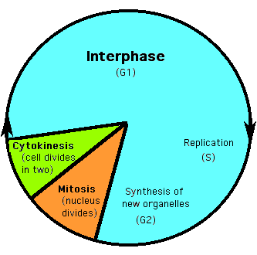
Cell division – increases the number of cells and causes many-celled organisms to grow
Cells have periods of formation, growth and development, and death called life cycles.

Slide 4
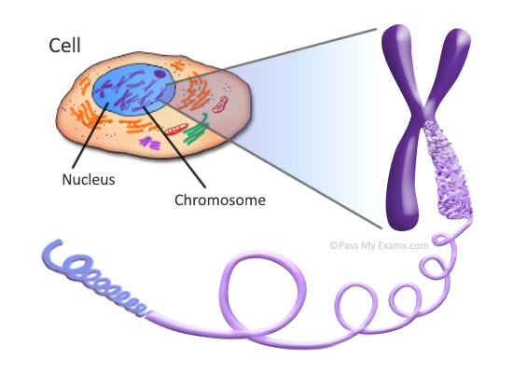
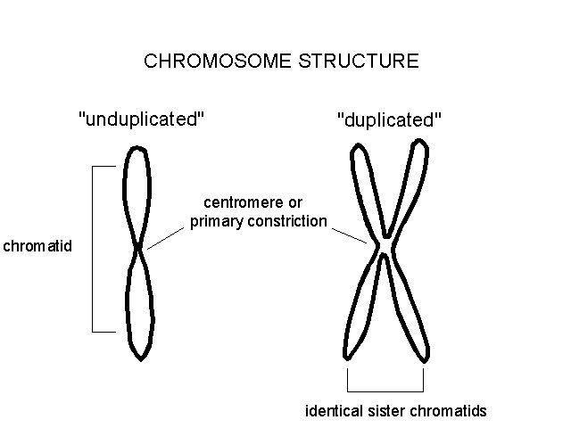
Interphase – most of the life of any eukaryotic cell, or cell with a nucleus, is spent in a period of growth and development.
Chromosome – structure in the nucleus that contains hereditary material
During interphase, a cell duplicates its chromosomes and prepares for cell division.
A duplicated chromosome is made up of two chromatids held together by a centromere
Centromere

Slide 5
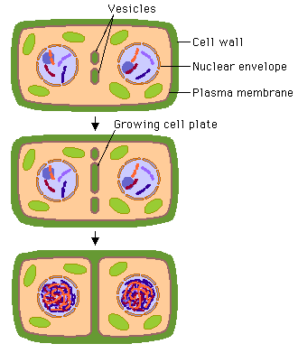
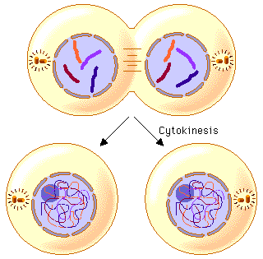
After interphase, the nucleus divides, and then the cytoplasm separates to form two new cells.
Plant cells form cell plates that develop into rigid cell walls that divide the two new cells.

Slide 6
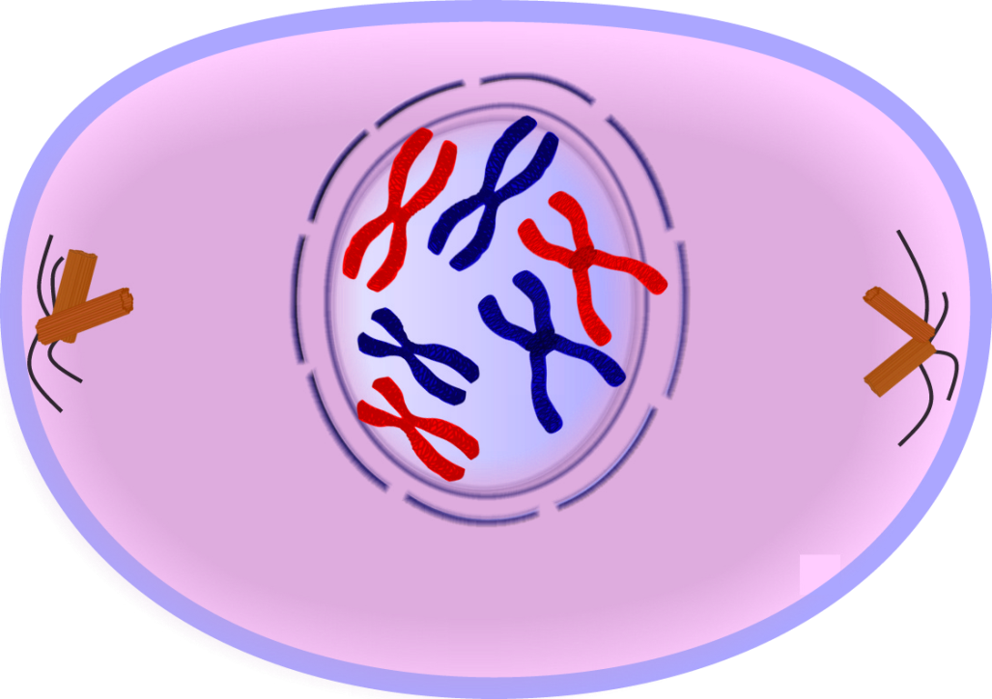
Mitosis – process in which the nucleus divides to form two identical nuclei
Prophase
Nucleolus and nuclear membrane disintegrate
Centrioles move to opposite ends of the cell (only in animal cells)
Spindle fibers begin to stretch across the cell

Slide 7
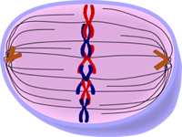
Metaphase
Pairs of chromatids (duplicated chromosomes) line up across the center of the cell

Slide 8
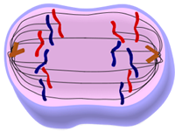
Anaphase
Each centromere divides
Each pair of chromatids separates and moves to opposite ends of the cell

Slide 9
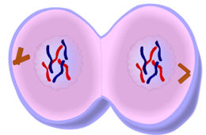
Telophase
Spindle fibers disappear and a new nucleus forms

Slide 10
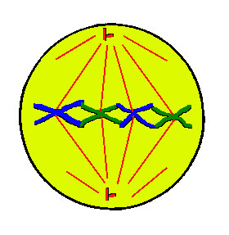
Which phase is this?

Slide 11
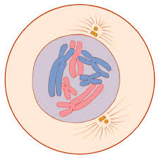
Which phase is this?

Slide 12
Which phase is this?

Slide 13
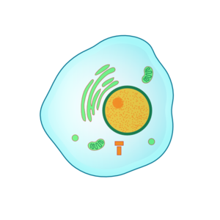
Which phase is this?

Slide 14
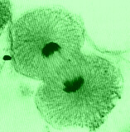
Which phase is this?

Slide 15
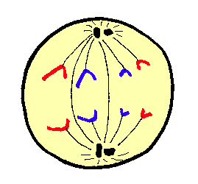
Which phase is this?

Slide 16
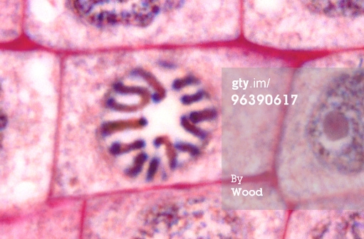
Which phase is this?

Slide 17
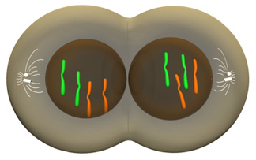
Which phase is this?

Slide 18
Results of mitosis
Each cell in your body, except sex cells, has the same number of 46 chromosomes
23 pairs of chromosomes
Allows growth and replaces worn out or damaged cells

Slide 19
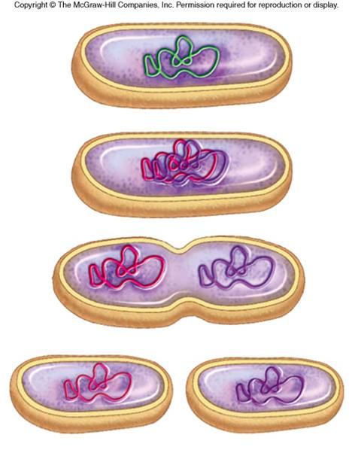
Asexual reproduction – a new organism is produced from one parent organism
An organism with no nucleus divides into two identical organisms by fission.

Slide 20
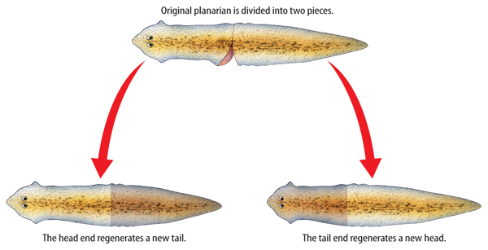
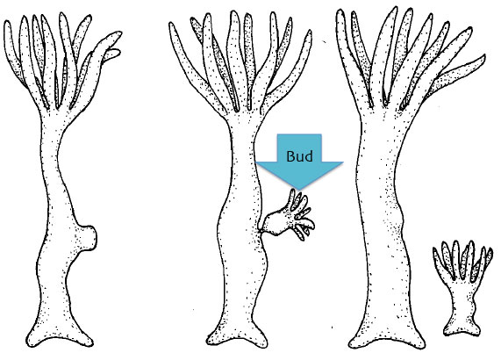
Budding – a small, exact copy of the adult grows from the body of the parent.
In regeneration, a whole organism grows from each piece of the parent.

Slide 21
Section 2: Sexual Reproduction and Meiosis

Slide 22
Sexual reproduction – two sex cells, usually an egg and sperm come together.
Fertilization – the joining of an egg and a sperm, generally from two different organisms of the same species.
Sperm are formed in the male reproductive organs
Eggs are formed in the female reproductive organs
A cell that forms from fertilization is a zygote.
Following fertilization, mitosis begins and a new organism develops

Slide 23
Division of sex cells
Body cells are diploid – have 23 pairs of similar chromosomes
Sex cells are haploid – have 23 single chromosomes

Slide 24
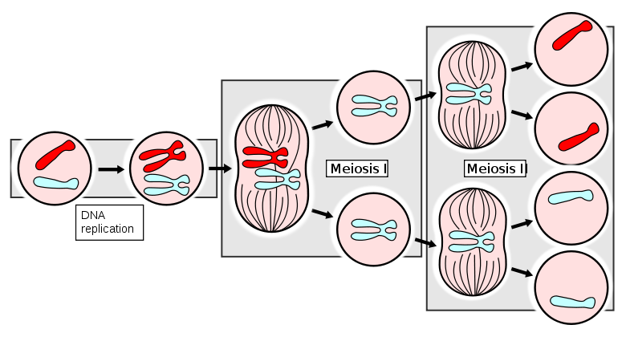
Meiosis – a process that produces haploid sex cells
In meiosis I, the nucleus divides and produces two new cells with one chromosome each
In meiosis II, the nuclei divide and the chromatids separate, producing four cells with half the number of chromosomes or the original nucleus

Slide 25
Section 3: DNA

Slide 26
DNA – a chemical that contains information that an organism needs to grow and function
Watson and Crick made an accurate model of DNA in 1953
The structure of DNA is similar to a twisted ladder (double stranded)
The sides of the ladder are made up of sugar-phosphate molecules
The rungs of the ladder are made up of nitrogen bases
Adenine (A) bonds with Thymine (T)
Cytosine (C) bonds with Guanine (G)

Slide 27
Diagram:
T
A
C
G
Sugar
G
C
Phosphate
A
T

Slide 28
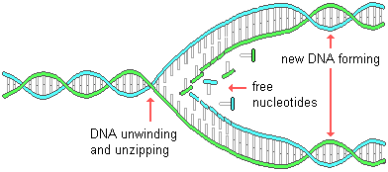
Before a cell divides, its DNA duplicates itself by unwinding and separating its sides, then forming new sides

Slide 29
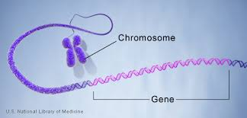
Genes – sections of DNA on a chromosome
Contain instructions for making specific proteins

Slide 30
RNA carries the codes for making proteins from the nucleus to the ribosomes in the cytoplasm.
Messenger RNA (mRNA) carries the code that directs the order in which the amino acids bond
Ribosomal RNA (rRNA) makes ribosomes, where proteins are built
Transfer RNA (tRNA) brings amino acids to the ribosomes to build the protein

Slide 31
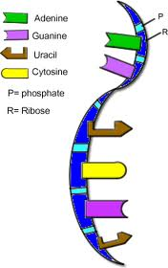
RNA structure
Made up of a single strand
Nitrogen bases
Adenine (A) bonds with Uracil (U)
Cytosine (C) bonds with Guanine (G)
Cells use only the genes that direct the making of proteins needed by that cell

Slide 32
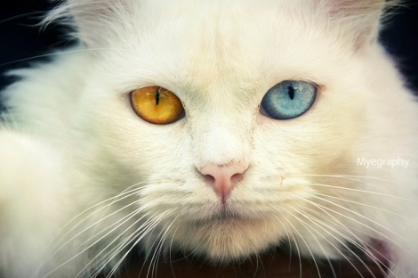
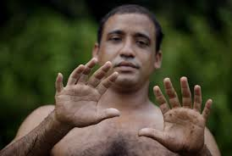
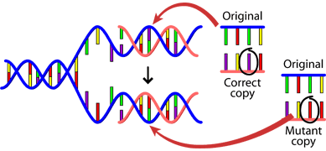
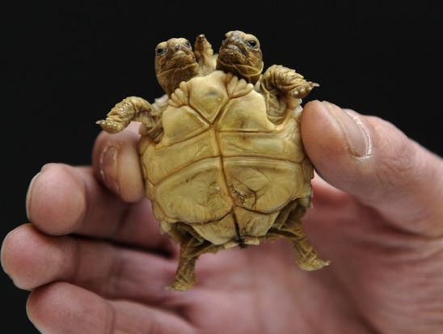
Mutations – any permanent change in the DNA sequence of a cell’s gene or chromosome
Can be caused by outside factors like X rays, sunlight, and some chemicals
A change in a gene or chromosome can change the traits of an organism

