Slide 1
Chapter 5: Heredity

Slide 2
Section 1: Genetics

Slide 3
Heredity – the passing of traits from parent to offspring
Genes on chromosomes control the traits that show up in an organism
The different forms of a trait that a gene may have are alleles

Slide 4
During meiosis a pair of chromosomes separates and the alleles move into separate cells
Each chromosome now contains one gene for each trait
The study of how traits are inherited is genetics

Slide 5
Gregor Mendel – the father of genetics
Mendel was the first person to use mathematics of probability to explain heredity and to trace one trait for several generations.

Slide 6
Hybrid – receives different genetic information for a trait from each parent
Dominant allele – covers up or dominates the other trait
Recessive allele – the trait seems to disappear

Slide 7
Gregor Mendel’s main conclusions
Traits are controlled by alleles on chromosomes
An allele may be dominant or recessive
When a pair of chromosomes separate during meiosis, the alleles move into separate sex cells
Probability helps you predict the chance that something will happen

Slide 8
A Punnett square can help you predict what an offspring will look like
Upper case letters stand for dominant alleles
Lower case letters stand for recessive alleles

Slide 9
Genotype – the genetic makeup of an organism
Homoxygous – an organism with two alleles for one trait that are the same (written as two upper case or two lower case letters, ex: TT or tt)
Heterozygous – an organism with two alleles for one trait that are different (written as one upper case and one lower case letter, ex: Tt)

Slide 10
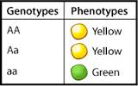
Phenotype – the way an organism looks and behaves as a result of its genotype

Slide 11
Making a Punnett Square:
The two alleles from one parent are listed on top of the square, and the two alleles from the other parent are listed on the left side.
 | T | t
T
t

Slide 12
To determine the possible genotypes of the offspring fill in the boxes with the alleles above and to the left side of the box
 | T | t
T
t

Slide 13
Each box contains a combination of two alleles → one possible genotype
TT = homozygous dominant
Tt = heterozygous
tt = homozygous recessive
The only option where the recessive phenotype is expressed
 | T | t
T | TT | Tt
t | Tt | tt

Slide 14
Section 2: Genetics Since Mendel

Slide 15
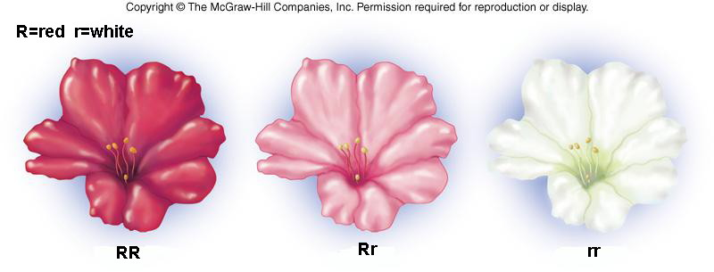
Incomplete dominance
Neither allele for a trait is dominant
The phenotype produced is intermediate between the two homozygous parents
Ex: experiments with four o’ clock flowers

Slide 16
Multiple alleles
More than two alleles are multiple alleles
Traits controlled by multiple alleles produce more than three phenotypes
Ex: blood type

Slide 17
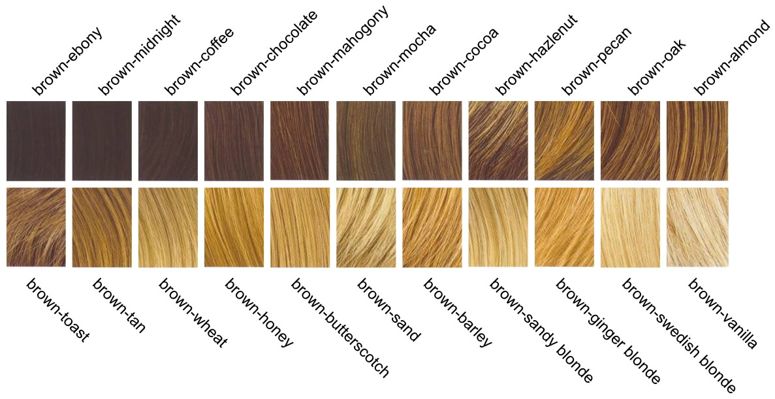
Polygenic inheritance
A group of gene pairs acts together to produce a trait
Creates more variety in phenotypes
Many human traits are controlled by polygenic inheritance
Ex: hair color, eye color

Slide 18
Mutations – genes that are altered or copied incorrectly
A mutation can be harmful, beneficial, or have no effect.
Chromosome disorders are caused by having more or fewer chromosomes than normal
Down Syndrome is caused by an extra copy of chromosome 21

Slide 19
Recessive genetic disorders
Both parents have a recessive allele responsible for the disorder and pass it to their child.
The parents are heterozygous and don’t show any symptoms of the disorder
The child with both recessive alleles will show symptoms of the disorder
Cystic fibrosis is a homozygous recessive disorder

Slide 20
Genes that determine the sex of an organism
Females produce eggs with an X chromosome only
Males produce sperm with either an X chromosome or a Y chromosome
Which chromosomes combine determines the sex of an organism
XX = female
XY = male

Slide 21
Sex-linked disorders
An allele inherited on an X or Y chromosome is called a sex-linked gene
Color blindness is a sex-linked disorder caused by a recessive allele on the X chromosome

Slide 22
A pedigree follows a trait through generations of a family
Circles represent females
Squares represent males
A completely filled shape shows that the trait is seen in that person
A half filled shape indicates a heterozygous carrier that does not exhibit the trait
An empty shape shows people that do not have the trait and are not carriers
A pedigree helps geneticists predict the probability that a baby will be born with a specific trait

Slide 23
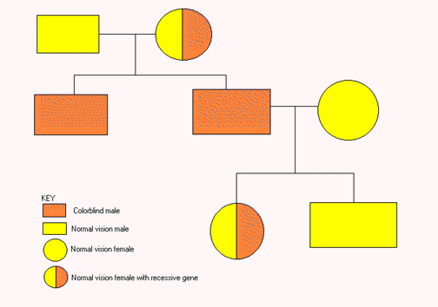

Slide 24
Section 3: Advances in Genetics

Slide 25
Genetic engineering – changing the arrangement of DNA that makes up a gene
Recombinant DNA
Insertion of a useful segment of DNA into a bacterium
An example is insulin

Slide 26
Gene therapy
A normal allele is placed into a virus, which delivers the normal allele when it infects its target cell
May be used to control cystic fibrosis or other genetic disorders

Slide 27
Genetically engineered plants are created by inserting the gene that produce desired traits in one plant into a different plant
Can be used to improve insect resistance or drought resistance
Desired traits may change ripening times, habitats, or growing seasons

