Slide 1
Chapter 6: Adaptations Over Time

Slide 2
Section 1: Ideas About Evolution

Slide 3
Evolution – changes in inherited characteristics of a species over time
A species is a group of organisms that share similar characteristics and can reproduce among themselves
Lamarck’s theory of acquired characteristics was not supported by evidence
Suggested that characteristics that develop during an individual’s lifetime are passed on to offspring

Slide 4
Darwin’s model of evolution
Darwin observed that species of finches on islands off the coast of South America looked similar to a mainland finch species.
Darwin hypothesized that plants and animals on the islands originally came from South America
Darwin reasoned that member of a population best able to survive and reproduce will pass their traits to the next generation
Over time, differences can result in separate species

Slide 5
Darwin’s hypothesis became known as the theory of evolution by natural selection
Natural selection - organisms with traits suited to their environment are more likely to survive and reproduce
Traits are passed on to the next generation

Slide 6
Principles of Natural Selection
Organisms produce more offspring than can survive
Differences, or variations, occur among individuals of a species
Variations are passed to offspring
Some variations are helpful. Individuals with helpful variations survive and reproduce better than those without these variations
Over time, the offspring of individuals with helpful variations make up more of a population and eventually become a separate species

Slide 7
Variation – an inherited trait that makes an individual different from other members of its species
Adaptation is a variation that makes an organism better suited to its environment
Many environmental factors can cause changes in the source of genes
Geographic isolation can make two populations so different they become different species

Slide 8
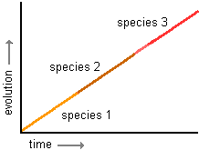
Two models explain the speed of evolution
Gradualism – describes evolution as a slow, ongoing process
Continuing series of mutations and variations over time will result in a new species

Slide 9
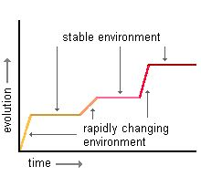
Punctuated equilibrium model – gene mutation can result in a new species in a relatively short time
Sudden changes occur between long periods of no change

Slide 10
Section 2: Clues About Evolution

Slide 11
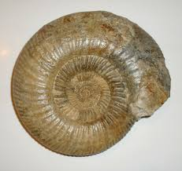
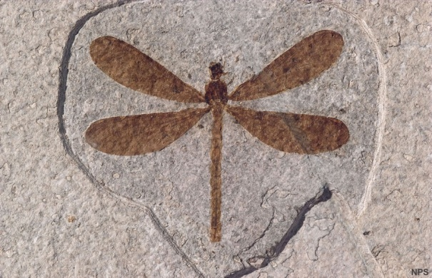
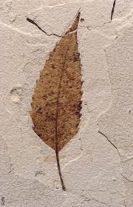
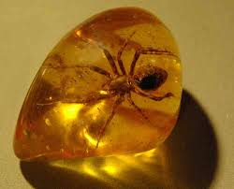
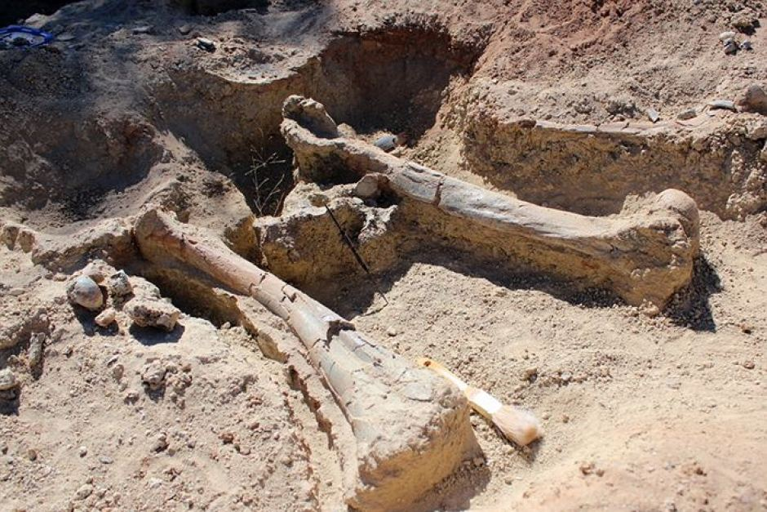
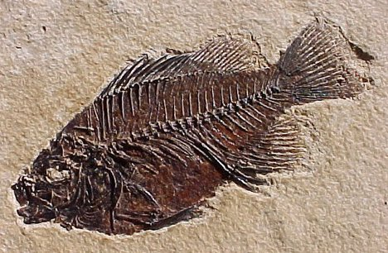
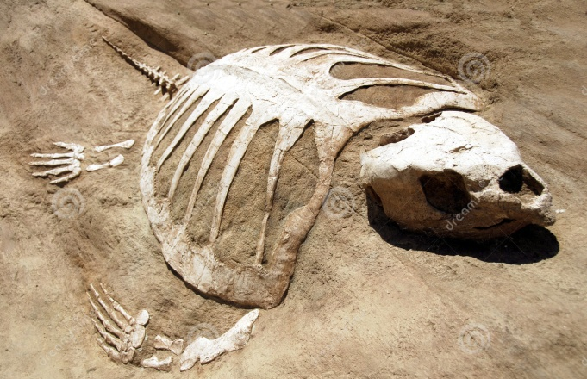
Fossils are the remains of organisms that have been preserved
Fossil found in sedimentary rock show evidence that living things evolved

Slide 12
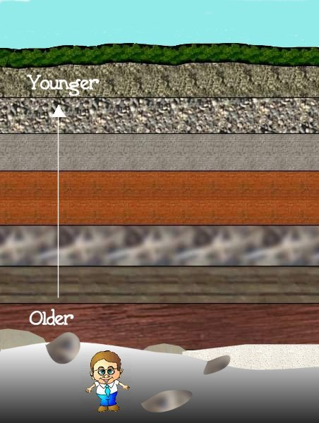
Fossil age can be determined by two basic methods
Relative dating looks at fossil location in a particular layer of rock
Older rock layers are under newer rock layers
Radiometric dating compares the amount of radioactive element with the amount of nonradioactive element in a rock

Slide 13
Fossil records have gaps
Incomplete rock record
Most organisms do not become fossils
Enough fossils have been discovered for scientists to conclude that complex organisms appear after simpler organisms

Slide 14
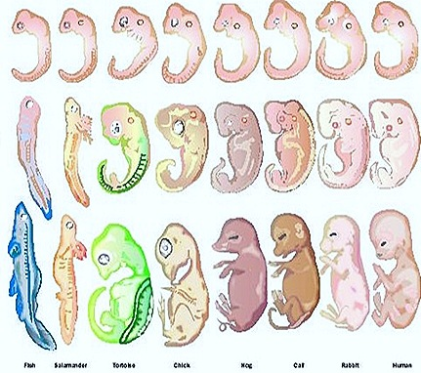
Direct evidence, such as the development of antibiotic resistance in bacteria, supports evolution.
Indirect evidence supporting evolution
Embryology – the study of embryos and their development
Shows similarities among all vertebrate species

Slide 15
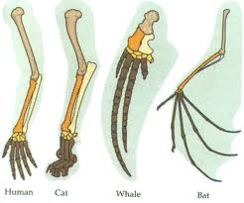
Homologous body parts have similar structures and can indicate that two or more species share a common ancestor

Slide 16
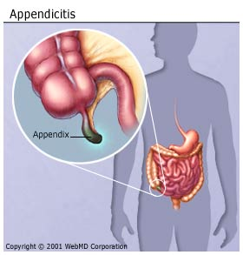
Vestigial structures – structures that don’t seem to have a function but might have once functioned in an ancestor
DNA can provide evidence about how closely related organisms are

